Slide 1
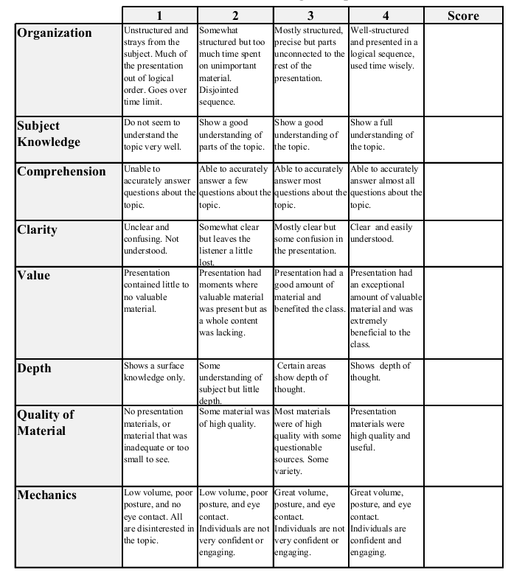
Stephanie Mazur
November 25th, 2014
Does Liberalising Bar Hours Decrease Traffic Accidents?
Colin P. Green, John S. Heywood, Maria Navarro
Journal of Health Economics
Pages 189-198

Slide 2
Introduction
Government acts as the chief regulator of alcohol
Taxes, availability, licenses
Does increasing the hours in which bars are open decrease the number of traffic accidents?

Slide 3
The Study
Where?
Wales and England
Scotland (control)
Policy Change
Licensing Act of 2003 allowed venues to apply for licenses to stay open until 5am
Previously had to stop serving alcohol at 11pm
Collection of Data
Road accident data from the Department of the Environment, Transport and the Regions

Slide 4
Results
Decrease of 3.95 accidents per month
Decrease mostly associated with young people
Decrease in serious / fatal traffic accidents
Fridays and Saturdays show 24% decrease in accidents
Between 11pm – 3am

Slide 5
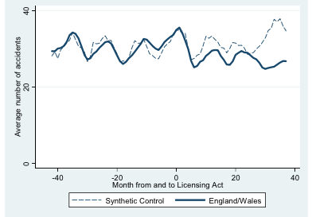

Slide 6
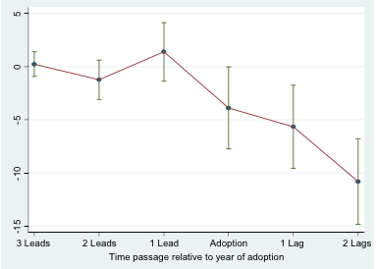
Estimated impact of extending opening hours on traffic accidents for years before, during and after adoption.

Slide 7
Why?
Longer bar hours reduce the need for “beat the clock” mentality
Less amount of intoxicated drivers at once
Fewer vehicles on the road
Less people traveling to parties or illegal late night pubs at the end of the night

Slide 8
Conclusion
Later bar closing hours are associated with a decrease in car accidents
Concentrated among young drivers
Driving intoxicated is only one of the many social problems associated with alcohol
Future research may indicate whether this act effected health, poverty levels, or job loss

