Slide 1
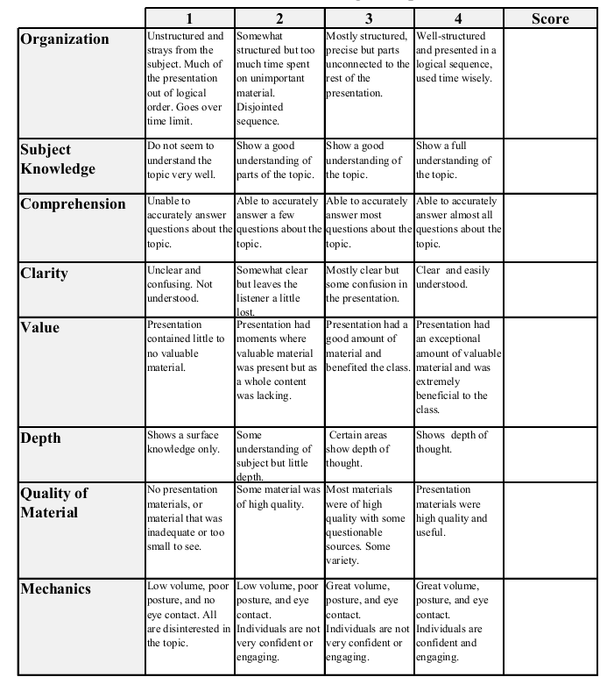
Fall 2014: Econ 339 Final Presentation
William Ridgely
November 25, 2014
Family Investment Responses to Childhood Health Conditions:
Intrafamily Allocation of Resources
Reference: Rosales-Rueda 2014, Family investment responses to childhood health conditions:
Intrafamily allocation of resources, Journal of Health Economics, 37, pg 41-57
Total:_________

Slide 2
Introduction
Health is a type of human capital and a contributor to other forms of human capital (Becker, 2007)
Importance of early childhood experiences
Poor health in childhood leads to poor adult outcomes

Slide 3
Background of Study
Purpose: to understand how families choose to invest in response to the onset of a child’s health condition.
Becker and Tomes (1976)
Reinforcement
Behrman et al. (1982)
Compensation
Data from the CNLSY79

Slide 4
The Study
Measuring family investments: HOME instrument
Cognitive stimulation
Emotional support
Mental vs. Physical Disabilities
Errors in reporting

Slide 5
Results
 | OLS |  |  | Family fixed effects
 | (1) | (2) | (3) | (4) | (5) | (6)
Panel A: Total HOME score
Ever ill | −0.048 | −0.050* | −0.015 | −0.061*** | −0.052*** | −0.044**
 | (0.031) | (0.027) | (0.021) | (0.018) | (0.018) | (0.017)
Number of observations | 27,602
Families (N) | 3007
Panel B: Cognitive stimulation
Ever ill | −0.023 | −0.025 | 0.0010 | −0.054*** | −0.042** | −0.037**
 | (0.030) | (0.027) | (0.023) | (0.018) | (0.018) | (0.018)
Number of observations | 26,245
Families (N) | 2979
Panel C: Emotional support
Ever ill | −0.063** | −0.063** | −0.027 | −0.049** | −0.046** | −0.037*
 | (0.028) | (0.027) | (0.022) | (0.020) | (0.021) | (0.020)
Effect of any health condition on parental investments:

Slide 6
Results
OLS |  |  | Family fixed effects
 | (1) | (2) | (3) | (4) | (5) | (6)
Panel A: Total HOME score
Ever a mental cond. | −0.39*** | −0.33*** | −0.24*** | −0.19*** | −0.17*** | −0.16***
 | (0.056) | (0.050) | (0.041) | (0.036) | (0.036) | (0.035)
Ever a physical cond. | 0.034 | 0.036 | 0.062** | −0.016 | −0.0093 | −0.0038
 | (0.036) | (0.032) | (0.025) | (0.021) | (0.021) | (0.020)
Number of observations | 27,075
Families (N) | 3007
Panel B: Cognitive stimulation
Ever a mental cond. | −0.38*** | −0.32*** | −0.24*** | −0.18*** | −0.16*** | −0.15***
 | (0.054) | (0.051) | (0.047) | (0.037) | (0.038) | (0.037)
Ever a physical cond. | 0.060* | 0.061* | 0.078*** | −0.012 | −0.0038 | −0.0014
 | (0.035) | (0.032) | (0.027) | (0.022) | (0.021) | (0.021)
Number of observations | 25,751
Families (N) | 2979
Effect of Physical vs. Mental Disabilities:

Slide 7
Results
Panel C: Emotional support
Ever a mental cond. | −0.27*** | −0.22*** | −0.14*** | −0.13*** | −0.12*** | −0.11***
 | (0.055) | (0.051) | (0.041) | (0.040) | (0.040) | (0.039)
Ever a physical cond. | −0.0074 | −0.0049 | 0.023 | −0.015 | −0.013 | −0.0042
 | (0.033) | (0.031) | (0.025) | (0.024) | (0.024) | (0.024)
Number of observations | 24,404
Families (N) | 2974
Effect of Physical vs. Mental Disabilities:

Slide 8
Conclusion
Reinforcement behavior: parents invest less in children with health conditions, which suggests they adopt a reinforcing strategy and are motivated by efficiency concerns.
Type of Condition: children with mental conditions are invested in less while children with physical conditions see no statistically significant change.

