Slide 1
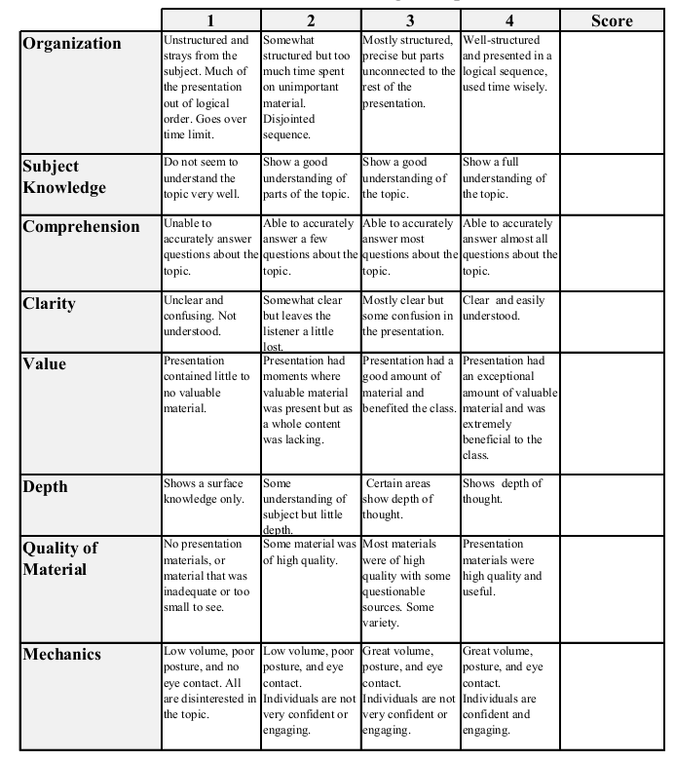
Fall 2013: Econ 339 Final Presentation
Catherine Menking
12/2/2014
The Impact of Direct-to-Consumer Television and Magazine Advertising on Antidepressant Use
Reference: Avery, R. J., Eisenberg, M. D., & Simon, K. I. (2012), The Impact of Direct-to-Consumer Television and Magazine Advertising on Antidepressant Use, Journal of Health Economics, vol. 31, p.705-718.
Total:_________

Slide 2
The Impact of Direct-to-Consumer Television and Magazine Advertising on Antidepressant Use

Slide 3
Direct-to-Consumer Advertising (DTCA)
United States and New Zealand currently allow DTCA for pharmaceuticals
New Zealand considered banning this practice in 2006
Canada and the European Union have considered DTCA
Started in the 1980s, regulated by Food and Drug Administration (FDA)
FDA regulations modified in 1997, resulted in 296.4% increase in pharmaceutical DTCA spending between 1997-2005

Slide 4
Antidepressants
2nd largest drug class in the US
Depression affects approximately 15 million adults in the US during any given year
An estimated 50-66% of individuals with depression receive no treatment, 15% of those affected eventually commit suicide
Depression costs employers $51 billion in lost productivity from absenteeism

Slide 5
Opposing Views on Pharmaceutical DTCA. . .
Advocates of DTCA
Increase disease awareness
Inform patients of treatment options
Opponents of DTCA
Overstate prevalence of health conditions
Only give partial drug information
Encourage patient-physician conversations
Risks of drugs not fully disclosed
Pressure physicians to prescribe new & expensive drugs with marginal benefits, increasing healthcare costs
Increase care for under-diagnosed and under-treated conditions

Slide 6
Study Objectives
Evaluate whether DTCA exposure affects use of these medications
Test if communication medium (television vs. magazine) impacts effect
Different impact on males vs. females?
Does depression severity (mild-severe) influence DTCA impact?

Slide 7
Results
Effect of DTCA Exposure on Antidepressant Use
Advertising Medium | Television (Low Exposure) | Television (High Exposure) | Magazine (Low Exposure) | Magazine (High Exposure)
Women | +5.6% | +8.6% | +5.4% | +4.9%
Men | +7.6% | +10.3% | -1.1%* | +0.5%*
Average | +6.2% | +10.1% | +3.6% | +3.0%
Low or High Exposure determined as above or below the mean
*Value not statistically significant

Slide 8
Conclusion
DTCA (low or high) resulted in 3%-10% increase in antidepressant use
Effects slightly more prevalent for women (magazine effects not statistically significant for men)
Television DTCA had greater impact than Magazine DTCA
Individuals with more severe symptoms had more significant effects from DTCA

