Slide 1
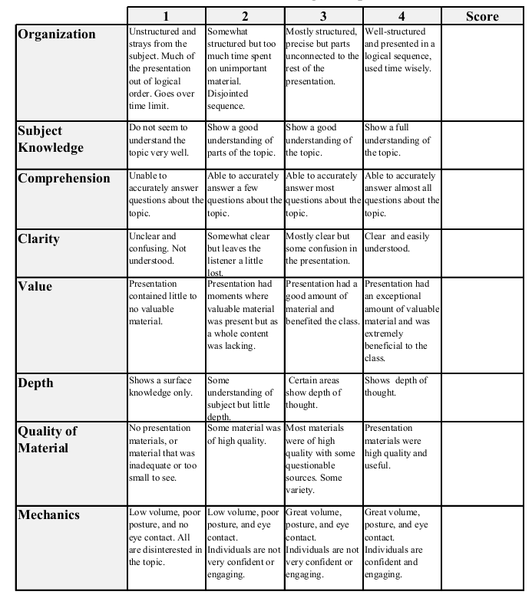
Fall 2013: Econ 339 Final Presentation
Ryan Kelley
12/2/14
Does seeing the doctor more often keep you out of the hospital?
Reference:Robert Kaestner, Anthony T. Lo Sasso, Does seeing the doctor more often keep you out of the hospital?, Journal of Health Economics, Available online 15 August 2014, ISSN 0167-6296
Total:_________

Slide 2
Does seeing the doctor more often keep you out of the hospital?
By Ryan Kelley

Slide 3
Main Question
Are outpatient care and inpatient care, compliments or substitutes?
Hypothesis 1- outpatient care consists of treatments that prevent illness and repair health subsequent to illness
Hypothesis 2-outpatient care consists of treatment that has little value in terms of repairing health or preventing illness

Slide 4
Prior Experiments and Literature
Dartmouth Atlas of Health Care- Supply sensitive care
Anderson et al(2012)-Young adults
Kolstad and Kowalski(2012)- Massachusetts reform
RAND Health Insurance Experiment

Slide 5
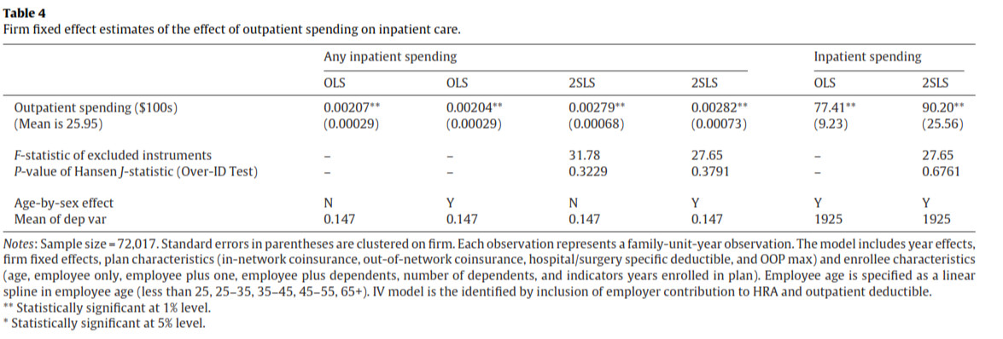
Information and Methodology
HRA(Health Reimbursement Account) vs HSA (Health Savings Account)
From small Midwestern insurance agency: 2000-2006

Slide 6
Results and Comparison
$100 (4%) increase in outpatient spending was associated with a 1.9% increase in the probability of having an inpatient event and a 4.6% increase in inpatient spending
No association between outpatient spending and admissions for births or low-variation procedures such as major cardiovascular care.
Dartmouth Atlas
RAND HIE
Clemens and Gottleib(2014)

Slide 7
References
Robert Kaestner, Anthony T. Lo Sasso, Does seeing the doctor more often keep you out of the hospital?, Journal of Health Economics, 15 August 2014, ISSN 0167-6296, http://dx.doi.org/10.1016/j.jhealeco.2014.08.003.

