Slide 1
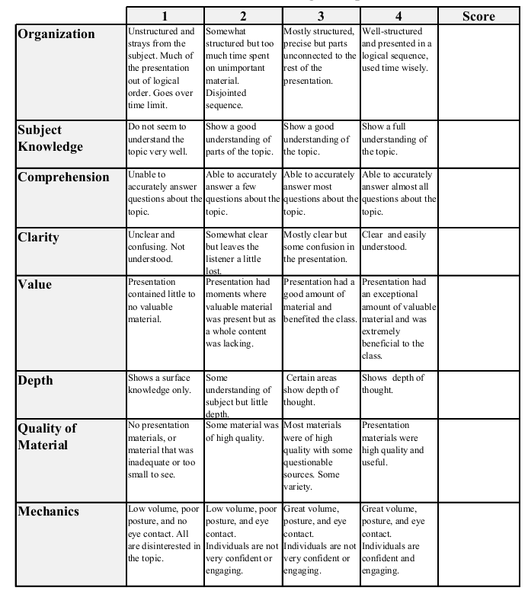
Fall 2013: Econ 339 Final Presentation
Daniel Mong
12/04/14
HIV, Wages, and The Skill Premium
Marinescu, Ioana E. "HIV, Wages, and The Skill Premium." Journal of Health Economics 37 (2014): 181-97. Electronic.
Total:_________

Slide 2
HIV/AIDS Background Information
HIV/AIDS represents one of the greatest public health crisis of the past several decades
Sub-Saharan Africa represents 2/3 of current HIV infections
22 million people were infected with HIV
1.5 million people died from AIDS
HIV is sexually transmitted and typically affects adults in their 30’s and 40’s
Life expectancy is 10 years

Slide 3
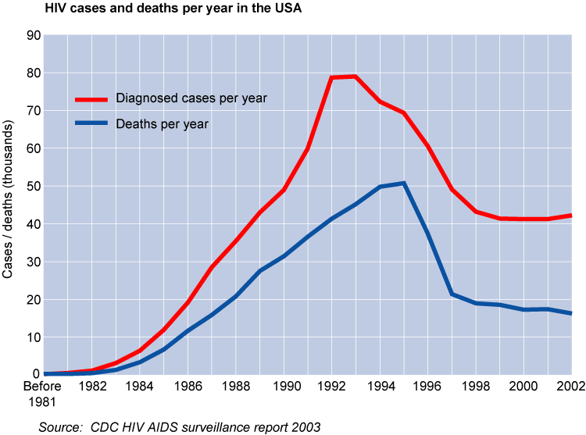

Slide 4
Other Related Studies
Economic effects of the epidemic are staggering and well documented, such as:
Young(2005) who developed a model centered around the theme that African’s are better off now that the population has decreased
Borjas(2003) who studied the impact of an increase in labor supply on the wages of different groups
Paper is closest to Young in theme but theoretically it is closer to Borjas

Slide 5
Skill Premium
Skill Premium - The difference between the wage of skilled labor and that of unskilled labor
Wage data from the urban manufacturing sector only, these firms pay higher wages and do not need to increase their wages much in order to attract new workers
- High skilled workers harder to replace without increasing wages
Supply of low skilled workers declined less than the supply of high skilled workers
- Impact of HIV on wages of high skilled workers will be higher
Positive association found between HIV and the skill premium

Slide 6
Wage Effect
Higher HIV rates are associated with significantly higher capital-labor ratios
- However, HIV has no significant impact on labor productivity
Higher HIV prevalence is consistently significantly associated with a higher skill premium
- A 10% increase in HIV prevalence is associated with a 1.5 percentage point greater increase in the wages of workers with 14 years of education or more, compared to workers with 10 years of education or less.

Slide 7
Dualism in Labor Market
The positive association between HIV and the skill premium only holds for larger firms
- those firms that are more likely to pay above market clearing level wages to start with
Recent migration from rural areas is an important factor that controls the impact of HIV on the wages of the least skilled workers
- the impact of HIV on low-skilled workers’ wages is estimated to be positive and significant in the absence of rural-urban migration
- impact declines significantly as rural urban migration increases.

Slide 8
Conclusion
Skill Premium
- higher HIV prevalence is significantly associated with a higher skill premium
Wages
- impact of HIV prevalence on wages is positive but imprecisely estimated
Labor market dualism
- HIV epidemic tends to increase wage inequality in Sub-Saharan Africa

