Slide 1

Fall 2013: Econ 339 Final Presentation
Stephen Hinder
December 4th 2014
“Does liberalizing cannabis laws increase cannabis use?”
Williams, Jenny, and Anne Line Bretteville-Jensen. "Does Liberalizing Cannabis Laws Increase Cannabis Use?" Journal of Health Economics 36.July 2014 (2014): 20-32. Web.
Total:_________

Slide 2
An Overview
This case study is based in Australia because their model for liberalization and decriminalization is similar to the form used in other countries like the U.S. and U.K.
Studies individuals ages 20-40 years old and asks the question “What age were you when you first used cannabis?”
The time period that was surveyed was from 1970-2010.
Decriminalization laws began being passed in 1970.

Slide 3
How does decriminalization affect uptake rates?
Critical Issue: Whether the decriminalization of the recreational use of cannabis will increase its use, if so, by whom and by what amount.
1 in 10 become dependent users and the likelihood of this happening are greater if users start at a younger age.
Two of the groups studied are the Treatment Sample or the states where cannabis has been decriminalized and the Control Sample or the states where cannabis is non-decriminalized.

Slide 4
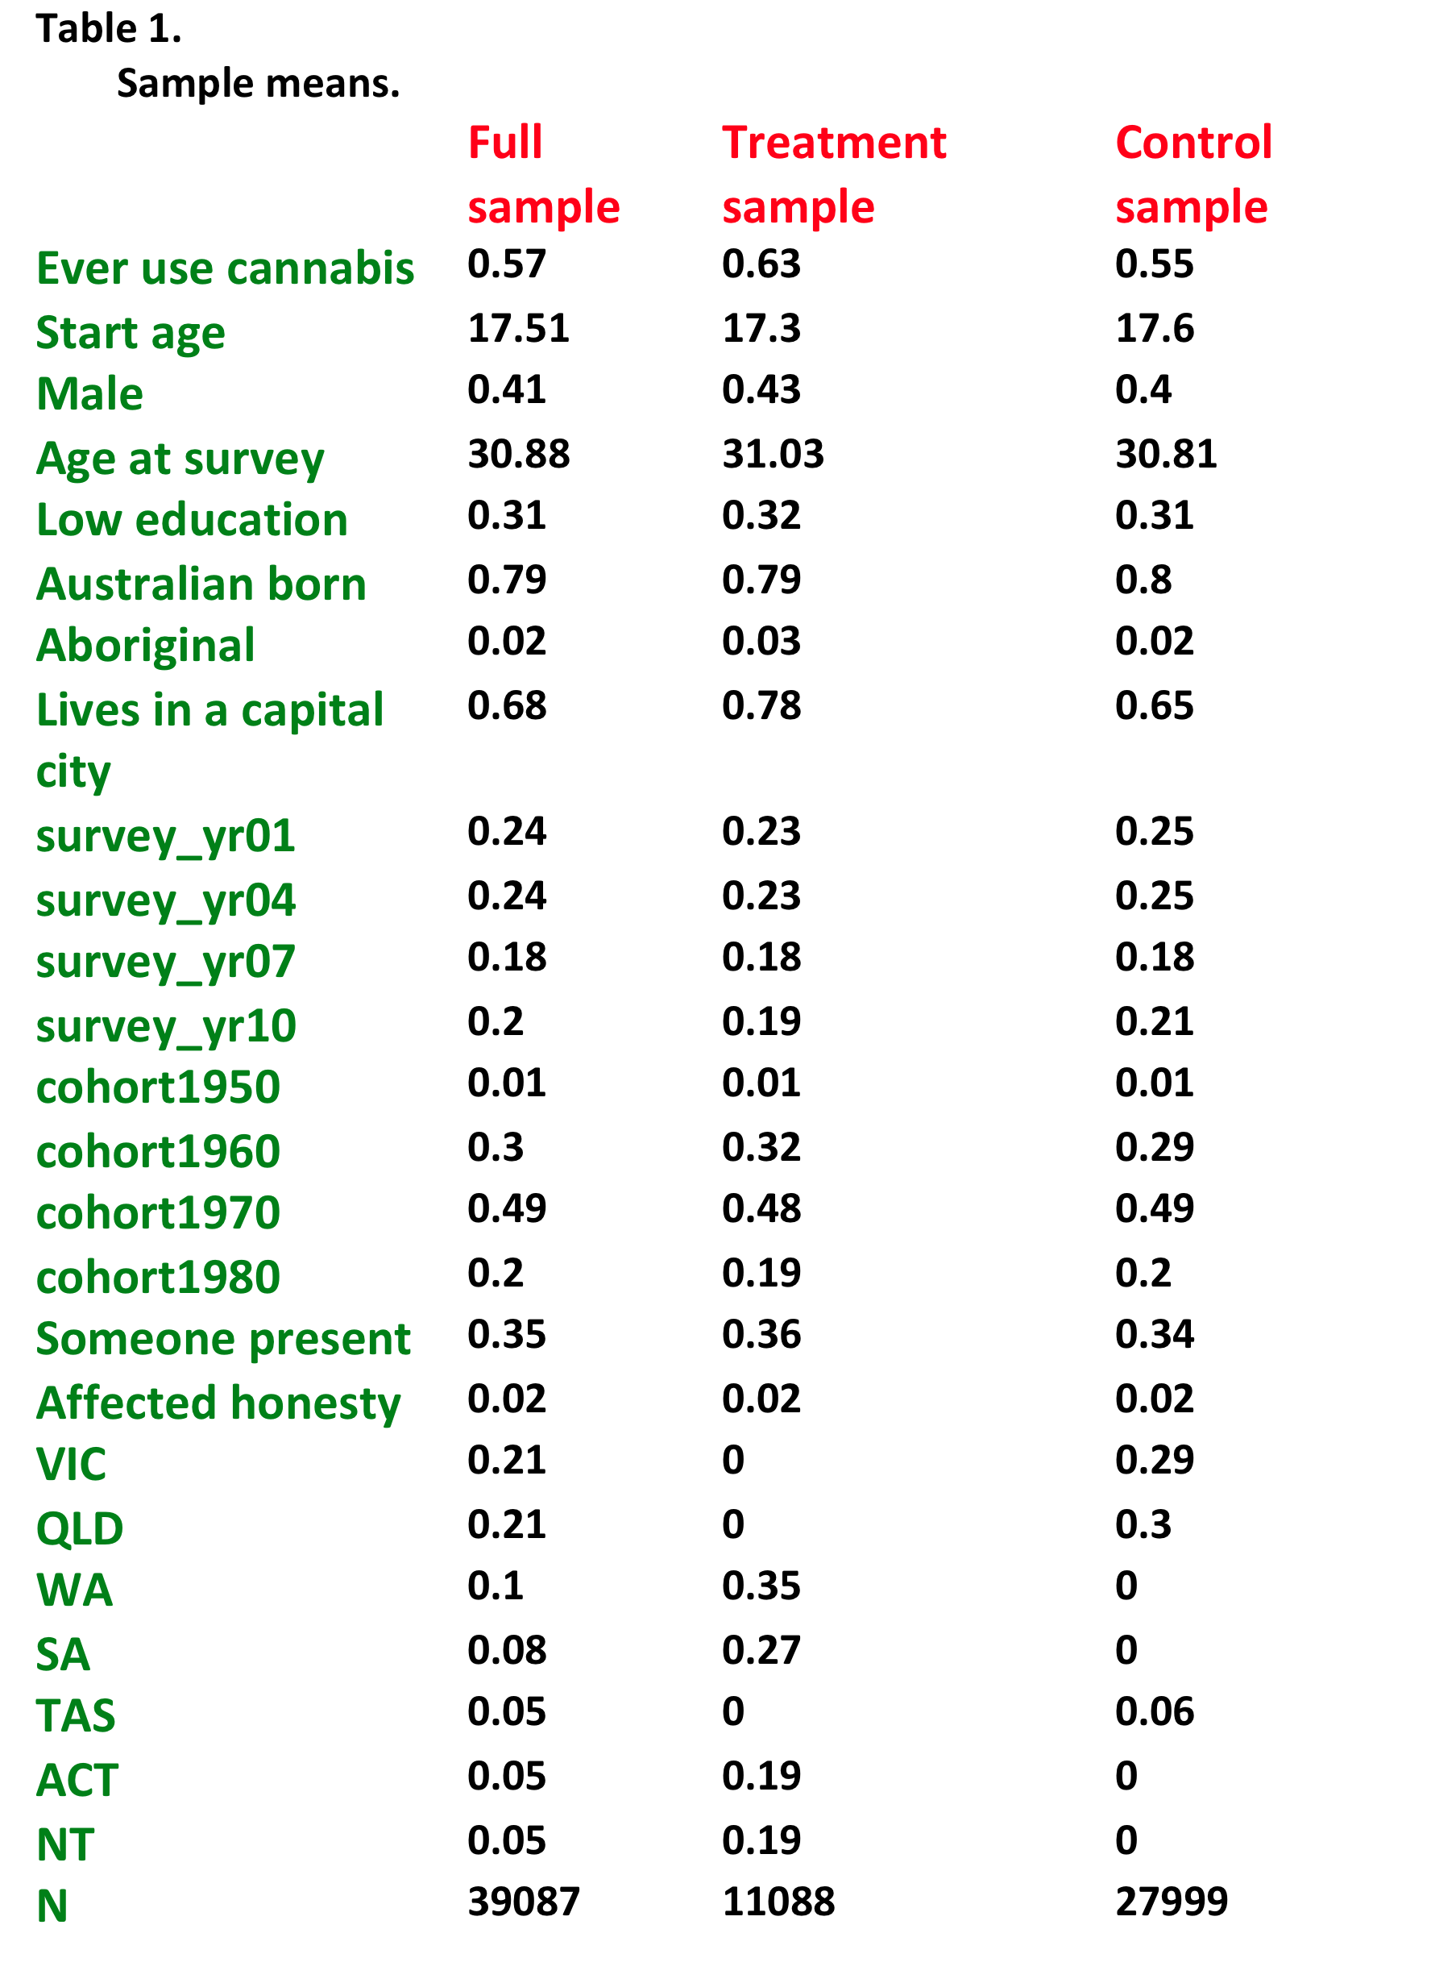

Slide 5
Uptake of cannabis
Some states in Australia have decriminalized cannabis but there are still some that have not which can affect the data.
Hazard Rate: This is the transition rate from non-use of cannabis to use for each particular year of age.
Survival Function: This is the probability of not using cannabis at all until age “T”.
These two factors are separated by the treatment and control groups which you can see on the following slide.

Slide 6
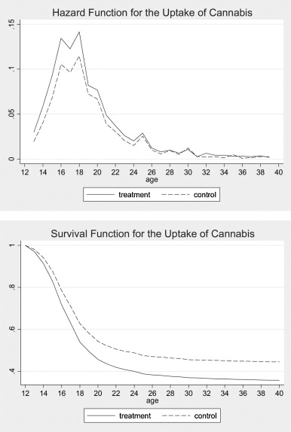

Slide 7
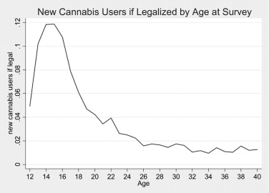
- This graph shows the proportion of people who do not currently use that would begin using if legalized

Slide 8
Summary
The case study found that in the Short Run (5 years after the decriminalization) those who do start using cannabis tend to do so at and earlier age than normally would have been the case.
In the Long Run (after 5 years of the decriminalization laws being passed) there was no statistically significant change in the uptake rates of people using cannabis at any age.
With the introduction of the decriminalization laws there was a small net increase in the proportion of the population who started using cannabis as well.

