Slide 1
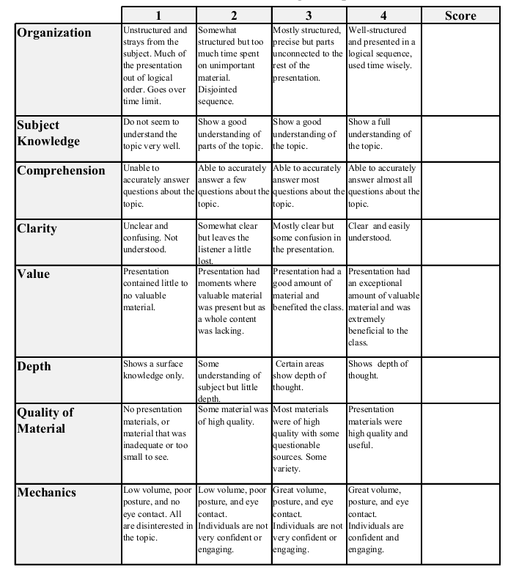
Fall 2014: Econ 339 Final Presentation
Jazz Morales
Thursday, December 4th
The Effects Of Pharmacological Treatment For Children With ADHD
Reference: Soren Dalsgaard, Helena Nielsen, Marianne Simonsen, 2014, “Consequences of ADHD Use for Children’s Outcomes”, Journal of Health Economics, vol. 37, p.137-151
Total:_________

Slide 2
What is ADHD?
Attention Deficit Hyperactivity Disorder
One of the most common, chronic mental health problems among young children. 3-7% of all children are victims.
Symptoms include: Difficulty staying focused, difficulty controlling behavior and hyperactivity.

Slide 3
Hypothesis
These core symptoms mentioned previously may lead to risky health behaviors.
Goals Of This Study:
Collect data.
Examine the different types of treatment.
Correlate the long-term effects of treatment with development into adulthood.

Slide 4
Studies Show Pharmacological Treatments Reign Supreme
Hospital visits and police encounters both decreased.
Timing is Key!
Difference in parenting and doctor behavior may cause lack of availability…

Slide 5
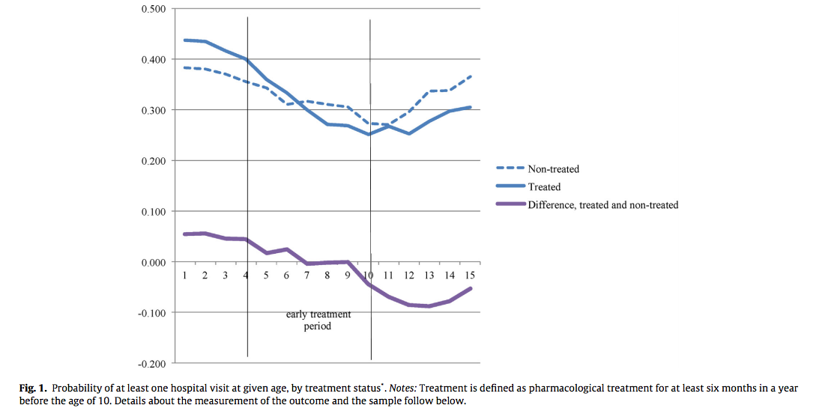
Comparing Hospital Visits Vs. Treatment

Slide 6
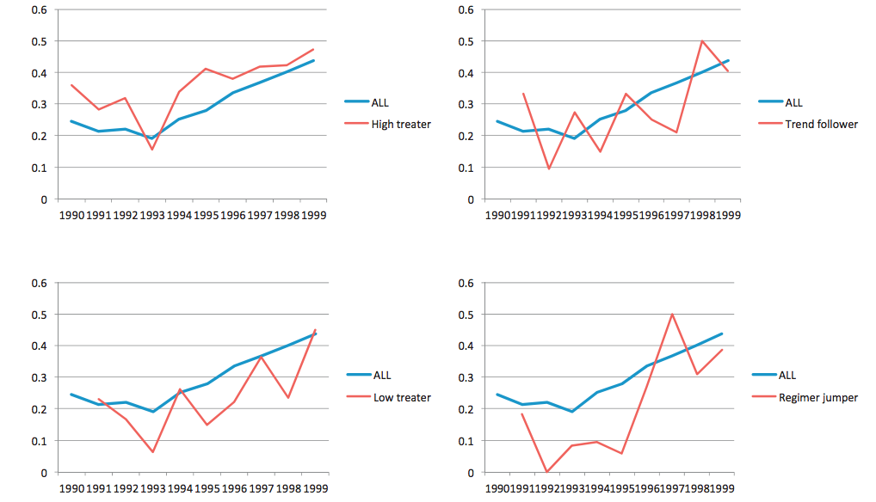
Propensities To Treat

Slide 7
How Does It Work?
Methylphenidate – Key Ingredient
Increases catecholamine levels but blocks dopamine & norepinephrine transporters.
Side effects exist as with any medication.
Is It Affordable?
Government subsidies.

Slide 8
In Conclusion…
ADHD, if untreated can cause cognitive, learning and social problems that can lead to risky health behaviors.
Early & proper diagnosis is key! (Diminishing returns.)
Long-term benefits extend beyond the relief of symptoms.

