Slide 1
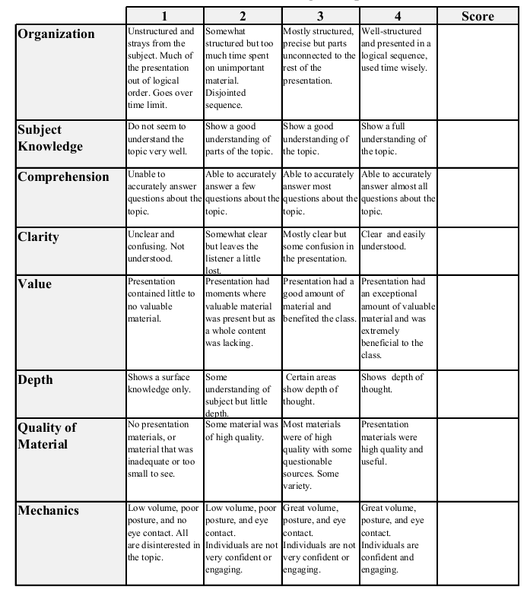
Fall 2014: Econ 339 Final Presentation
Adam Suarez
December 9, 2014
Does Retirement Affect Cognitive Functioning?
Reference: Eric Bonsang, Stephane Adam, and Sergio Perelman (2012), Does Retirement Affect Cognitive Functioning?, Journal of Health Economics, vol. 31, 3., p.490-501
Total:_________

Slide 2
Introduction
Increased life expectancies are increasing the retirement period in the average person’s life
Extended retirement brings elderly mental health into focus
Lower cognitive ability results in lower productivity and lower investment in human capital
Previous research suggests retirement does lower cognitive function

Slide 3
Cognitive Decline
Individuals have some control over their cognitive decline
Why would retirement lead to cognitive decline?
-Less human engagement
-Decreased stimulating activities
-Changes in environment
Lifestyle changes directly affects cognitive ability

Slide 4
Empirical Strategy
Cognitive ability equation: Cit=ritβ+f(age_{it})+μ_{i}+ν_{it}
Used social security ages in US to determine retirement eligibility
Expected cognitive decline to occur with a lag after the date of retirement
- Progressive environment change
-“Honeymoon Phase”

Slide 5
Data
Responses came from the Health and Retirement Study (HRS)
-Conducted an episodic memory test over the phone scored 0 to 20
-54,377 observation for 14,710 individuals ages 51 to 75
-Wide range of parameters (financial, physical health, mental health, etc.)
Individuals had to be retired for one year before completing the memory test

Slide 6
Results
The data exhibits a downward trend of cognitive function after the date of the individual’s retirement
Significant cognitive drops and increased probability of retiring at age 62 to 63 and 66 to 67
Cognitive decline was delayed about 14 months after retirement
Earlier retirement correlated with lower cognitive scores

Slide 7
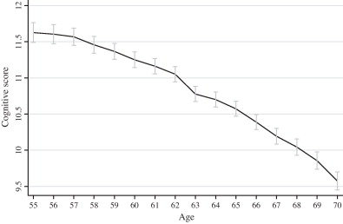

Slide 9
Conclusion
Increasing the age of retirement would delay cognitive decline and long term health expenditures
Cognitive decline is not instantaneous
Individuals have some control over the rate of decline
Supports policy to increase the average retirement age

