Slide 1
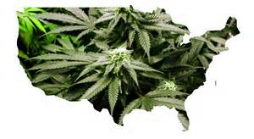
The Effects of Medical Marijuana on Illegal Marijuana Use
Joseph McCargo
11/25/14

Slide 2
Introduction
More states have passed laws that allow individuals to use marijuana for medical reasons
Studying marijuana possession arrests in cities from 1988 to 2008
(These laws increased marijuana arrests among adult males by about 15–20%)

Slide 3
Medical States
Colorado – November, 2012
Washington – November 2012
**Washington, D.C. and 22 other states
allow individuals with designated symptoms to use marijuana for medical purposes
(ex: California)

Slide 4
The Laws
Permit patients with legally designated diseases and syndromes to use marijuana as a means of treatment. (background late 80s, early 90s – AIDS)
**conditions now include: chronic pain, glaucoma
California – “any other illness for which marijuana provides relief”
New Mexico – first state to pass a law with provision to license production and distribution at the state level (2007)

Slide 5
Impact of Law Enforcement
Dispensaries and caregivers considered to be legal covers for illegal drug dealing and are constantly being raided by the DEA
San Diego County – very restrictive policy toward dispensaries and its law enforcement organizations actively cooperate with the DEA
Allowed to have a certain amount on you

Slide 6
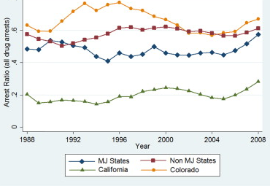

Slide 7
Uniformed Crime Report (data)
(UCR) arrest data is an administrative series of monthly police records from state and local police agencies across the U.S compiled by the FBI
The graph gives estimates based on alternate coding of the first year of the laws (in %)

Slide 8
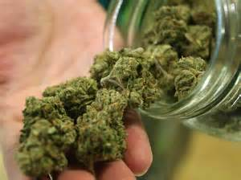
Conclusion
Decriminalization
Growing difference in numbers of patients and dispensaries across US – have become more and more heterogeneous since 2009

