Slide 1
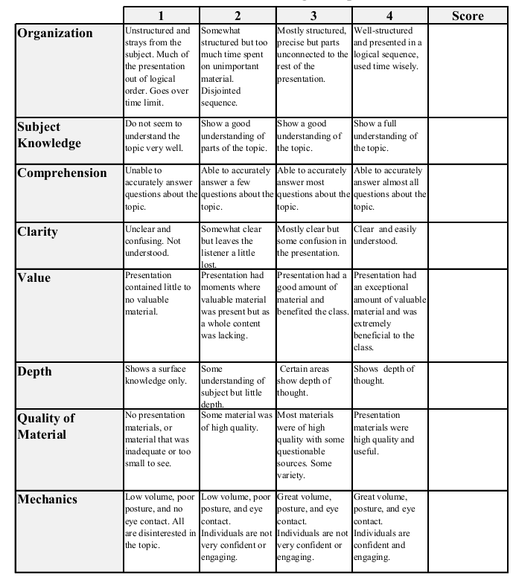
Fall 2013: Econ 339 Final Presentation
Joel Flores
Moral Hazard and Adverse Selection in Australian Hospitals
Reference: Donald J. Wright 2006, Moral hazard and Adverse selection in Australian Hospitals, Journal of Health Economics, vol.22 , Issue 3., p.331-359
Total:_________

Slide 2
Introduction
US: Private System
UK: Public System
Australia: Mixed System
From 1989-1999
44% of Individuals had private hospital insurance
35% of hospital users used a private hospital

Slide 3
Introduction Cont.
Purpose of the paper
To establish the existence of moral hazard and adverse selection in the Australian market for hospital care
To asses the extent of moral hazard and adverse selection in the market
“This paper is an attempt to model and empirically test the interaction between private hospital insurance choice and private hospital service use”(Wright 2006)

Slide 4
Research
National Health Survey (NHS) by the Australian Bureau of Statistics.
54,241 fully completed individual questionnaires.
This represented about one in 300 of the population
Whether they had existing medical conditions and what they were
Whether they visited a hospital in the last 12 months, and whether it was a private or public hospital,
The reason for visiting hospital and length of stay in hospital
Whether they had private hospital insurance

Slide 5
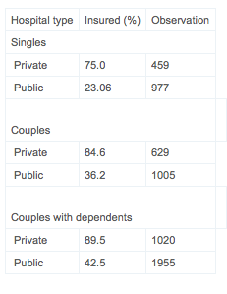
Research Cont.

Slide 6
The Model
Wright created a model that used functions based on the relationship between the type of insurance a patient has, and the likelihood of them using a private hospital.
Wright then paired this information with other characteristics.

Slide 7
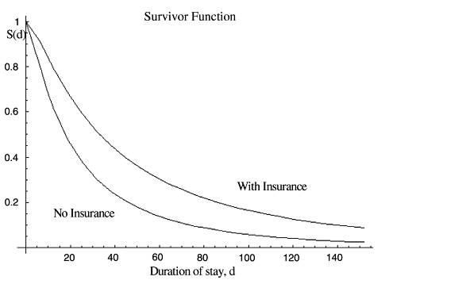
Results

Slide 8
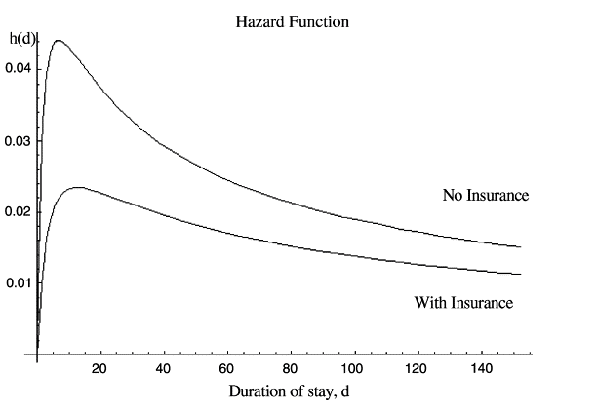
Results Cont.

Slide 9
References
Donald J. Wright. Department of Economics, University of Sydney, Sydney, NSW 2006, Australia <http://www.sciencedirect.com/science/article/pii/S0167629602001042>

