Slide 1
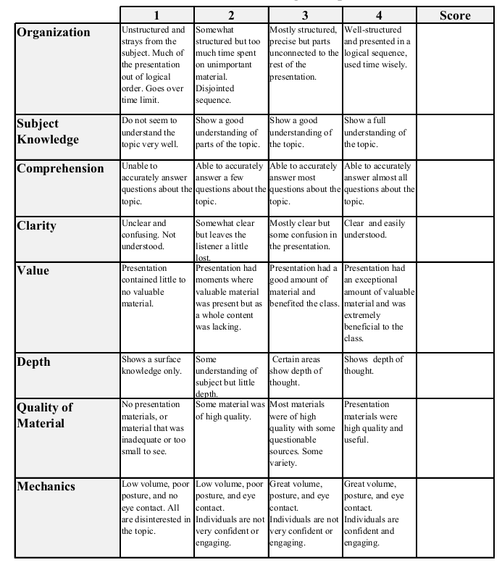
Fall 2014: Econ 339 Final Presentation
Joseph Princiotta
November 25, 2014
Sick But Satisfied: The Impact of Life and Health Satisfactions on Choice Between Health Scenarios
Reference: Dolan, Paul; Kavetsos, George; Tsuchiya; Aki. Sick But Satisfied: The Impact of Life and Health Satisfactions on Choice Between Health Scenarios. Journal of Health Economics 32 (2013) pp. 708-714
Total:_____________

Slide 2
Objective
This study attempts to describe health in such a way that allows comparisons across a broad range of health conditions.
Most widely used health state descriptive systems:
EQ-5D: describes health in terms of 3 levels across 5 dimensions. (Satisfaction levels)
TTO and/or SG: places all health states on an interval scale between 0 and 1, thus allowing for the calculation of QALYs. (Preferences)

Slide 3
Objective, cont’d
2 descriptive systems raises 2 major questions
First: Are health state preferences influenced by satisfaction levels in the states mentioned in the EQ-5D?
Additionally: Are health state values, which contain satisfaction levels, influenced by the respondent’s own satisfaction level?
Summed up: Does each separate descriptive system have an effect on one another? If so, how?

Slide 4
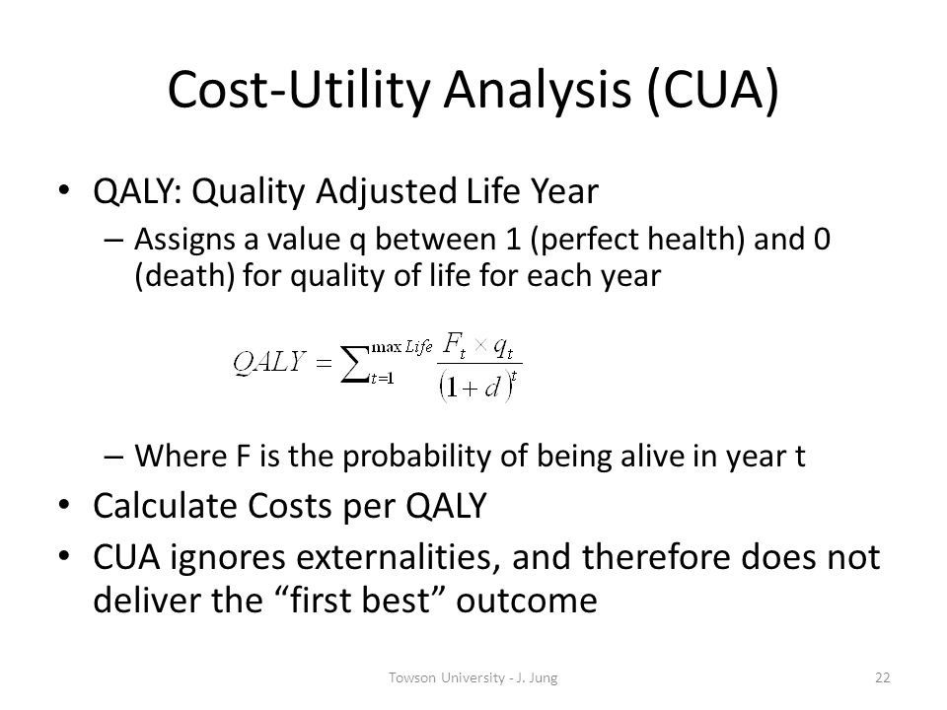
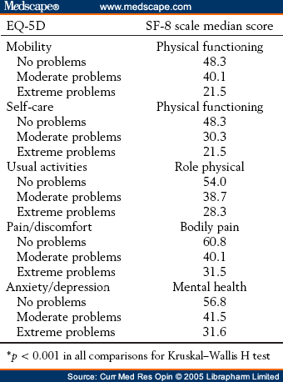

Slide 5
Data and Methods
Data consists of respondents’ own, personal preferences to a series of pairwise choices.
Scenario A: You live in health state H with satisfaction S for 5 years, and then die.
Scenario B: You live in full health for 3 years, and then die.
3 hypotheticals were used from the EQ-5D model, combined with 4 satisfaction states.

Slide 6
Results
A scenario that contains low health satisfaction leads to a significant increase in the likelihood of preferring to die sooner in full health.
Similarly, a scenario that contains a high satisfaction with either health or life leads to a significant increase in the likelihood of preferring to live for a longer time in poor health.

