Slide 1
Inequality

Slide 2
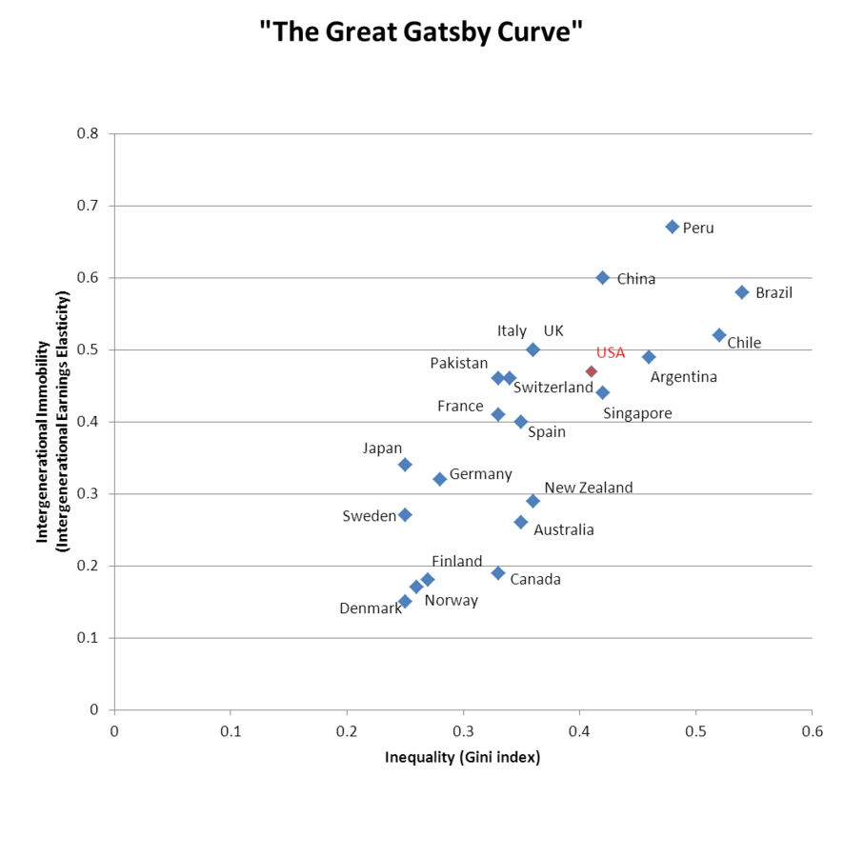
http://en.wikipedia.org/wiki/Income_inequality_in_the_United_States

Slide 3
Gini Coefficient

