Slide 1

Project Presentation Part 2
Annie Maras and Abby White

Slide 2
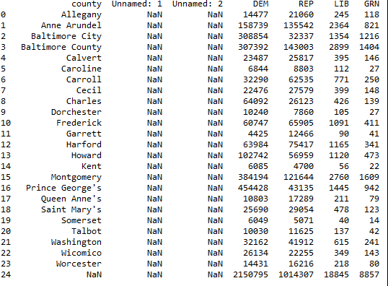
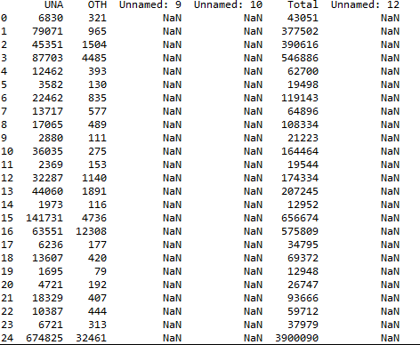
Voter Data Set
First Data Set showing the different counties voting preferences

Slide 3
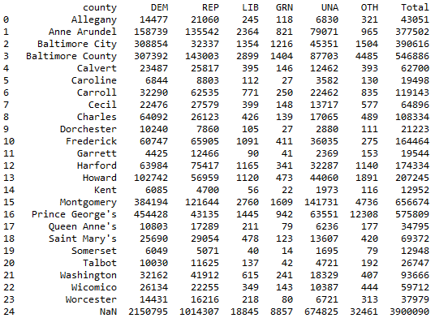
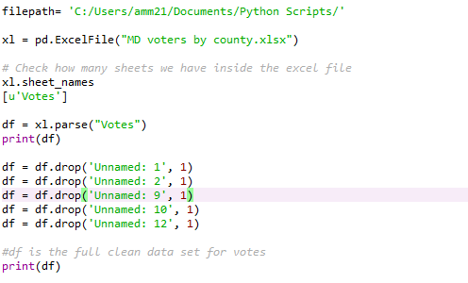
Clean Voter Data Set
Cleaned Data Set

Slide 4
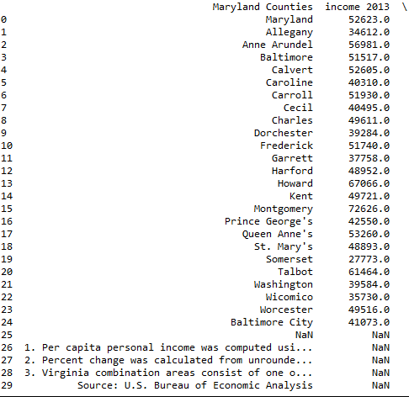
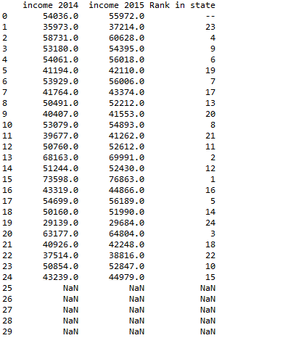
Income Data Set
Second Data Set showing per capita income

Slide 5
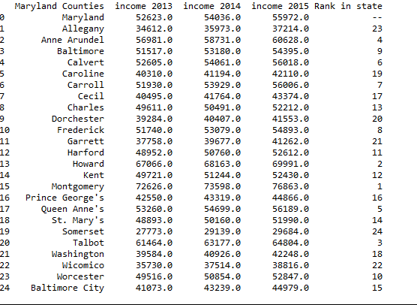
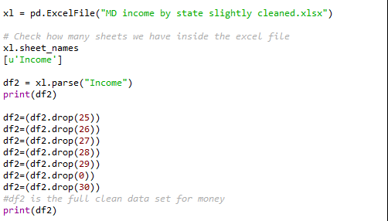
Clean Income Data Set
Here is the code used to clean the data set, and the results

Slide 6
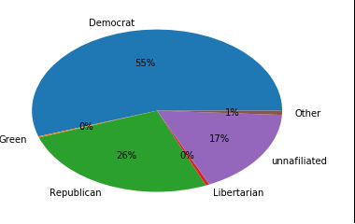

Pie Chart
Started working with the data

Slide 7
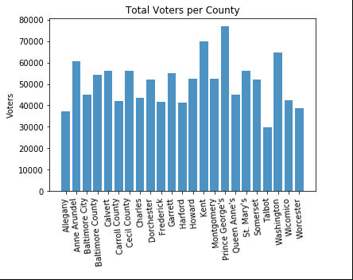
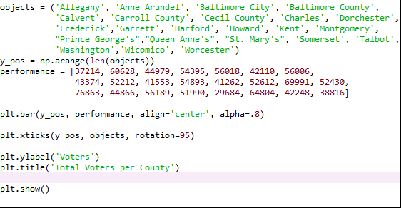
Working with the Data Sets

Slide 8
Comparisons
Top 3 wealthiest counties:
Montgomery Democratic
Howard Democratic
Talbot Republican
Top 3 poorest counties:
Somerset Democratic
Allegany Republican
Wicomico Democratic

Slide 9
Future Considerations
Create regression of political party and county wealth
How strong is the relationship between these two factors
We may need to consider:
Size of each county
Voter participation of each county

Slide 10

Gathered Data Web Sites
https://bea.gov/newsreleases/regional/lapi/lapi_newsrelease.htm
http://www.elections.state.md.us/voter_registration/stats.html

