Slide 1
Hotel Ratings
Do reviews effect the price of a room?

Slide 2
Introduction
Last time…
We felt we did not present a clear question.
Hotel Reviews are indicators of a hotel’s status.
For good or ill they show how the hotel is.
Can a hotel capitalize on these reviews?
Are prices influenced by online reviews?

Slide 3
Ogut (2009)
A similar study was conducted on an international scale.
Found that reviews and price were indeed correlated.
Did not focus on region like we attempt to do.

Slide 4
Mayzlin, Dover, and Chevalier (2014)
Explores hotel incentives to post fake reviews.
If they have an impact on prices then there is a large incentive.
Better to fake negative reviews on competitors.

Slide 5
Balaska and Tzortzaki (2017)
Attempted to look at which online reviews helped.
Found clarity in online reviews as a necessity.

Slide 6
Coker (2012)
Looked at the arrangement of reviews.
Having a positive review first helps promote the brand.
It is bad to have a negative review first.

Slide 7
Methodology
We will constrain our focus to the US.
We will focus our view on major cities
These can be broken up regionally.
Together this data can be used to make a complete model for the country.
Analysis will show how price responds to reviews and content.

Slide 8
Methodology
Each review will be broken into parts:
A Score (1-5)
Content Analysis (Anything specific?)
Location
These content areas will make a clearer picture.

Slide 9
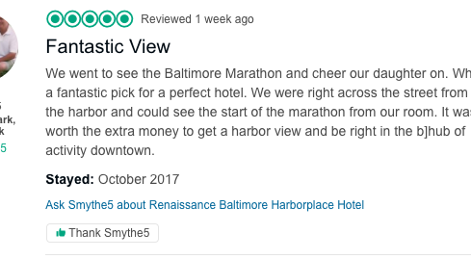
An Example

Slide 10
An Example
In this example:
Region: North East
City: Baltimore
Review: 5/5
Special Notes: Good view of harbor; especially for the marathon.

Slide 11
State of Data
Currently we are working on a program to gather data.
We will have summary statistics, graphs, and a preliminary regression soon.

