Slide 1
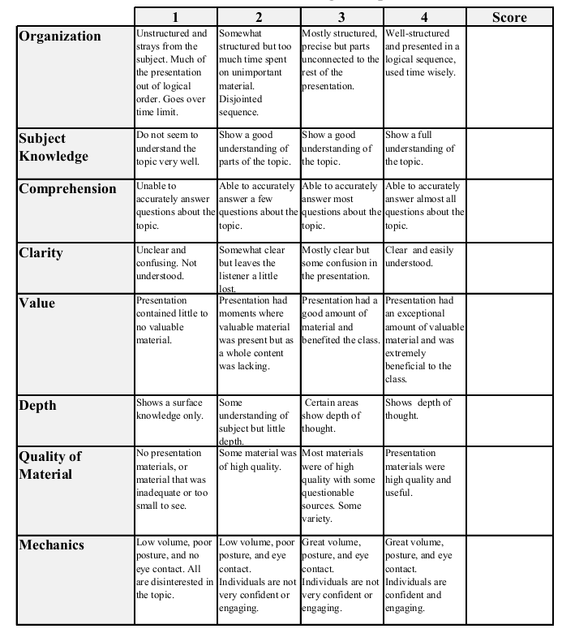
Econ 431 Data Presentation
Micah Torbert
Souleymane Kabore
October 31st, 2017
Analysis of the Exchange Rate Between US Dollar and the Chinese Yuan
Total:_________

Slide 2
Review: What Is “Pegged” Currency?
A pegged currency is a type of exchange rate regime where a currency’s value is fixed against the value of another single currency
Since the early 1970’s the Chinese yuan has been pegged to the U.S. dollar, but in 2005 it was taken off of this peg

Slide 3
What Were We Trying to Find Out?
Our goal was to find whether or not there was a correlation between certain macroeconomic variables and the exchange rate between the USD and the CNY
More specifically we looked at the following variables:

Slide 4
Our Independent Variables
China’s Gross Domestic Product (GDP)
The M1 Money Supply of the U.S.
(M1: All physical money, checking accounts, demand deposits, & negotiable order of withdrawal accounts)
The Rate of Inflation in the U.S. (CPI)
The Total Population of China
The Total Population of the U.S.
The Net Amount of Itemized Assets in the U.S.
Net U.S. Imports

Slide 5
Our Dependent Variable
As stated previously, the dependent variable in our regression was the exchange rate between the USD and the CNY
We examined the trend of this variable from 1988 to 2014 annually
After examining the graph of this data, we observed a negative slope in the graph after the year 2005

Slide 6
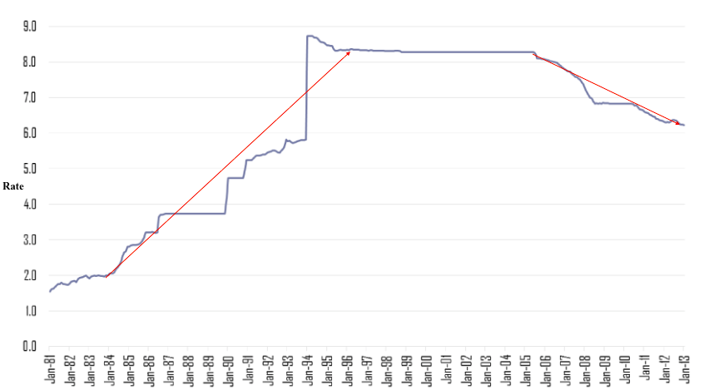
Visual Representation
USD vs. CNY Exchange Rate

Slide 7
Trends From the Graph
The exchange rate seemed to increase rapidly in favor of the U.S. dollar from 1984 to 1995
From 1995 to 2005 there was very little variation in the exchange rate
After the year 2005 we noticed a significant decrease in the exchange rate, in favor of the Chinese yuan

Slide 8
What Was Happening?
In the early 1990’s the yuan was systematically debased at a price ratio of roughly 3.7 CNY to 8.3 USD and left that way for a decade in order to make Chinese goods cheap in U.S. dollars
This in turn rapidly increases China’s exporting industry
In 2005 the Chinese was yuan was taken off of the U.S. peg due to political and economic pressures that were put on China by it’s trading partners

Slide 9
Our Method
Step One: Setup account with Quandl
Step Two: Received an authorization token so that we could extract data from the FRED website
Step Three: Drafted script that would extract the data we needed
Step Four: Ran script and extracted data
Step Five: Ran regression on collected data

Slide 10
Our Regression Results
Dependent Variable: | USD_CNY_ExRate
R-squared: | 0.963
Adj. R-squared: | 0.952
F-statistic: | 87.25
 | Coef. | Std. Error | t | P>|t| | [0.025 | 0.975]
GDP_China | -1.05E-12 | 2.04E-13 | -5.136 | 0.000 | -1.48E-12 | -6.23E-13
US_M1 | 2.43E-12 | 8.36E-13 | 2.902 | 0.009 | 6.82E-13 | 4.17E-12
US_CPI | -2.61E-02 | 0.081 | -0.322 | 0.751 | -0.195 | 0.143
China_Population | -0.0001 | 0.000 | -0.520 | 0.609 | -0.001 | 0.000
China_CPI | 0.010 | 0.014 | 0.736 | 0.470 | -0.018 | 0.038
US_Assets | 0.0877 | 0.017 | 5.239 | 0.000 | 0.053 | 0.123
US_Imports | 1.42E-07 | 6.91E-07 | 0.205 | 0.840 | -1.30E-06 | 1.58E-06

Slide 11
Interpretation & Further Analysis
Based on the P-test (the P>|t| column) we were able to conclude that from the data we compiled thus far, the least statistically significant macro-economic variables were:
The Rate of Inflation in the U.S. (CPI)
China’s Population
The Rate of Inflation in the China (CPI)
The Net Amount of U.S. Imports

Slide 12
Summary Statistics
 | Mean | Std. Dev. | Min | 25% | 50% | 75% | Max
USD_CNY_ExRate | 7.035552 | 1.481 | 3.731 | 6.1549 | 7.6058 | 8.27775 | 8.6397
GDP_China | 2.81E+12 | 3.09E+12 | 3.12354E+11 | 6.49E+11 | 1.34E+12 | 4.08E+12 | 1.05E+13
US_M1 | 1.40E+12 | 5.60E+11 | 7.87E+11 | 1.08E+12 | 1.18E+12 | 1.49E+12 | 2.93E+12
US_CPI | 8.49E+01 | 13.785343 | 62.10 | 74.212559 | 83.210549 | 97.691414 | 107.335762
China_Population (mil.) | 8257.89 | 1848.37 | 5479.70 | 6516.15 | 8499.13 | 9911.57 | 11045.23
China_CPI | 1267.09 | 71.78 | 1114.16 | 1221.95 | 1277.19 | 1323.16 | 1369.44
US_Assets (bil.) | 78.561481 | 22.670879 | 36.28 | 71.83 | 80.55 | 93.355 | 113.7
US_Imports | 1.56E+06 | 7.93E+05 | 5.54E+05 | 8.58E+05 | 1.43E+06 | 2.31E+06 | 2.88E+06

Slide 13
Problems We Ran Into
Small values are mixed in with large values, could lead to scaling issues
Several independent variables that we collected data for were not compiled were not statistically significant
Limited number of observations

Slide 14
Possible Solutions
Select new variables to extract from the FRED site and run a new regression (growth rate data)
Select a new time interval to view data from, thus increasing the number of samples in our dataset
Increase the size of the number(s) in certain statistics such as population

Slide 15
Questions?

