Slide 1
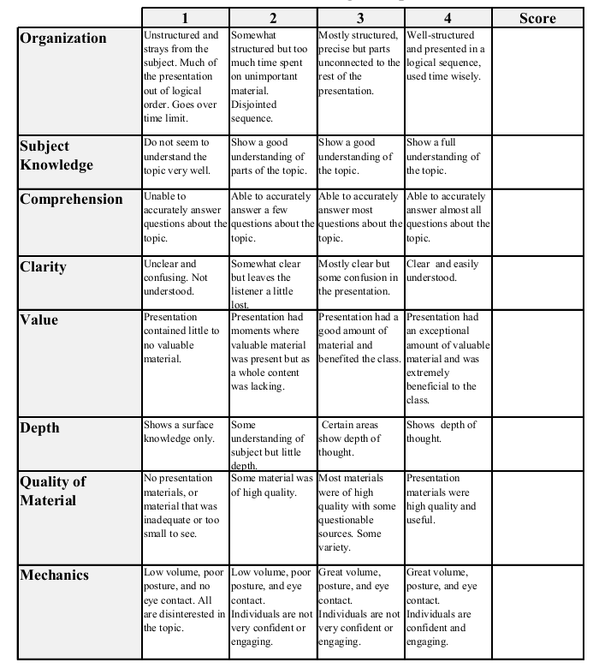
Political Affiliation and per capita income
Abby White

Slide 2
Research question
Is per capita income correlated to political party affiliation and how strong is this correlation?

Slide 3
variables
Per capita income
County
State
Rank in State
Political Party won in 2016 (Dependent)

Slide 4
Literature Review
Public Assumptions
Republicans are more wealthy per capita
Regional
Stronger correlation to physical region rather than income

Slide 5
Income Findings
Republicans | Observations | Mean | Standard Deviation | Min | Max
Per capita | 2,398 | 40016.13 | 10291.1 | 18255 | 156708
Democrats | Observations | Mean | Standard Deviation | Min | Max
Per capita | 681 | 42113.49 | 14692.12 | 16007 | 194861

Slide 6
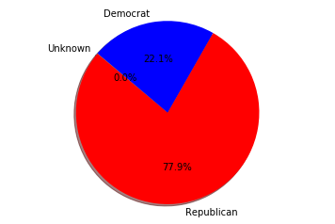
Party distributions
￼￼
3,080 counties
50 states plus D.C.

Slide 7
Regression results
Dependent Variable | Party
R squared | .0060
Adj. R squared | .0057
F- statistic | 18.69
 | Coefficient | Std. Error | t | P>|t| | 0.025 | 0.975
percap | -2.82e-06 | 6.51e-07 | -4.32 | 0.000 | -4.09e-06 | -1.54e-06

Slide 8
conclusion
There is a correlation between income and political party
Strong ties to where someone lives (also related to income)
Future Considerations
Look at previous elections as well as the 2016
Compare standard of living instead of per capita income

