Slide 1
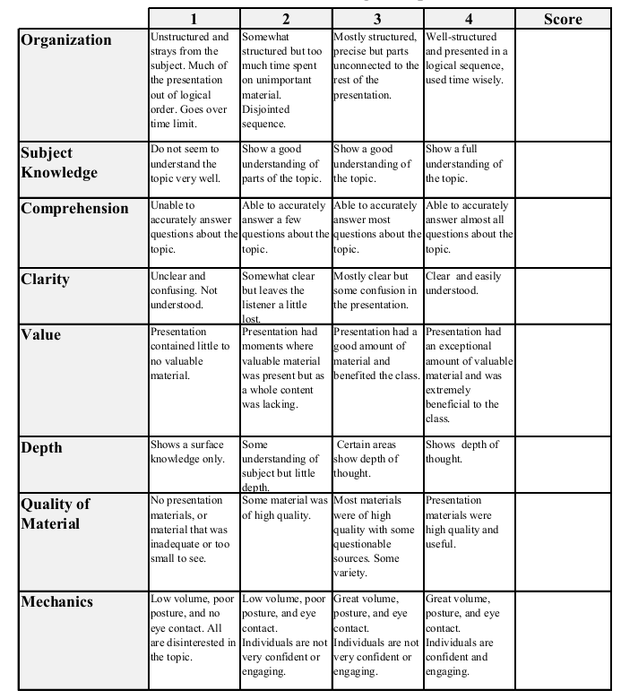
Econ 431 Data Presentation
Micah Torbert
Souleymane Kabore
December 5th, 2017
Analysis of the Exchange Rate Between US Dollar and the Chinese Yuan
Total:_________

Slide 2
Review: What Is “Pegged” Currency?
A pegged currency is a type of exchange rate regime where a currency’s value is fixed against the value of another single currency
Since the early 1970’s the Chinese yuan has been pegged to the U.S. dollar, but in 2005 it was taken off of this peg

Slide 3
What other Economists Have said
The market value of the yuan was appraised much higher than it was actually worth (J. Frankel, 2006)
This assumption was based on the Balassa–Samuelson relationship
Balassa–Samuelson relationship states: consumer price levels in richer countries are systematically higher than in poorer ones, which in turn creates the effect of productivity biased purchasing power parity

Slide 4
What is PPP?
Purchasing power parity is an economic theory that states that the exchange rate between two currencies is equal to the ratio of the currencies' respective purchasing power
Therefore, when compared to not just the US dollar, but other rich countries as well, the yuan was estimated to be substantially below even the equilibrium value for a country at China’s stage of development

Slide 5
The primary objective
Our goal was to evaluate the statistical impact of changes in macroeconomic variables on the exchange rate between the United States dollar and the Chinese yuan
More specifically we looked at the following variables:
The M1 Money Supply of the U.S.
(M1: All physical money, checking accounts, demand deposits, & negotiable order of withdrawal accounts)

Slide 6
Our Independent Variables
The United States M2 monetary metric
(M2: All of M1 as well as all savings deposits, money market securities, mutual funds and other time deposits)
The total value of all items being imported into China
The lead index of the United States
The net gold reserves of China

Slide 7
Our Independent Variables
The total value of all items being exported out of China
The Consumer Price Index (CPI) of transportation within the United States
The Consumer Price Index (CPI) of energy within the United States

Slide 8
Our Independent Variables
China’s Purchasing Power Parity (PPP)
The Korean M2 monetary metric
The Japanese M1 monetary metric
The net amount of oil production in the world

Slide 9
Our Dependent Variable
As stated previously, the dependent variable in our regression was the exchange rate between the USD and the CNY
We examined the monthly trends of this variable from 1982 to 2016
Also observed a negative slope in the graph after the year 2005

Slide 10
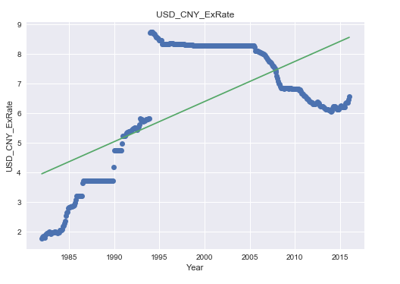
Visual Representation

Slide 11
Trends From the Graph
The exchange rate increases rapidly in favor of the U.S. dollar from 1984 to 1995
From 1995 to 2005 there was little variation in the exchange rate
After the year 2005 the exchange rate significantly decreases, in favor of the Chinese yuan

Slide 12
What Was Happening?
In the early 1990’s the yuan was systematically debased at a price ratio of roughly 3.7 CNY to 8.3 USD
Rapidly increases China’s exporting industry
In 2005 the Chinese was yuan was taken off of the U.S. peg due to political and economic pressures that were put on China by it’s trading partners

Slide 13
What Was Happening?
In 2006 the Chinese started buying US treasuries (a lot of them)
For a while this seemed to help the value of their currency appreciate faster

Slide 14
Our Method
Step One: Setup account with Quandl
Step Two: Received an authorization token so that we could extract data from the FRED website
Step Three: Drafted script that would extract the data we needed
Step Four: Ran script and extracted data
Step Five: Ran regression on collected data

Slide 15
Summary Statistics
Variable | Count | Mean | Std. Dev. | Min | Max
USD_CNY_ExRate | 409 | 6.254 | 2.111 | 1.771 | 8.725
Gold_China_2 | 409 | 873.853 | 1283.687 | 5.175 | 4010.834
US_M1_2 | 409 | 12.720 | 6.313 | 4.419 | 30.910
China_Value_of_Imports_2 | 409 | 44.967 | 54.178 | 1.388 | 183.013
US_M2_2 | 409 | 5.413 | 2.878 | 1.765 | 12.454
Lead_Index_US | 409 | 1.278 | 0.864 | -2.770 | 3.360
China_Exports_2 | 409 | 5.268 | 64.903 | 1.250 | 227.513
World_Oil_Prod | 409 | 89.946 | 12.636 | 66.635 | 135.509
US_CPI_Trans | 409 | 151.147 | 37.543 | 94.100 | 223.543
US_CPI_Energy | 409 | 143.661 | 55.505 | 82.100 | 271.149
China_PPI_HH_Durables | 409 | 175.221 | 40.361 | 97.800 | 246.800
Korea_M2_2 | 409 | 7.490 | 6.686 | 1.777 | 2.263
Japan_M1_2 | 409 | 2.874 | 1.899 | 7.223 | 6.403

Slide 16
Regression Equation
The equation describing our regression was:
China_US_Ex_Rate = (B₀ ) + (B₁ )*Gold_China_2 + (B₂ )*US_M1_2 + (B₃ )*China_Value_of_Imports_2+ (B₄ )*US_M2_2 + (B₅ )*Lead_Index_US + (B₆ )*China_Exports_2 + (B₇ )*World_Oil_Prod + (B₈ )* US_CPI_Trans + (B₉ )* US_CPI_Energy + (B₁₀ )* China_PPI_HH_Durables + (B₁₁ )* Korea_M2_2 + (B₁₂ )* Japan_M1_2.

Slide 17
Our Regression Results
Number of Observations: | 409
R-Squared: | 0.966
Adj. R-squared: | 0.965
F-statistic: | 949.4
Degrees of Freedom (model): | 12
Degrees of Freedom (resid): | 396
Variable | Coefficient | Std Error | p-value
Gold_China_2 | -0.0009 | 0.0000 | 0.0000
US_M1_2 | 0.4405 | 0.0320 | 0.0000
China_Value_of_Imports_2 | 0.0014 | 0.0040 | 0.7360
US_M2_2 | -2.4354 | 0.1640 | 0.0000
Lead_Index_US | -0.1452 | 0.0310 | 0.0000
China_Exports_2 | -0.0004 | 0.0030 | 0.8700
World_Oil_Prod | -0.0343 | 0.0060 | 0.0000
US_CPI_Trans | 0.0187 | 0.0080 | 0.0170
US_CPI_Energy | -0.0094 | 0.0040 | 0.0090
China_PPI_HH_Durables | 0.0794 | 0.0070 | 0.0000
Korea_M2_2 | 0.0036 | 0.0000 | 0.0000
Japan_M1_2 | 0.4261 | 0.0950 | 0.0000

Slide 18
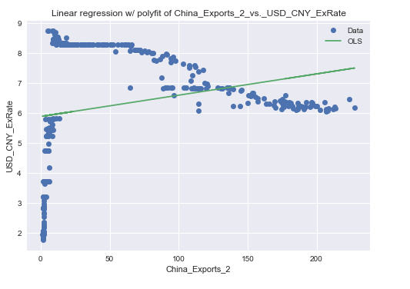
Regression Analysis

Slide 19
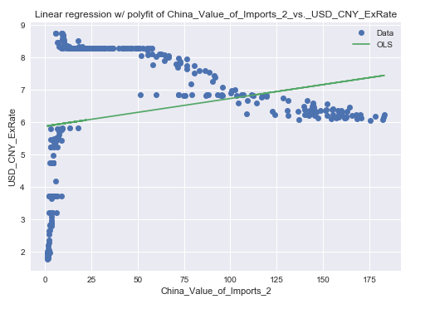
Regression Analysis

Slide 20
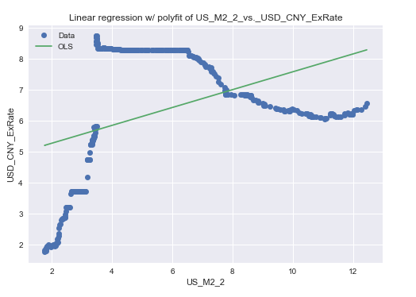
Regression Analysis

Slide 21
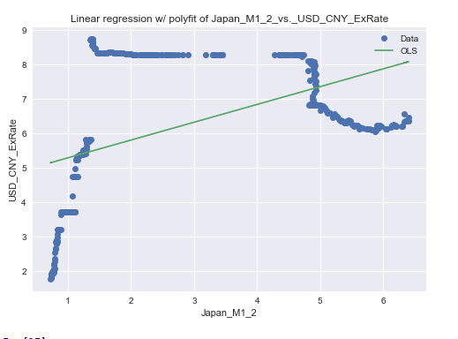
Regression Analysis

Slide 22
Problems We Ran Into
Trying to find data for the specified time interval proved to be rather difficult
Several independent variables that we sought out to collect data for did not correlate with the scope of our study
Limited variables to choose from via the Quandl platform
Could not remove 1995-2005 from data; may have caused collinearly among regression variables

Slide 23
Interpretation & Further Analysis
Based on the P-test (the P>|t| column), the least statistically significant macro-economic variables were:
The net value of imports from China
The net value of exports leaving China
(Basically China’s trade balance)

Slide 24
Conclusion(s):
The variable with the greatest impact on the dollar to yuan exchange rate, was the US M2 metric
There does indeed seem to be a great deal of correlation between the exchange rate, and most of the macroeconomic variables

Slide 25

3D Visualization

