Slide 1
Best Lunch Options
By Shaneka Vickerie

Slide 2
Introduction
I will be using categories, price, and ratings to determine the best lunch options.
Categories range between 1and 3.
Price symbol “$” is changed to a numerical number.
Ratings is between 1 and 5.

Slide 3
Data
I used Yelp Fusion to scrape data.
I observed 200 restaurants.
I initially had technical issues will getting 200 observations.
I cleaned the data to find all the ratings, categories, and prices.

Slide 4
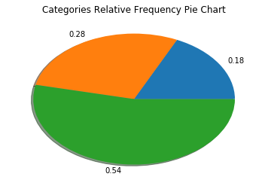
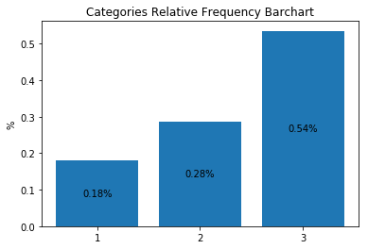
Results

Slide 5
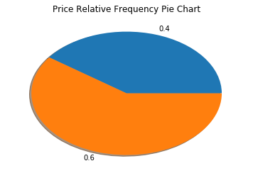
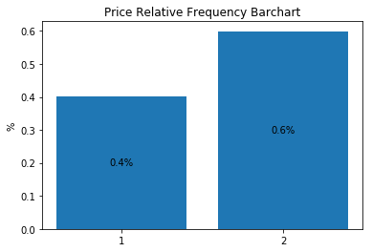
Results

Slide 6
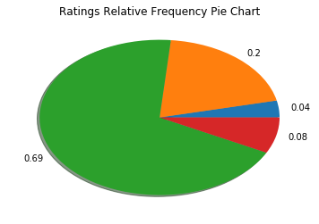
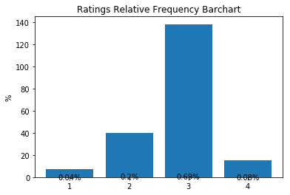
Results

Slide 7
Results
 | Categories | Price | Ratings
Mean | 2.4 | 1.6 | 4.4
Standard Deviation | .8 | .5 | .3
Minimum | 1 | 1 | 3.5
Maximum | 3 | 4 | 5
Count | 200 | 200 | 200

Slide 8
Conclusion
For the best restaurants with lunch I used the average of ratings, price, and categories since it might be hard to find it manually.
Common Ground
McFaul’s Iron Horse Tavern
Uncle Wiggly’s Deli & Ice Cream
Atwater’s Belvedere
Falafel House

Slide 9
Conclusion
This is good because it will increase competition.
If I can do something better I would find a better way to determine the best lunch options.
If I were to use Yelp Fusion again I would try to find the best travel destination based on hotels around the world.

Slide 10
Refrences
Glaeser, Edward L., et al. "Nowcasting the Local Economy: Using Yelp Data to Measure Economic Activity." NBER Working Papers, 13 Nov. 2017, p. 2. EBSCOhost, proxy-tu.researchport.umd.edu/login?ins=tu&url=http://search.ebscohost.com/login.aspx?direct=true&db=edb&AN=126398887&site=eds-live&scope=site.
Orso, Valeria, et al. "Overlaying Social Information: The Effects on Users’ Search and Information-Selection Behavior." Information Processing and Management, vol. 53, 01 Nov. 2017, pp. 1269-1286. EBSCOhost, doi:10.1016/j.ipm.2017.06.001.
Pantano, Eleonora, et al. "‘You Will Like It!’ Using Open Data to Predict Tourists' Response to a Tourist Attraction." Tourism Management, vol. 60, 01 June 2017, pp. 430-438. EBSCOhost, doi:10.1016/j.tourman.2016.12.020.
Sabharwal, Chaman Lal and Bushra Anjum. "An SVD-Entropy and Bilinearity Based Product Ranking Algorithm Using Heterogeneous Data." Journal of Visual Languages and Computing, vol. 41, 01 Aug. 2017, pp. 133-141. EBSCOhost, doi:10.1016/j.jvlc.2017.06.001.
Weijia, Dai, et al. "Optimal Aggregation of Consumer Ratings: An Application to Yelp.Com." New This Week, 03 Dec. 2012, p. 1. EBSCOhost, proxy-tu.researchport.umd.edu/login?ins=tu&url=http://search.ebscohost.com/login.aspx?direct=true&db=edb&AN=85331117&site=eds-live&scope=site.

