Slide 1
Basics for Econ 201 and Econ 202
Chapter 1 - 4

Slide 2
What is Economics?
Economics is the study of the choices mad by people when there is scarcity.
Scarcity is a situation in which resources are limited in quantity and can be used in different ways.
Without scarcity the problem of choice would be an easy one, just take everything, always!

Slide 3
Society’s Choices
The decisions of producers, consumers and government determine how an economic system answers three fundamental questions:
What products do we produce?
How do we produce these products?
Who consumes the products?

Slide 4
Factors of Production
The resources used for production are called factors of production:
Natural resources
Labor
Natural resources
Labor
Physical capital
Human capital
Entrepreneurship

Slide 5
Factors of Production
Natural resources:
The things created by acts of nature such as land, water, mineral, oil and gas deposits, renewable and nonrenewable resources.
Labor:
The human effort, physical and mental, used by workers in the production of goods and services.

Slide 6
Factors of Production
Physical capital:
All the machines, buildings, equipment, roads and other objects made by human beings to produce goods and services.
Human capital:
The knowledge and skills acquired by a worker through education and experience.

Slide 7
Factors of Production
Entrepreneurship:
The effort to coordinate the production and sale of goods and services. Entrepreneurs take risk and commit time and money to a business without any guarantee of profit.

Slide 8
Production Possibility Frontier (PPF)
Describes the combinations of products that are possible given resources and technological know-how
Shows the production options
An economy should always produce “on the curve”

Slide 9
Production Possibility Frontier (PPF)
The PPF curve shows the possible combinations of goods and services available to an economy, given that all productive resources are fully and efficiently employed.
Tons of factory goods
Tons of farm goods

Slide 10
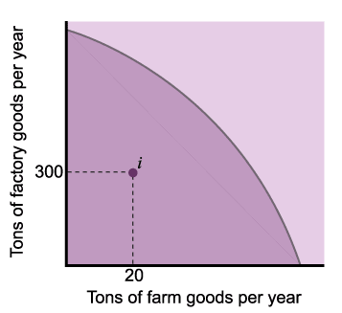
The Production Possibilities Frontier (PPF) Curve
When the economy is at point i, resources are not fully employed and/or they are not used efficiently.

Slide 11
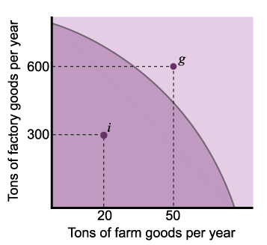
The Production Possibilities Frontier (PPF) Curve
Point g is desirable because it yields more of both goods, but not attainable given the amount of resources available.

Slide 12
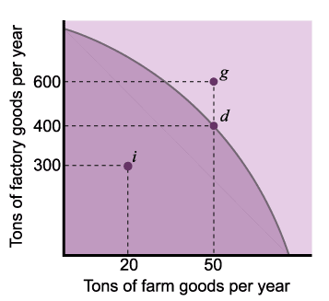
The Production Possibilities Frontier (PPF) Curve
Point d is one of the possible combinations of goods produced when resources are fully and efficiently employed.

Slide 13
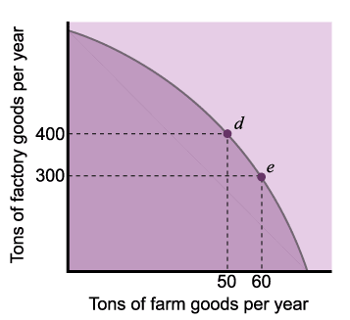
Scarcity and Production Possibilities Curve
To increase the amount of farm goods by 10 tons, we must sacrifice 100 tons of factory goods.

Slide 14
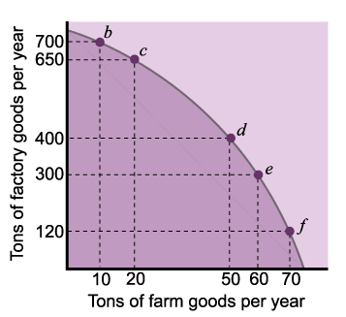
The Production Possibilities Frontier (PPF)
The PPF curve is bowed out because resources are not perfectly adaptable to the production of the two goods.
As we increase the production of one good, we sacrifice progressively more of the other.

Slide 15
Shifting the PPF
If economy acquires more resources the entire curve shifts outward.
What happens during a war?
Tons of factory goods
Tons of farm goods

Slide 16
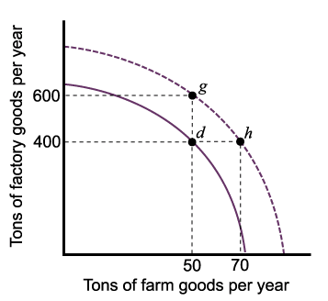
Shifting the Production Possibilities Frontier Curve
The PPF curve shifts outward as a result of:
An increase in the economy’s resources, or
A technological innovation that increases the output obtained from a given amount of resources.

Slide 17
Markets
A market is an arrangement that allows buyers and sellers to exchange things, trading what they have for what they want.
Markets determine the price of goods and services purely by bringing together people who act in their self interest.
The invisible hand.

Slide 18
Adam Smith’s Idea
“It is not from the benevolence of the butcher, the brewer, or the baker that we expect our dinner, but from their regard to their own interest. We address ourselves, not to their humanity but to their self-love, and never talk to them of our own necessities but of their advantages. [Man is] led by an invisible hand to promote an end which was not part of his intention …. By pursuing his own interest he frequently promotes that of the society more effectually than when he really intends to promote it.”

Slide 19
Efficiency Idea of Market Economies
Competitive markets are (Pareto-)efficient

Slide 20
Positive and Normative Economics
Positive economics answers the questions
What is or
What will be?
Normative economics answers the question
What ought to be?

Slide 21
Think About the Underlying Assumptions
In economic modeling we use many assumptions.
Assumptions are generalizations or simplifications that make a model more tractable or workable by eliminating irrelevant details.
How do we know which details are irrelevant?

Slide 22
The Two Main Assumptions in this Course are
People are self interested.
There is solid evidence hat most people act in their own interest in many (not all) situations. Hence the economic analysis in this course is relevant for a wide range of decisions.
People make informed (rational) decisions.
People observe prices and then decide whether to buy or sell etc.
There are also models that deal with asymmetric information etc.

Slide 23
Graphs
To illustrate relationships between variables.
Make sure you understand how to draw a positive and negative relationship between two variables in a 2-dimensional graph.
Computing the slope of a curve
Slope=vertical difference between 2 points/horizontal difference between the 2 points.

Slide 24
The Slope
Linear curve
y=k£x + d
y
k=vertical distance/ horizontal distance
d
x

Slide 25
Linear and Nonlinear Relationships
Positive nonlinear, decreasing rate
Positive nonlinear, increasing rate
Negative linear
Tapes purchased in a month
Cost of production
Points at exam
CDs purchased in a month
Study time in hours
Tons of grain produced

Slide 26
Computing Percentage Changes
Percentage change =
(absolute change/initial value)£100

Slide 27
Opportunity Cost Principle
The opportunity cost of something is what you sacrifice to get it.
You calculate the opportunity cost of something by picking the best alternative to it.
The principle of opportunity cost also explains why the production possibilities frontier is negatively sloped.

Slide 28
Opportunity Costs
What is the opportunity cost of military spending?
What is the opportunity cost of a college degree?

Slide 29
Marginal Thinking
A small change in one variable is called a marginal change.
We denote marginal changes is say, variable y, as:
Δy (delta y) or
y’

Slide 30
Marginal Cost and Marginal Benefit
Marginal Benefit (MB): is the extra benefit resulting from small (one unit) increase in an activity.
Marginal Cost (MC): is the extra cost resulting from a small (one unit) increase I an activity.
Increase the level of an activity if marginal benefit is larger than marginal cost.
Does a one unit increase of something make us better off?

Slide 31
The Marginal Principle and TV Time
MC with pedaling
1.20
Benefit or cost in $ per hour
MC without pedaling
0.35
MB
3
20
Hours of TV time per week

Slide 32
Principle of Diminishing Returns
Example:
1 copy machine and 1 worker produce 1000 pages.
1 copy machine and 2 workers produce how many pages?
1 copy machine and 100 workers produce how many pages?
As we increase the number of workers and hold the number of copy machines constant output per additional worker decreases.

Slide 33
Production Curve
With 1 copy machine
Pages produced
1800
1000
1
2
Number of workers

Slide 34
Marginal Product of Labor
With 1 copy machine
Pages produced per worker
1000
800
1
2
Number of workers

Slide 35
The Short Run
Is the time period over which one or more variable are fixed (wages, factors of production etc.)
In the long run most variables are flexible.
In the long run, more photo copy machines would be acquired and we would not see diminishing returns to labor. Since firms can duplicate or replicate production facilities.

Slide 36
Spillover Principle - Externalities
A cost of benefit by people who are external to the decision about how much of a good to produce or consume (externalities).
Pollution
Secondhand smoke
Scientific discovery
Unregulated markets often make decisions disregarding externalities. Gov’t intervention can help in such cases.

Slide 37
Consumer Demand
What affects consumer demand?
Price of the product
Consumer income
Price of substitute goods
Price of complementary goods
Consumer tastes and advertising
Consumer expectations about future prices
Item 2 to 6 are held constant in the demand schedule.

Slide 38
Law of Demand
Holding 2-6 constant the demand curve is downward sloping.
That is, as prices increase, demand goes down.

Slide 39
Market Demand
John’s demand
Mary’s demand
Market demand
Price per pizza in $
8
4
2
6
Pizzas per month
Pizzas per month
Pizzas per month

Slide 40
When Prices Change
Income effect
Substitution effect

Slide 41
The Supply Curve
Sellers decisions are influenced by
Price of the product.
Cost of the inputs used in production (e.g. wages, cost of electricity, etc.).
State of production technology.
Number of producers in the market.
Producer expectation about future prices.
Taxes or subsidies from the government.

Slide 42
Law of Supply
As prices increase, supply increases.
Upward sloping supply curves.
The marginality principle.
Marginal Cost
10
MB or MC in $
8
Pizzas per month
300
400

Slide 43
Supply Curves and Market Supply
Firm 1 supply
Firm 2 supply ….Firm n
Market supply
Price per pizza in $
4
100
100
10,000
Pizzas per month
Pizzas per month
Pizzas per month

Slide 44
Market Equilibrium
When the quantity of the product supplied equals the quantity of the product demanded, this is called a market equilibrium.
In equilibrium there is no pressure to change the price.

Slide 45
Excess Demand
Excess demand causes prices to rise.
Consumers are willing to buy more than producers are willing to sell.
Firms will increase the selling price for their limited supply of pizza and
Anxious consumers will pay the higher price to get one of the rare products.

Slide 46
Price Increase
As prices increase two things will happen,
Fewer goods are demanded as the market moves upward on the demand curve.
More goods are supplied as the market moves up the supply curve.
Hence the gap between quantity demanded and supplied narrows.
Price continuous to rise until excess demand is eliminated.

Slide 47
Excess Supply
Excess supply causes prices to drop.
Producers are willing to sell more than consumers are willing to buy.
To sell the extra goods firms lower prices.
The market moves downward along the demand curve as prices drop.
The market moves downward on the supply curve.

Slide 48
Excess Supply and Excess Demand
Excess supply at p=10
10
8
6
Excess demand at p=6
Pizzas per month
15
30
50

Slide 49
Market Effects of Demand Changes
What shifts the demand curve to the right?
Income increase (given it is a normal good).
Increase in price of a substitute good.
Decrease in price of a complementary good.
Increase in population.
Shift in consumer tastes.
Favorable advertising.
Expectations of higher future prices.
The effect is an excess demand → prices go up.

Slide 50
Inferior Goods
As income increases the demand for these goods goes down.
Goods with a more expensive alternative.
E.g. margarine and butter. If you have a higher income you might switch to the better quality product.
Used clothing
Intercity bus travel

Slide 51
Market Effects of Supply Changes
Supply increases , shifts to the right, if
Decrease in inputs costs
Advance in technology
Increase in the number of producers
Expectations of lower future prices
Subsidy.
As supply shifts to the right, excess supply → prices drop.

Slide 52
Demand And Supply Shifts
When both, demand and supply increase, then the quantity ‘traded’ increases.
The price depends on the magnitude of supply change vs. demand change.

