Slide 1
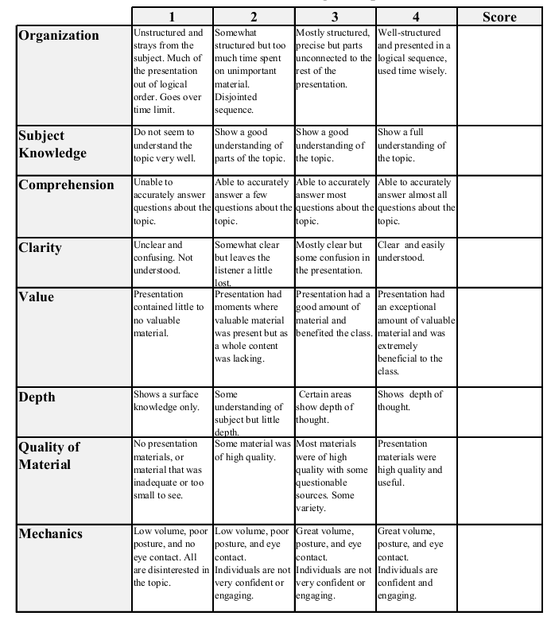
Econ 431 Presentation 2
Claudia Gomes & Virginia Amerman
April 13, 2016
Graduation Rates & Rate My Professor
Total:_________

Slide 2
Graduation Rates and Rate My Professor
Claudia Gomes & Virginia Amerman

Slide 3
Our Project
Is there a correlation between ratings from Rate My Professor and College Graduation Rates for Maryland?
What determines Rate my Professor scores:
Reputation
Internet
Opportunity
Campus
Social
Location
Food
Library
Clubs
Happiness

Slide 4
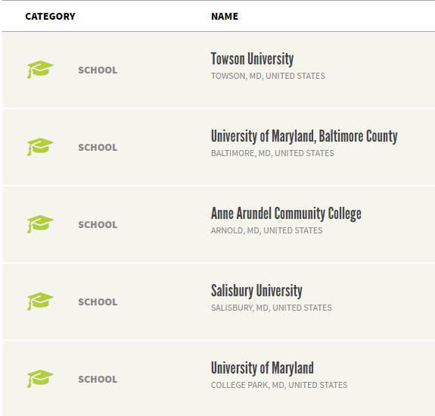
Web Scrapping Rate My Professor

Slide 5
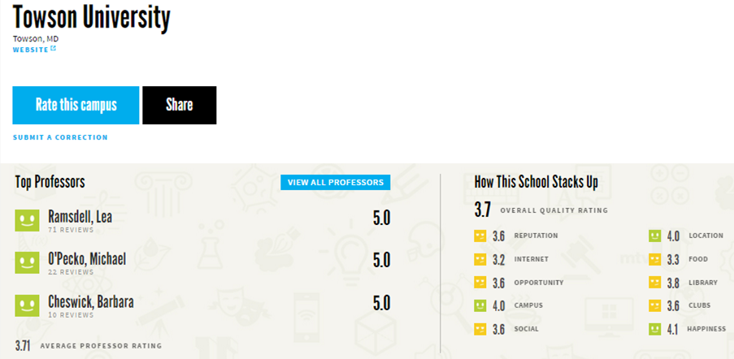

Slide 6
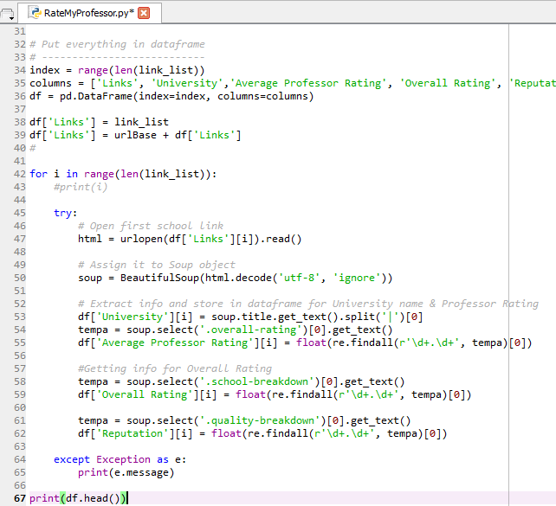

Slide 7
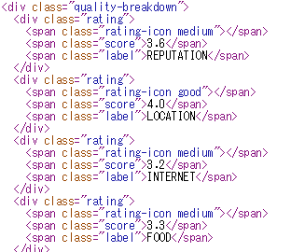

Slide 8

Our Data

Slide 9
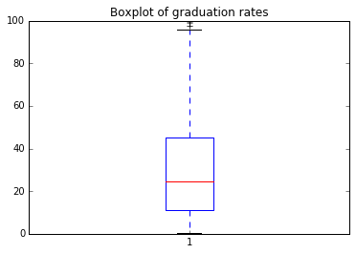
4 Year Graduation Rates
Number of schools counted=3248
Min= 0.299
Max=100.0
Mean=30.2769
Variance=522.21693174904919
Skewness=0.8230
Median=24.75

Slide 10
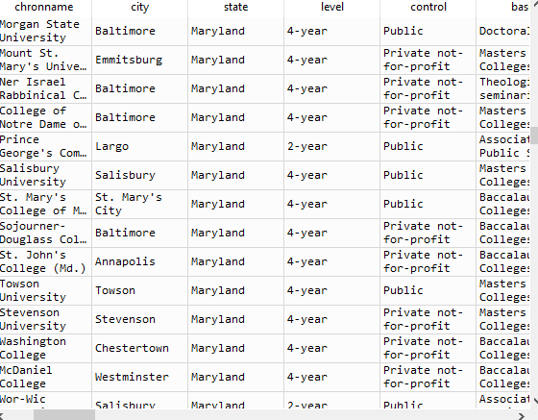
Data Problems
44 Maryland Colleges
Dummy variables for states
Cleaning data

