Slide 1
Best Bars In Baltimore
By: Nicole Delgado & Brian Jensen
aka: Where the While Ones Are

Slide 2
New Project Description
Finding best bars in Baltimore based on Yelp star ratings and number of reviews
Python tools used:
Yelp API
Pandas

Slide 3
API
Obtaining API (application)
Using the API→ https://www.yelp.com/developers/documentation/v2/search_api

Slide 4
Problems Faced
Getting more than 20 results (offset, limit of 20)
**params

Slide 5
Code Problem
params = {'term': 'restaurants','lang': 'en'} res = client.search('Baltimore', )
res1 = client.search('Baltimore', offset=20, limit=20)
res2 = client.search('Baltimore', limit=20, offset=40) res3 = client.search('Baltimore', limit=20, offset=60)
for i in range(len(res.businesses)): print(res.businesses[i].name) print(res.businesses[i].rating) print('-------------------') for i in range(len(res1.businesses)): print(res1.businesses[i].name) print(res1.businesses[i].rating) print('-------------------') for i in range(len(res2.businesses)): print(res2.businesses[i].name) print(res2.businesses[i].rating) print(res2.businesses[i].deals) print('-------------------') for i in range(len(res3.businesses)): print(res3.businesses[i].name) print(res3.businesses[i].rating) print(res3.businesses[i].deals) print('-------------------') res3=res,res1,res2 print (res3)

Slide 6
Code Problem Fixed
business_list = [] rating_list = [] review_count = [] for i in range(388): params = {'term': 'sports bars','lang': 'en'} res1 = client.search('Baltimore', **params, offset=i) for t in range(1): print ('t:',t) n = res1.businesses[t].name print(n) business_list.append(n) r = res1.businesses[t].rating print(r) rating_list.append(r) rev = res1.businesses[t].review_count review_count.append(rev) print(rev) print('-------------------') t=t+1

Slide 7
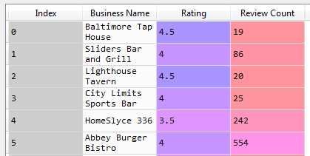
Data Frame

Slide 8
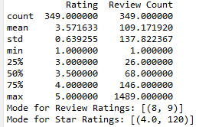
Simple Summary Statistics

Slide 9
What the future beholds
Map
Dropping businesses with less than 8 reviews
Regression
Price filter and other variables

