Slide 1
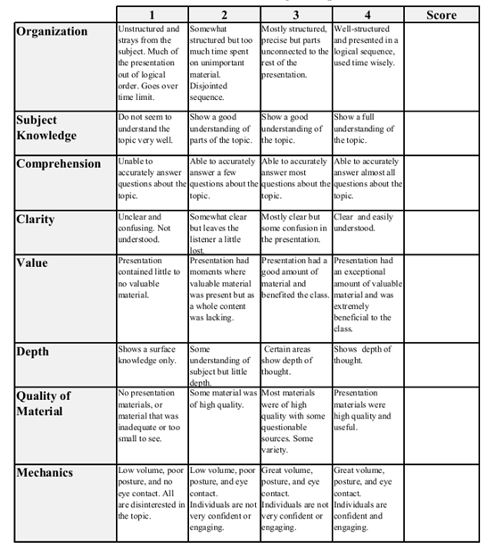
Political Affiliation vs Household Income
By: Annie Maras and Abby White

Slide 2
Specified Topic
Correlation between political party and household income
Districts of Maryland
Gerrymandering
Bias in media

Slide 3
Literature
Differences between Obama/Romney election and Clinton/Trump election
Liberal leanings vs conservative leanings in media
Initial findings
Democratic Households are wealthier than Conservative Households

Slide 4
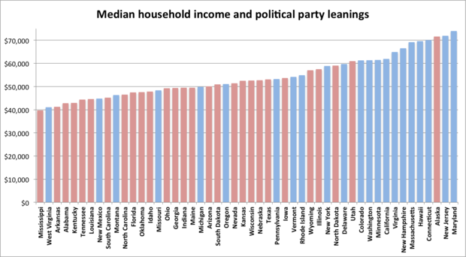

Slide 5
Data
Political party results by county
Characteristics of voters
Maryland wealthiest citizens

Slide 6
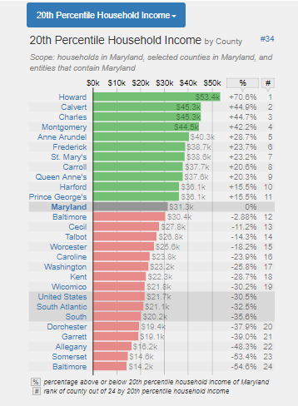
Richest Counties

Slide 7
Sources
Exner, R. R. (2015, September 18). Blue states, red states; rich states, poor states; politics and household income. Retrieved from http://www.cleveland.com/datacentral/index.ssf/2015/09/blue_states_red_states_rich_st.html
October 2016 Political Survey. (2017, May 12). Retrieved from http://www.people-press.org/dataset/october-2016-political-survey/
Savchuk, K. (2015, July 01). Are America's Richest Families Republicans or Democrats? Retrieved from https://www.forbes.com/sites/katiasavchuk/2014/07/09/are-americas-richest-families-republicans-or-democrats/#48ddf31d3e83
Thompson, D. (2012, November 05). Does Your Wage Predict Your Vote? Retrieved from https://www.theatlantic.com/business/archive/2012/11/does-your-wage-predict-your-vote/264541/

Slide 8
Sources continued.
Household Income in Maryland (State). (n.d.). Retrieved October 04, 2017, Retrieved from:
https://statisticalatlas.com/state/Maryland/Household-Income#figure/state-in-united-states/six-figure-incomes
Elections, M. S. (2016, October 26). By County. Retrieved October 04, 2017, from
http://www.elections.state.md.us/voter_registration/stats.html

