Slide 1
Hotels and Events
Are reviews of hotels more favorable after a large scale event?

Slide 2
Introduction
Reviews of hotels determine who stays there.
Cities have large scale events all the time.
Do people staying in a hotel write a good review after an event?

Slide 3
Online Reviews
Torres, Singh, and Robertson-Ring (2015)
found reviews played a role in hotel performance.
Even over traditional business tactic's.
More online reviews were found to impact profitability as well.
Getting people to write reviews helps.

Slide 4
Hospitality Online Reviews
Neirotti, Ragueseo, and Paolucci (2016)
Customer reviews help small and medium sized hotels.
No impact on revenue margins.
Reviews have a significant impact and are changing the hotel industry.

Slide 5
Online Reviews
Hu and Chen (2016)
Used Data mining techniques to evaluate reviews.
Determined good reviews and models for them.
Applied this to two different cities with different results.

Slide 6
Performance
Tang (2017)
People use online sites for products of all kinds.
Information gathering phase.
Managers should look to maintaining an online image.
Through their site and other third-party sites.

Slide 7
Predictability
Moro, Rita, Coelho (2017)
Used a similar methodology to create a model
Seasons were included in the model.
Accurately predicted hotel performance on the Las Vegas Strip.

Slide 8
Furthering the Literature
We are using similar techniques to determine if timing impacts reviews.
If more reviews are written does that mean more business?
When are these reviews written?

Slide 9
Works Cited
Hu, Ya-Han and Kuanchin Chen. “Predicting hotel review helpfulness: the impact of review visibility and interactions between hotel stars and review ratings.” International Journal of Information Management. Vol 36, 2016. 929-944. https://ac-els-cdn-com.proxy-tu.researchport.umd.edu/S0268401215301845/1-s2.0-S0268401215301845-main.pdf?_tid=e99bdd20-a967-11e7-a1eb-00000aab0f6c&acdnat=1507165122_d9e68dcf9384a94cb6c20173a04445e5.
Neirotti, Paolo, Elisibetta Raguseo, and Emilio Paolucci . “Are customers’ reviews creating value in the hospitality industry?” International Journal of Information Management. Vol 36, 2016. 1133-1143. http://www.sciencedirect.com.proxy-tu.researchport.umd.edu/science/article/pii/S0268401216301049?_rdoc=1&_fmt=high&_origin=gateway&_docanchor=&md5=b8429449ccfc9c30159a5f9aeaa92ffb
Moro, Sergio, Paulo Rita, and Joanna Coelho. “Stripping customers’ feedback on hotels through data mining: The case of the Las Vegas Strip.” Tourism Management Perspectives. Vol 23, 2017. 41-52. https://www-sciencedirect-com.proxy-tu.researchport.umd.edu/science/article/pii/S2211973617300387
Torres, Edwin, Dipendra Singh, and April Robertson-Ring. “Booking reviews and the creation of hotel transactional value: Lessons from the hotel industry.” International Journal of Hospitality Management. Vol 50, 2015. 77-83. https://www-sciencedirect-com.proxy-tu.researchport.umd.edu/science/article/pii/S0278431915001127
Linghui, Tang. "Mine Your Customers or Mine Your Business: The Moderating Role of Culture in Online Word-Of-Mouth Reviews." Journal of International Marketing, vol. 25, no. 2, June 2017, pp. 88-110.EBSCOhost, proxy-tu.researchport.umd.edu/login?ins=tu&url=http://search.ebscohost.com/login.aspx?direct=true&db=buh&AN=123750247&site=eds-live&scope=site.

Slide 10
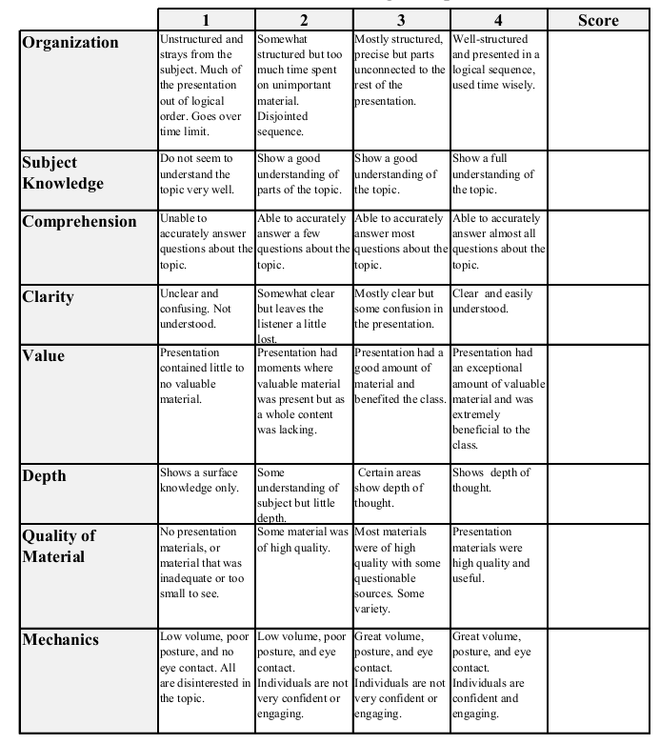
Econ 431 Final Presentation
Your names
Date of presentation
Title of presentation
Total:_________

