Slide 1
The Impact of Concussions on High School Athletics
By: Curtis Mack

Slide 2

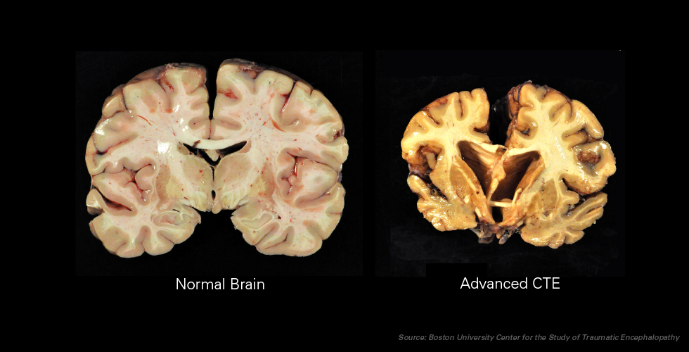
Recent Head Lines
Alex Hernandez was found to have CTE

Slide 3
CTE
chronic traumatic encephalopathy
progressive degenerative disease of the brain found in people with a history of repetitive brain trauma
Athletes
Memory loss, confusion, mood swings, and dementia
Doctor first notice symptoms in boxers in 1920s

Slide 4
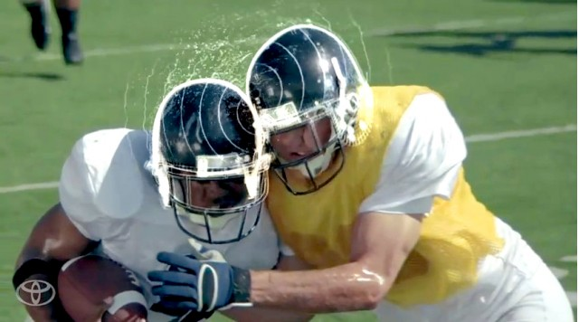
Concussion
is a type of traumatic brain injury that causes the head and brain to move rapidly back and forth

Slide 5
Video
https://youtu.be/PYsK0u5WWrw

Slide 6
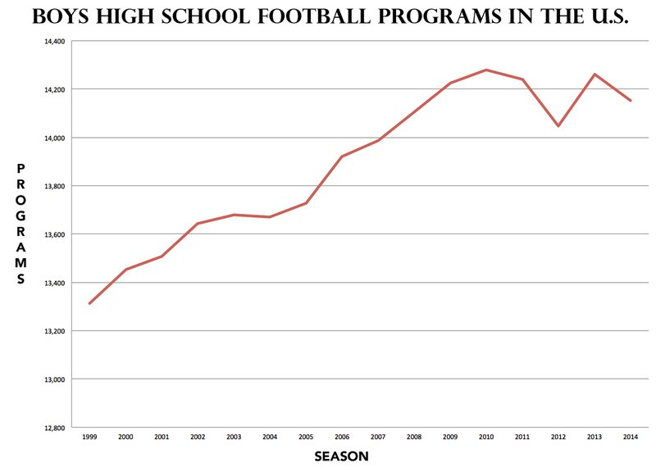
Data and Research Regarding High School Athletes

Slide 7
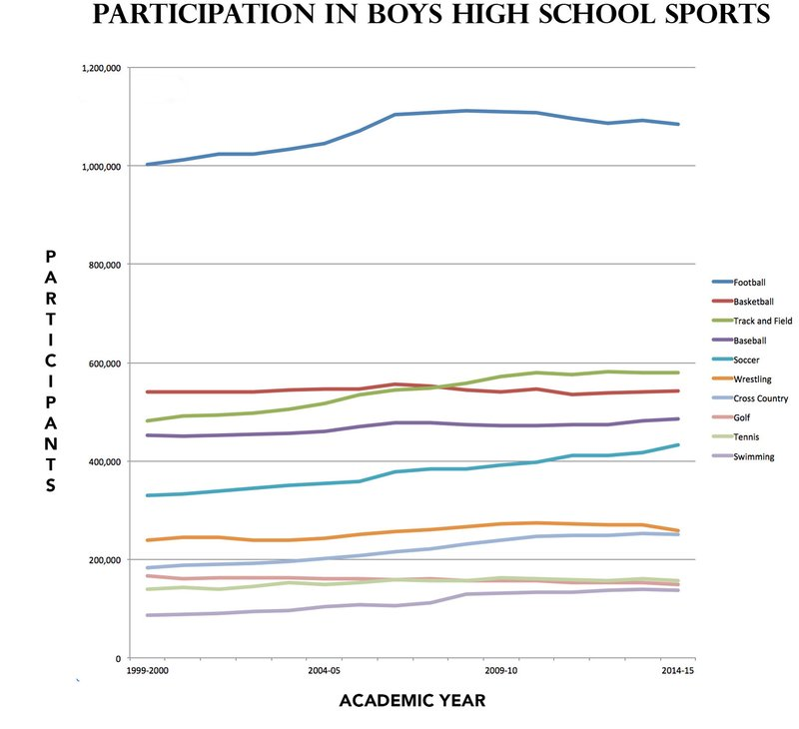

Slide 8
Web Scraping and Data Collection
Has Concussion cause a drop in High school sport participation?
What research is being done on High school athletes?
What impact does Concussion have on student athletes grades?

