Slide 1
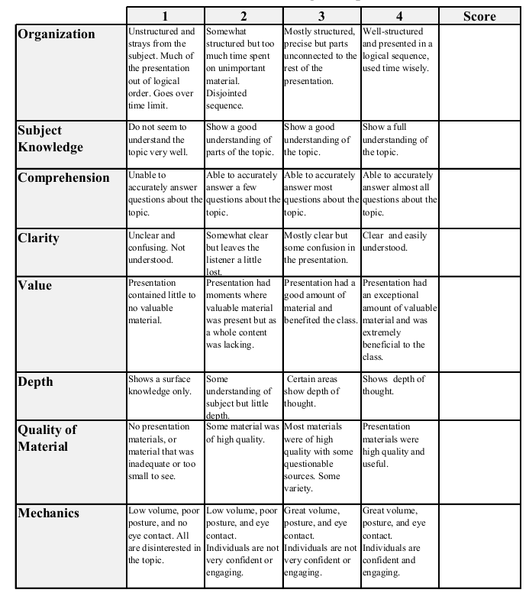
Econ 431 Final Presentation
Micah Torbert
Souleymane Kabore
October 5th, 2017
Analysis of the Exchange Rate Between US Dollar and the Chinese Yuan
Total:_________

Slide 2
What Is “Pegged” Currency?
A pegged currency is a type of exchange rate regime where a currency’s value is fixed against the value of another single currency
Since the early 1970’s the Chinese yuan has been pegged to the U.S. dollar, but in 2005 it was taken off of this peg

Slide 3
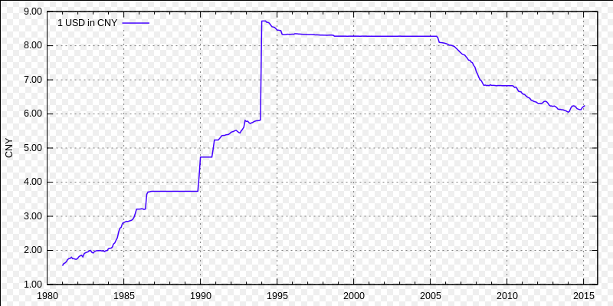
USD vs. CNY (1980-2015)
Figure 1 Source: https://www.federalreserve.gov

Slide 4
Previous Studies
According to economists such as Jerry Frankel, there are arguments that support the view that the dollar peg had long outlived its usefulness for China before 2005
Foreign exchange reserves are a useful shield against currency crises however;
China’s monetary system has been growing at a steady pace
US treasury securities do not pay a high return

Slide 5
Previous Studies (cont’d)
According to Kang, Ratti, and Vespignani, rolling sample analysis indicated that rapid money growth in China would increase the demand for dollars
However, forecasts are to the contrary for the mid 2000’s (before the renminbi left the dollar peg)

Slide 6
Previous Studies (cont’d)
With the break from a dollar peg in 2005 and subsequent currency appreciation, the distortion was eased and the forecast direction for the dollar became as expected
This was where we saw the negative slope depicted in figure 1

Slide 7
What We Are Trying to Find
The correlation between certain exogenous macro-economic variables and the exchange rate of the US Dollar to the Chinese Yuan, more specifically the M1 money supply of China
We will also attempt to conclude whether or not these exogenous variables impact this relationship either negatively or positively

Slide 8
We Also Want to Find Out..
As Kang, Ratti, and Vespignani insinuated, did money growth in China’s currency increase the demand for U.S. dollars? Or were there other factors that lead to this increase in demand?
If so, what were they?

Slide 9
Our Proposed Method
Using the Quandl package that we will download into our Python library we will extract data from the FRED website
We will then import this data into spyder and plot it accordingly using the math plot library

Slide 10
Our Proposed Method (cont’d)
In addition to these visual aids, we will use the correlate function in the numpy library to compute the correlation coefficients between various sets of vectors holding the data we have imported
We will then use these coefficients to draw a conclusion in regards to which exogenous variables have the most significant impact on the USD/CNY exchange rate

Slide 11
Works Cited
Barros, C.P., Gil-Alana, L.A. & Chen, Z. Empir Econ (2016) 51: 1399. doi:10.1007/s00181-015-1063-3
Bauwens, L., Koop, G., Korobilis, D., & Rombouts, J. (2014). The contribution of structural break models to forecasting macroeconomic series. Journal of Applied Econometrics, 30, 596–620.
Cline, William and John Williamson, “Estimates of the Equilibrium Exchange Rate of the Renminbi: Is There a Consensus and, If Not,Why Not?” in Morris Goldstein and Nicholas Lardy (eds), Debating China’s Exchange Rate Policy, Washington: Peterson Institute for International Economics Policy (2008). “Notes on Equilibrium Exchange Rates: January 2010,” Peterson Institute for International Economics policy brief 10-2 (2010).

Slide 12
Works Cited
Coudert, Virginie and Cécile Couharde, “Real Equilibrium Exchange Rate in China: Is the Renminbi Undervalued?” Journal of Asian Economics 18 (2007):568–94.Jeong, Se-Eun and Jacques Mazier, “Exchange Rate Regimes and Equilibrium Exchange Rates in East Asia,” Revue Économique 54 (2003):1161–82.
Frankel J. On the Yuan: The Choice between Adjustment under a Fixed Exchange Rate and Adjustment under a Flexible Rate. Cesifo Economic Studies [serial online]. June 2006; 52(2):246-275. Available from: SocINDEX with Full Text, Ipswich, MA. Accessed April 23, 2017.
Frankel, J. A. (2009). New estimation of China’s exchange rate regime. Pacific Economic Review, 14(3), 346–360.
Goldberg, L. S. (2011). The international role of the dollar: Does it matter if this changes? FRB of New York Staff Report522

