Slide 1
Externalities in the Competitiveness of NBA Basketball
Alex Bennett
Joe Nickens

Slide 2
Hypothesis
The Western Conference of the NBA is more attractive to superstars than the Eastern Conference. Therefore resulting in more championships than the Eastern Conference in the last 20 years.

Slide 3
Analysis of competitiveness in the NBA Regular Season
The article measures overall competitiveness of NBA through the years of 1993-2009
Competitiveness was measured using an equation that measured the level of uncertainty in outcome of each game

Slide 4
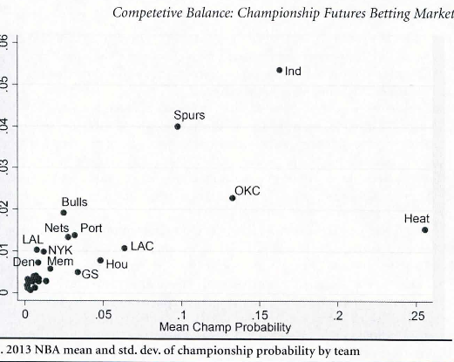
Competitive Balance
This article proposes a competitive balance measure at the start of the season and suggest that the more favorable teams to win have a higher standard deviation.

Slide 5
The Methods of Analyzing & Evaluating NBA's Competition Agenda
The article suggests that the NBA puts the Western Conference teams at a disadvantage by having longer travel distances and longer road trips when compared to the Eastern Conference

Slide 6
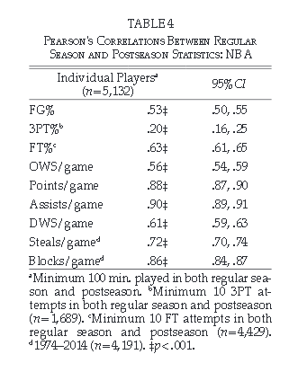
Player Statistics
This article provides an analyzes NBA Statistics from the regular season going into the post season and how they correlate to winning.
NBA statistics such as team FG% 3PT% FT% OWS/game Points/game Assists/game DWS/game Steals/game Blocks/game

Slide 7
How to Gather the Data
Web scrape FG% 3PT% FT% OWS/game Points/game Assists/game DWS/game Steals/game Blocks/game Home/Away Records East vs West win % Team Salary Cap and Top Scorers in games from NBA.com
Web scrape Ticketmaster.com for ticket prices
Location of team’s Median Household Income

Slide 8
Goals
Create formulas to measure the importance of individual variables such as
Game Attendance
Travel Distance
Climate of team location
Player Injuries

Slide 9
Works Cited
Guerra, Yves De Saá, Juan Manuel Martín González,, and Nieves Arjonilla López. "ANALYSIS OF COMPETITIVENESS IN THE NBA REGULAR SEASONS." SPORTAS 80th ser. 7 (2011): 17-21. Towson. Web. 20 Mar. 2016.
McEwen, Wayne, and Neil E. Metz. "International Journal of Sport Finance." Competitive Balance: Championship Futures Betting Markets 11 (2016): 63-78. Towson. Web. 20 Mar. 2016
Zhu, Hong Su. "The Methods of Analyzing & Evaluating Nba's Competition Agenda." Journal of Mathematics & Informatics 2 (2014): 31-37. Towson. Web. 20 Mar. 2016.
Otton, Mark P., and Travis J. Miller. "Perceptual & Motor Skills: Exercise & Sport." A BALANCED TEAM WINS CHAMPIONSHIPS: 66 YEARS OF DATA FROM THE NATIONAL BASKETBALL ASSOCIATION 121.3 (2015): 654-65. Towson. Web. 20 Mar. 2016.

