Slide 1
Maryland Corporate Income Tax (CIT)
Tra Nguyen

Slide 2
Idea.
Create a simple model to predict Corporate Income Tax in Maryland at different tax rate.
Find an optimal tax rate.

Slide 3
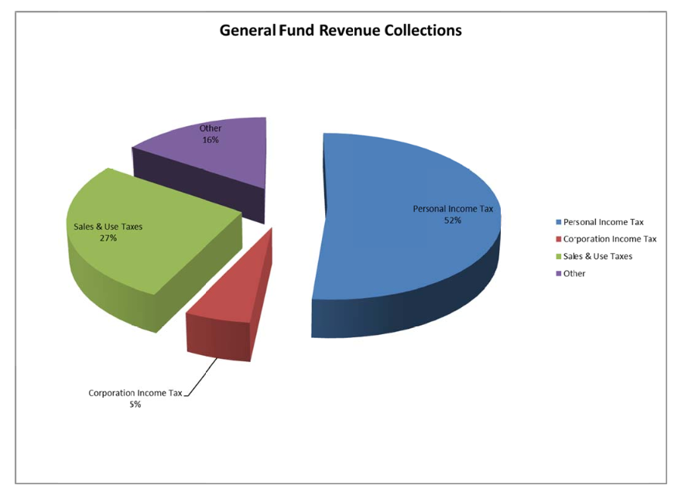
Literature Review
Maryland Tax Revenue by types

Slide 4
Maryland CIT is 8.25%
Nation average is 5.89%
One of the highest CIT rate in the country

Slide 5
How Maryland CIT rate affects business?
41st in Business Friendliness
Effective CIT is > 40% (combined with FCIT).
99.3rd percentile

Slide 6
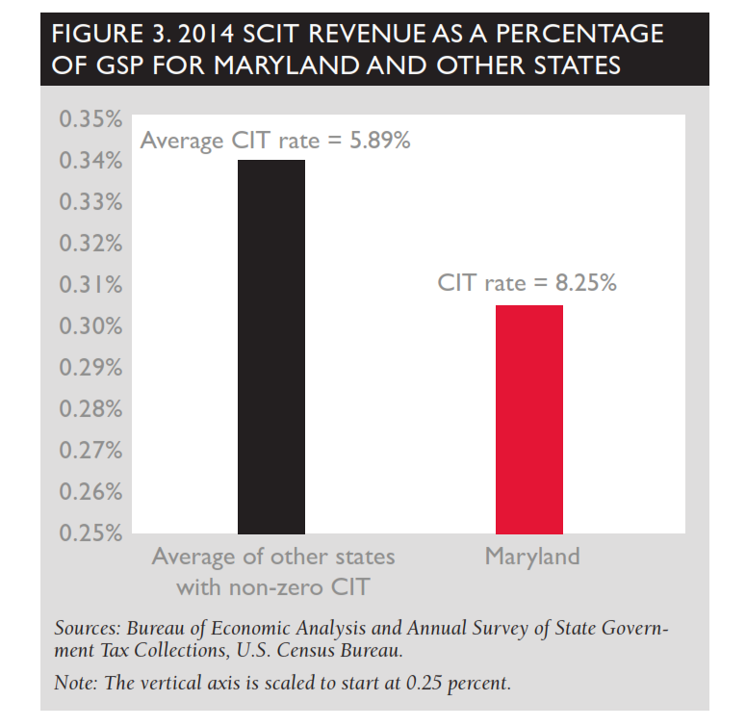
Lower CIT as a percentage of GSP

Slide 7
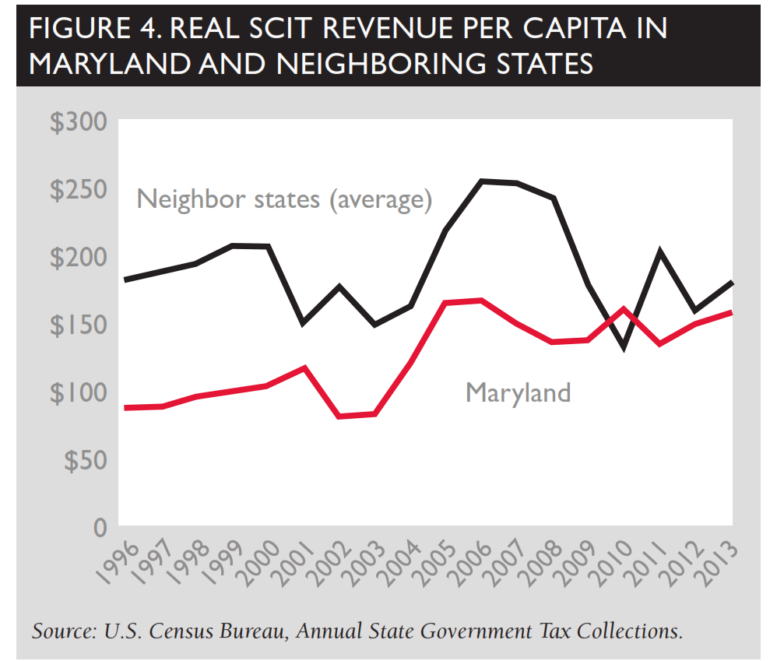
Lower real tax revenue per capita

Slide 8
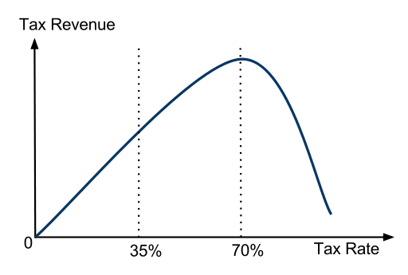
Laffer Curve

Slide 9
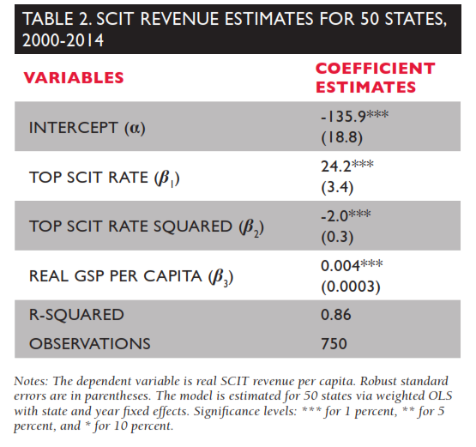
A regression model for tax revenue
Predict MD optimal SCIT rate is 6.05%

Slide 10
What I’m going to do?
Collect data about Corporate Income Tax:
Across states.
Over times in MD.
Run regression with variable: Tax revenue, and T²
T: tax rate
Find the Optimal Tax rate.

Slide 11
Reference
https://www.mdpolicy.org/docLib/20151217_ACaseforLoweringMaryland'sCorporateIncomeTax.pdf
http://finances.marylandtaxes.com/static_files/revenue/consolidated/crr-13.pdf
https://en.wikipedia.org/wiki/Laffer_curve
http://scholar.harvard.edu/files/mankiw/files/optimal_taxation_in_theory.pdf

