Slide 1
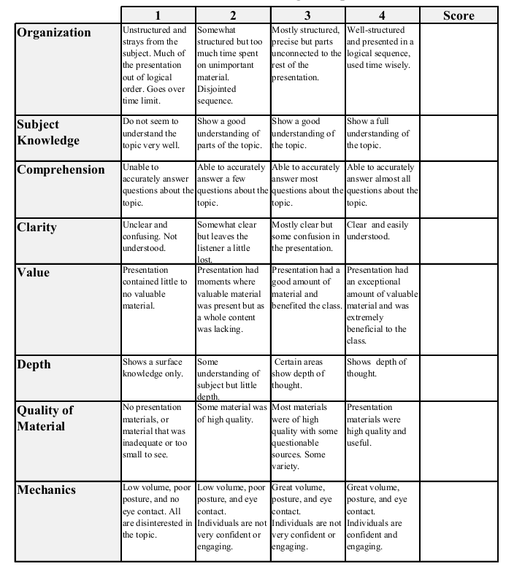
Project and presentation grading Rubik
Total:_________

