Slide 1
Paper Review ---Development and Validation of a Deep Learning Algorithm for Detection of Diabetic Retinopathy in Retinal Fundus Photographs
Shan Li
(shanl2)

Slide 2
Outline
Objective
Data set
Grading and Preprocessing
Model architecture and settings
Result

Slide 3
Objective
To apply deep learning to create an algorithm for automated detection of diabetic retinopathy and diabetic macular edema in retinal fundus photographs.

Slide 4
Data set
EyePACS---were acquired as a part of routine clinical care for diabetic retinopathy screening, and approximately 40% of the images were acquired with pupil dilation
Messidor-2--- has been used by other groups for benchmarking performance of automated detection algo- rithms for diabetic retinopathy. Approximately 44% of images were acquired with pupil dilation.

Slide 5
Grading and Preprocessing
Diabetic retinopathy severity (none, mild, moderate, severe, or proliferative) was graded according to the Inter-national Clinical Diabetic Retinopathy scale.
Images of excellent, good, and adequate quality were considered gradable.
The images used for the algorithm training and testing in the original study were all graded by ophthalmologists for image quality (gradability), the presence of diabetic retinopathy, and macular edema.
Input images were scale normalized by detecting the circular mask of the fundus image and resizing the diameter of the fundus to be 299 pixels wide. Images for which the circular mask could not be detected were excluded from the development and the clinical validation sets.

Slide 6
Model architecture and settings
Model Architecture:
Conv
Conv
Conv padded
Pool
Conv
Conv
Conv
3 x Inception
5 x Inception
2 x Inception
Pool
Linear
Softmax
Other tricks: using batch normalization layers after each convolutional layer. Weights are pre-initialized using weights from the neural network trained to predict objects in the ImageNet data set; the fully connected layer of the classifier is also batch-normalized, not just the convolutions.
This neural network consists of a range of convolutional layers that transforms pixel intensities to local features before converting them into global features.
The neural network of the original study was trained to output multiple binary predictions

Slide 7
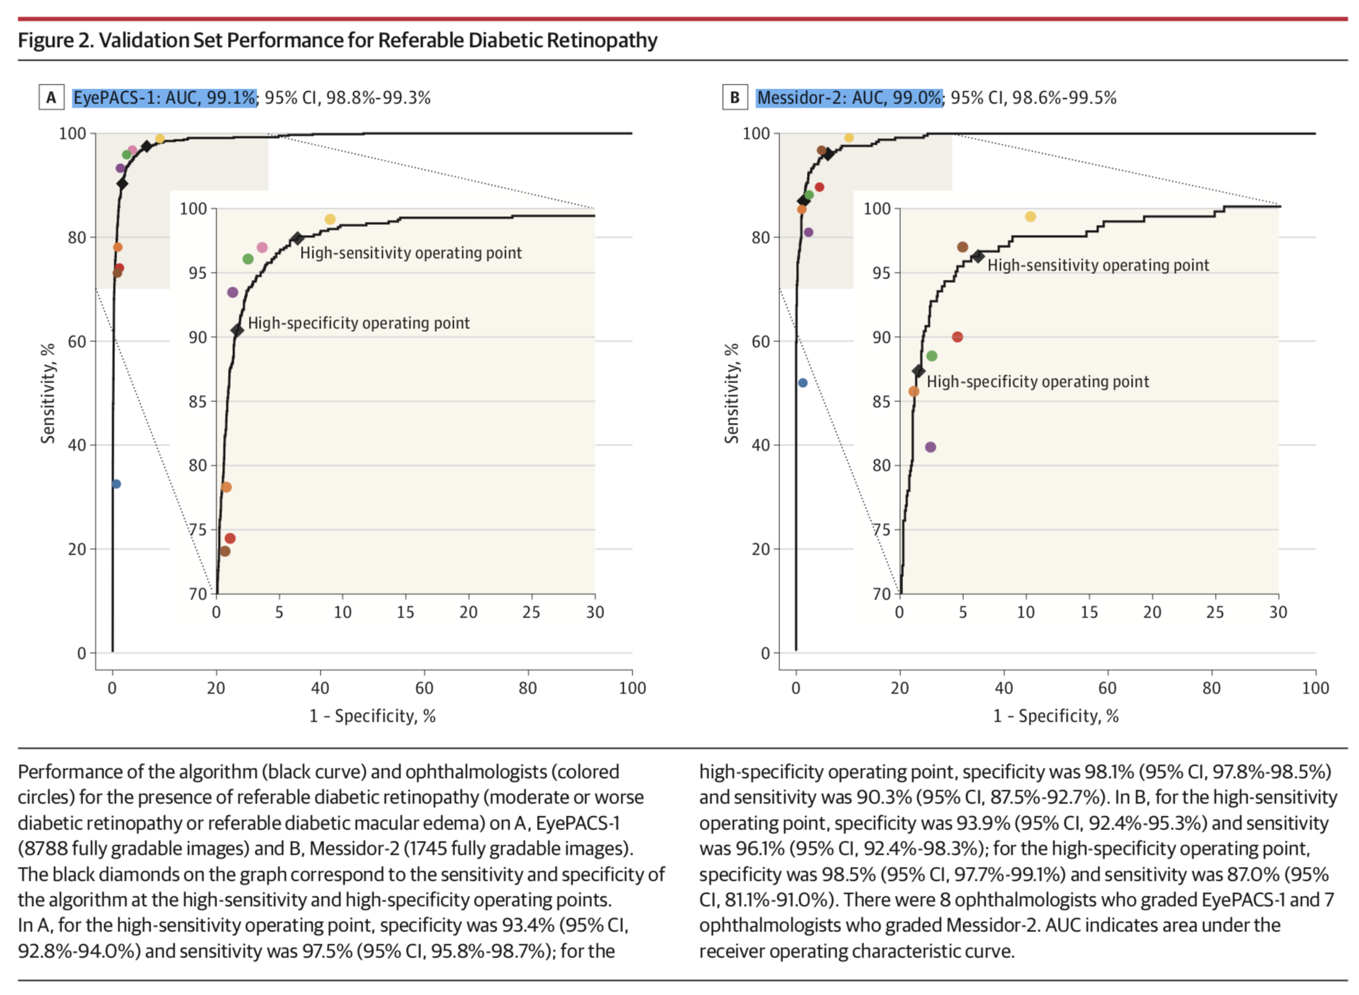
Results

