Slide 1
Multi-View 2D Image-Based 3D
Modeling of Objects
GROUP 11
Jugal Vaghmashi [AU2340017]
Rena Malhotra [AU2340018]
Siya Dhaduk [AU2340022]
Jayvat Shah [AU2340027]

Slide 2
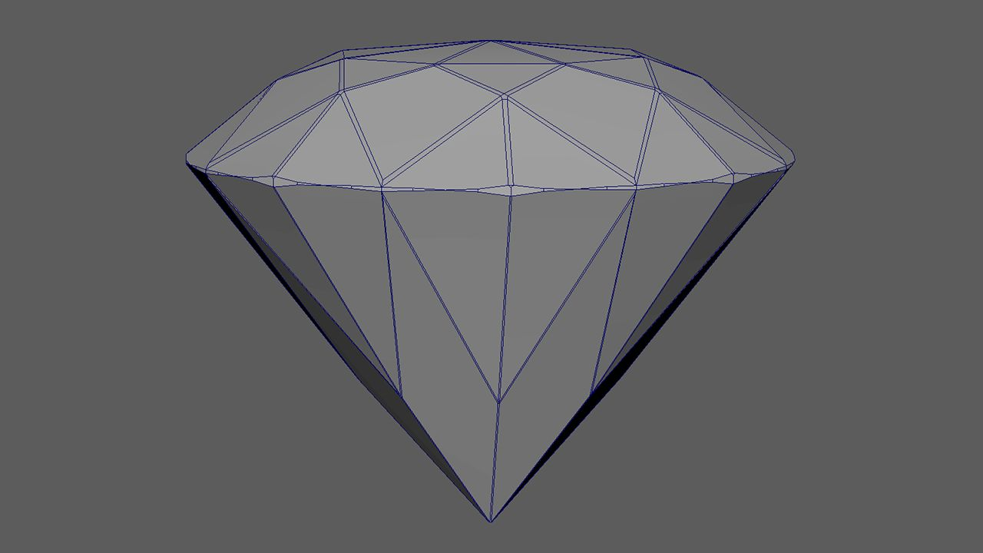
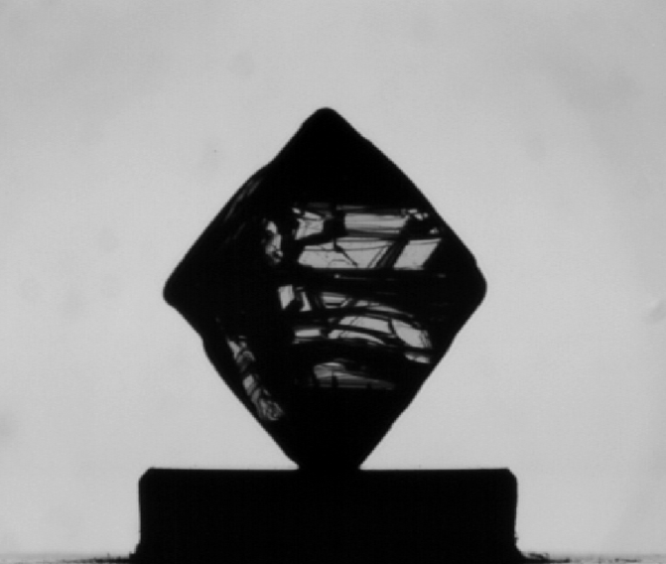
Introduction
Aim: To reconstruct a 3D diamond stone model using
multiple 2D silhouette projections
Motivation: Diamonds’ precision geometry
requires accurate 3D visualization
700 images of a single diamond stone
(BMP format)
Captured at 0.9°,1.8°,3.6° rotational difference

Slide 3
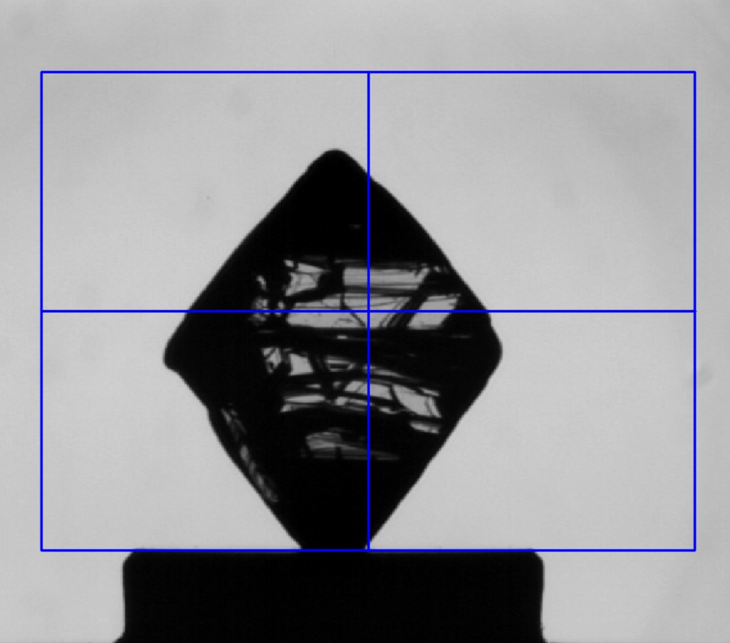

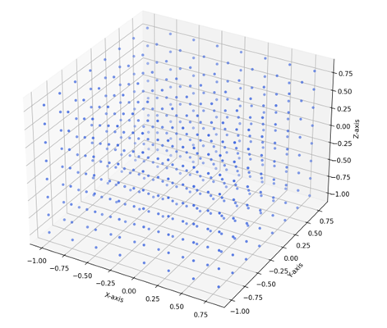

Work Done Before Mid-Sem
ROI Selection
2. Creating Clean Silhouette
3. Voxel Grid Creation

Slide 4
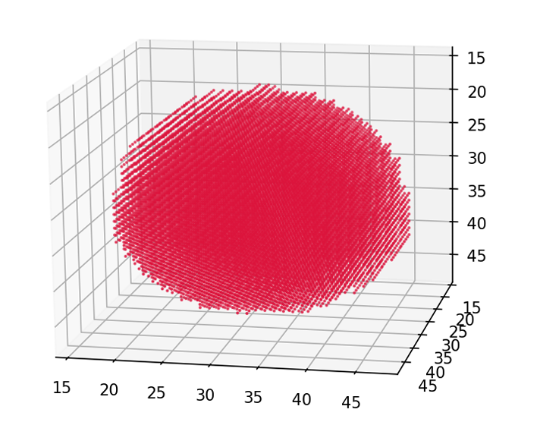
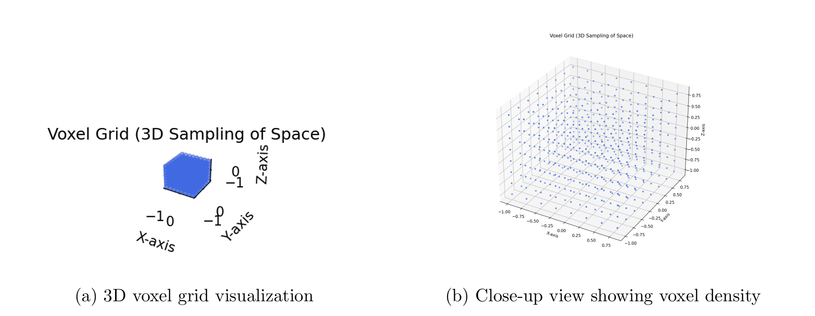

Updated Methodology
Replaced manual thresholding with Otsu’s auto-threshold method Ensures consistent and unbiased silhouette generation Handles varying illumination across images
Reconstructed 3D shape using silhouettes from multiple views Each silhouette defines a visual cone [1] Final 3D model = intersection of all cones (carving away impossible regions)
Generated synthetic silhouettes of sphere using simple shape Performed voxel-grid carving to validate pipeline [2] Confirmed correctness before processing real images
Reconstructed 3D Sphere Voxel Model
3D voxel grid visualization
Close-up view showing voxel density

Slide 5
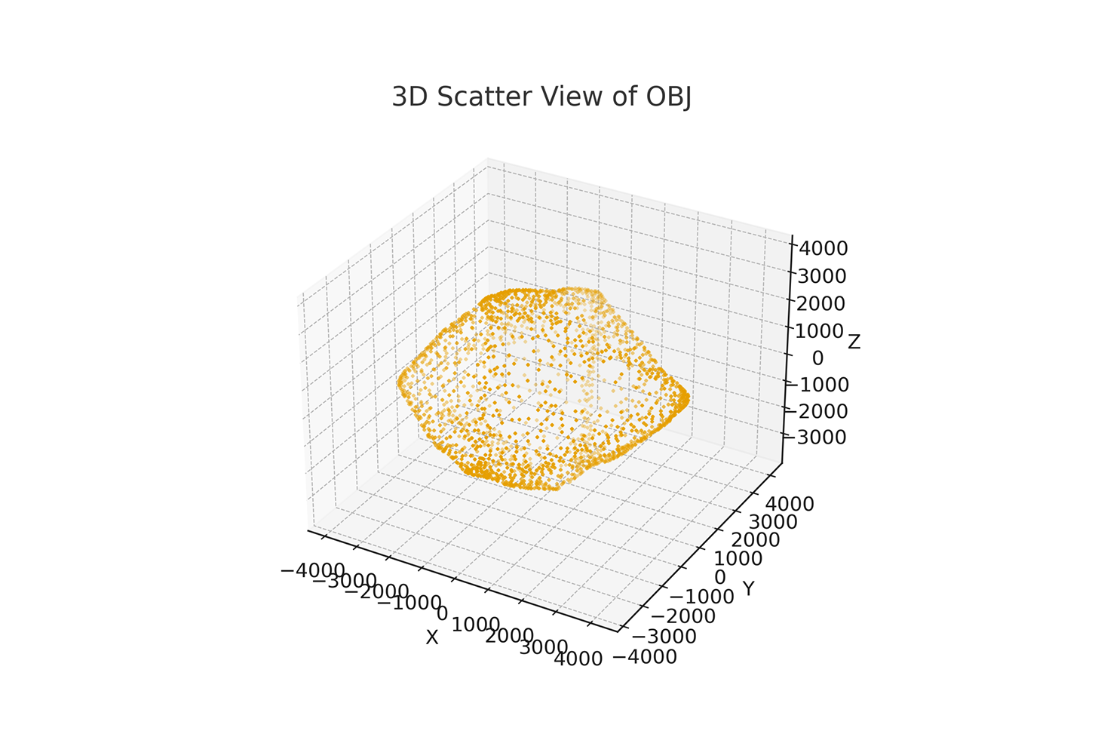
Updated Methodology
Converted diamond image to silhouette using Otsu Placed voxel grid around object Performed shape carving from multiple viewpoints Used 3 rotation angles: 0.9°, 1.8°, 3.6°

Slide 6
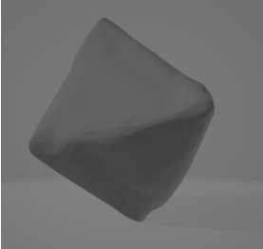
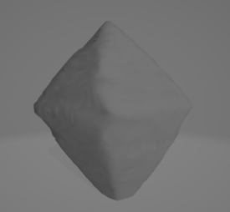
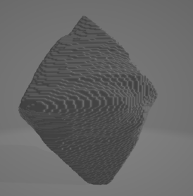
Results
After improving ROI selection, thresholding, voxel projection, resolution, and silhouette quality, the diamond model was fully reconstructed without missing regions or geometric errors.
Impact of Angular Sampling:
Finer Sampling Moderate Sampling Coarse Sampling
0.9° (400 images)
1.8° (200 images)
3.6° (100 images)

Slide 7
Conclusion
Implemented a complete multi-view silhouette-based 3D reconstruction pipeline using the visual hull method.
Angular sampling directly affects reconstruction quality:
0.9° rotation gives the best fidelity and minimal artifacts.
Coarser sampling (1.8°, 3.6°) reduces detail and increases irregularities.
Visual hull size remains proportional to input image dimensions, preserving correct scale and aspect ratio.

Slide 8
References
[1] A. Laurentini, “The Visual Hull Concept for Silhouette-Based Image Understanding,” IEEE Transactions on Pattern Analysis and Machine Intelligence, vol. 16, no. 2, pp. 150–162, 1994.
https://www.researchgate.net/publication/324389722/figure/fig3/AS:11431281391286952@1745321870314/Regular-3D-voxel-grid-unoccupied.tif
[2] T. Pham, H. Nguyen, and M. Ho, “Multi-View 3D Reconstruction from Silhouettes,” Computer Vision and Image Understanding, vol. 203, 103151, 2021.
https://www.itm-conferences.org/articles/itmconf/pdf/2024/07/itmconf_icacs2024_01010.pdf

Slide 9
THANK YOU

