Slide 1

Lab Book 1.0. Waveguides
Student: Jesús Ugeda Mas

Slide 2
Instructions
General
SCRIPTS
From GitHub →
  Fork the repo: cccanvas-upv/pic-upv-lab1
  Clone the repo using VSCode
Run the Jupyter Notebook:
  WAVEGUIDES_Student.ipynb
W (width)
W (width)
Core
Core
h_core
h
(height)
Cladding
Cladding
Slab
h_slab
deep waveguide
shallow waveguide

Slide 3
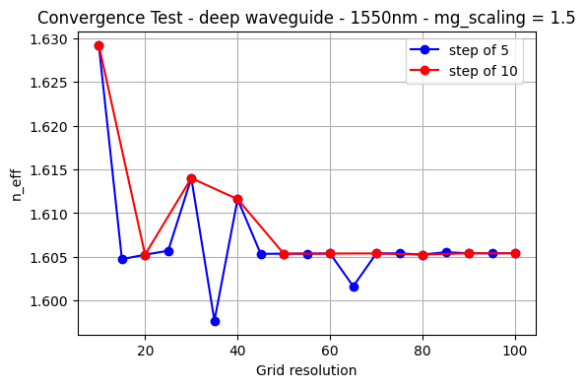
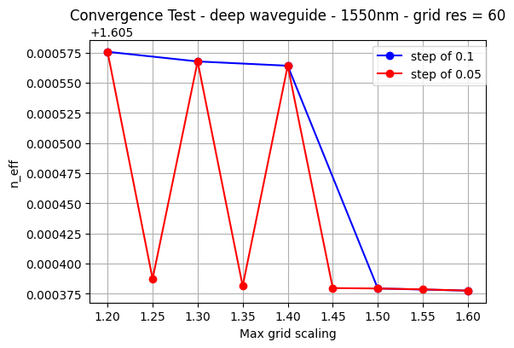
Learning outcome #1 – Convergence tests
DE waveguide, w = 1.2 µm, neff_TE0, wvl 1.55 µm.
As we can deduce from the figures, the convergences tests are a crucial part in our simulations. Clearly, the effective index value depends on the “grid resolution” (grid res) and the “max_grid_scaling” (mg_scaling), as it results from a numerical method. There isn’t a specific dependence of n_eff with the input parameters, but we can safely use the value when it remains almost constant. This occurs for enough high grid resolutions, like 60 and beyond, and a high enough max_grid_scaling.
In addition, we have studied how the number of steps in the convergence tests affects the “convergence” of the n_eff value. For the grid resolution sweep, the behavior is very similar, leaving out some numerical distortions, but for the max_grid_scaling sweep we see a greater disorder, that eventually seems to stop at 1.5. That will be our first safe value. Also, having done the grid resolution sweep with a mg_scaling of 1.5 gives us more confidence on the results.
Based on this results, we can conclude that {grid_resolution = 60, max_grid_scaling = 1.5} will be a safe configuration for the input parameters for this particular case. Although, if you don’t want to spend that much time in simulations, grid_resolution = 20 seems to provide a very similar n_eff to the “stable” one.

Slide 4
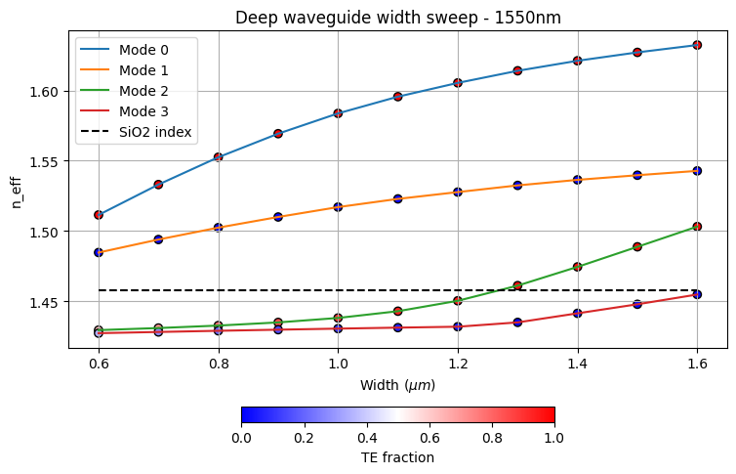
Learning outcome #2 – Width dependence
Width 0.6 - 1.6 µm (step 0.1 µm) – Wavelength 1.55 µm
First of all, the effective index increases with width, which means that a wider waveguide has a higher confinement of the light. As a higher fraction of the field remains within the core, the effective index value increases and moves closer to the core refractive index. Because of this, a cutoff point is reached where the waveguide becomes multimode: n_eff for the next higher-order mode (TE) exceeds the SiO2 refractive index.
We must also highlight that:
Data has a smooth variation and the modal ordering remains unchanged over the visualized width range. These are not universal behaviors, and different trends like modal crossing or reordering, may appear for larger widths or for other waveguide geometries.
Modes 0 and 1 remain well confined over the entire width range studied, making them less sensitive to geometric variations. However, modes 2 and 3, if guided, have indexes closer to the cladding value, indicating weaker confinement. As a result, they are more sensitive to fabrication imperfections and geometric variations.

Slide 5
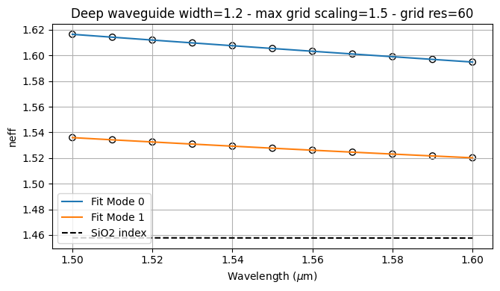
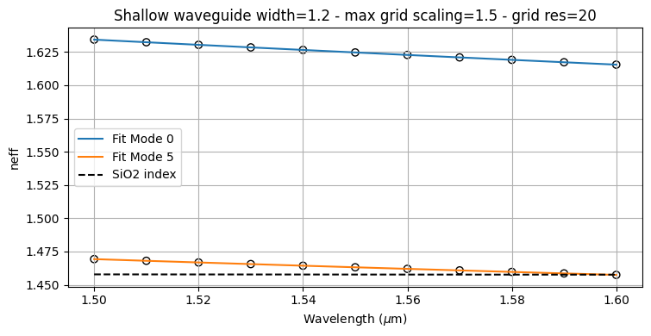
Learning outcome #3 – Waveguide compact model
Let’s model the waveguide using a second order polynomial: $n_{eff}\left(λ\right)=n_{1}+n_{2}\left(λ−λ_{0}\right)+n_{3}{\left(λ−λ_{0}\right)}^{2}$
Deep waveguide – width = 1.2 μm
max_grid_scaling = 1.5 – grid_resolution = 60
Shallow waveguide – width = 1.2 μm – slab = 150 nm
max_grid_scaling = 1.5 – grid_resolution = 60
We fit the effective refractive index (values obtained from the mode_solver) vs λ to the second-degree polynomial model shown above. Then we relate the fit coefficients with the group index and the dispersion parameter (next slide).
For all guided modes, the effective index decreases smoothly with increasing wavelength. This indicates that the modal field for larger λ becomes less confined in the core (n_eff moves closer to the cladding effective index). This modal behaviour is something expected for this kind of silicon waveguides.
The compact model provides an excellent fit to the simulated data, indicating that it describes sufficiently the wavelength dependence of n_eff.
The shallow waveguide supports more modes than the deep waveguide, indicating a different modal structure and a stronger multimode behaviour. We had to find for the exercise that these particular geometries, in this specific λ –range, only support 2 modes and 6 modes, respectivelly. Looking at their polarization fractions, we have deduce that TE0 is the Mode 0 in each waveguide and the TM0 is the “last” guided mode in each one: Mode 1 in the deep case, and Mode 5 in the shallow case.

Slide 6
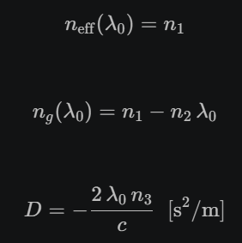
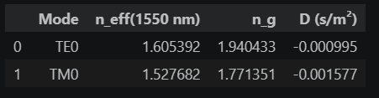
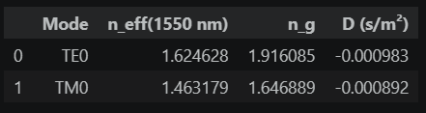
Learning outcome #3 – Waveguide compact model
Let’s model the waveguide using a second order polynomial: $n_{eff}\left(λ\right)=n_{1}+n_{2}\left(λ−λ_{0}\right)+n_{3}{\left(λ−λ_{0}\right)}^{2}$
Deep
waveguide
Shallow
waveguide
Following the equations on the right, we obtain the group index (n_g) and the dispersion parameter (D) for the two geometries. Both deep and shallow waveguides exhibit similar behaviour for the TE0 mode, with comparable effective and group indexes. The shallow waveguide exhibits a higher effective index for TE0, indicating a larger modal overlap with the core and, therefore, a stronger confinement of the guided mode.
However, values for TM mode are more different between waveguides and compared to the TE0 modes. The reason is that TM mode is more affected by the waveguide geometry, as we know by its visualization (and definition) that these kind of modes are less confined and always interacts more with the waveguide walls. Therefore, the deep waveguide provides significantly stronger confinement for the TM mode, resulting in higher effective and group indexes and a larger magnitude of the dispersion parameter.
Finally, the dispersion parameter is negative, indicating that modes present normal dispersion in the considered wavelength range.

Slide 7
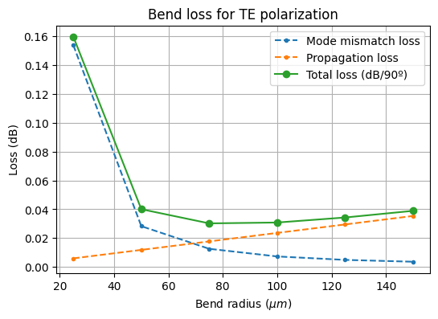
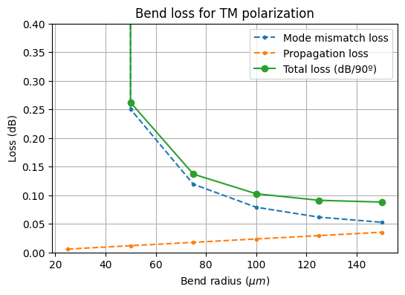

Learning outcome #4 – Bend waveguide radius vs. loss – deep
Find neff_TE0 for wvl 1.55 µm, width 1.0 µm for R=25,50,75,100, 125,150 µm
$α\left[\frac{dB}{90°}\right]=$ $R\frac{π}{2}α\left[\frac{dB}{µm}\right]$
The criteria for a safe bend radius (R) is that losses do not reach 0.1 dB/90º.
Total losses in TM polarization for R = 25 μm are too high (up to 120 dB). We have visualized its modal field and there is definetly a guided mode, but or the losses are in fact that high, or there are some tricky considerations with the solver way of evaluating that data.
First of all, we must highlight that we are neglecting the radiation losses at the bend, mainly because is not easy to implement as a quick simulation. Under certain conditions, like sufficiently large bend radii and well-confined modes (high-index-contrast), the main loss sources are the ones considered in this example.
Propagation losses increase, linearly, with R because the physical length of the light’s travel increases. However, mode-mismatch losses decrease rapidly with R because in a highly bended waveguide, the mode highly differs from the straight waveguide mode. As the radius increases, the both indexes come closer to one another and the mismatch (losses) decreases. However, propagation losses increase, so a safer radius is not always a bigger one.
For the TE mode, a bend radius of 50 μm is already sufficient to keep the total bend loss below 0.1 dB, but for the TM mode, the minimum safe R value is approximately 100-125 μm. This is a clear way to see that the TE mode is more robust than the TM mode. The TM mode cross section for a straight waveguide shows that power is already closer to the walls (has weaker confinement) so, when bended, the losses effects intensify.

Slide 8

EXTRA EXERCISES
All the past simulations were done considering as core material de Silicon Nitride (SiNx) and Silicon Dioxide (SiO2) as cladding material. Now, simulate the Silicon-On-Insulator technology changing the core material to Silicon (Si). In this case, the dimensions will be 220 nm height and 500 nm width.
1. Repeat the LO.1. wavelength behavior simulations, considering the updated materials and dimensions.
2. Repeat the LO.3. width dependence analysis, now sweeping in a 300nm - 1um range.
3. Find the safe radius for this technology. Consider sweeping the radius in a 5um to 30um range.
4. Compare the SiNx and SOI technologies.

Slide 9
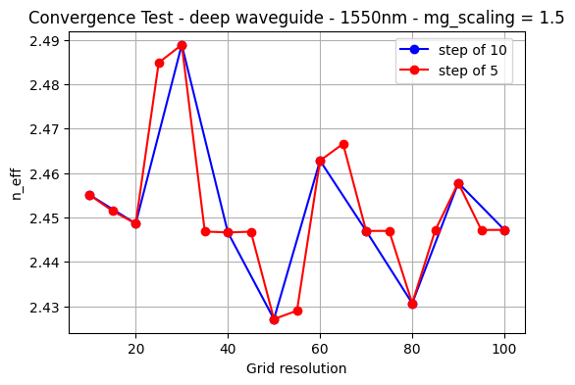
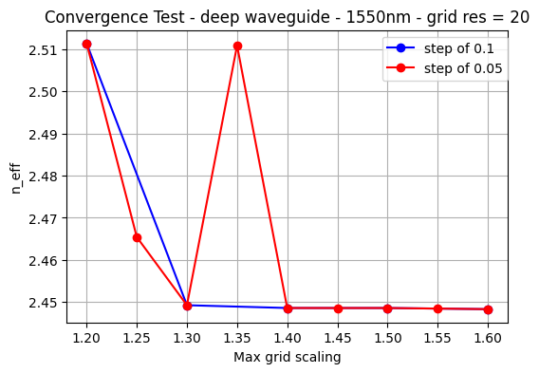
Learning outcome #1 – Convergence tests
DE waveguide, w = 1.2 µm, neff_TE0, wvl 1.55 µm.
These figures show similar tendencies compared to SiN-SiO2 waveguides: n_eff must reach a “constant” regime so that we can take with confidence the numerical parameters for the simulations. In this case, we see that {grid_resolution = 20, max_grid_scaling = 1.5} can be a safe configuration for the input parameters.
In this specific case, our choice “grid_resolution = 20” is based on the overviewed tendency of the red curve in the left figure: there seems to be a n_eff mean value mixed with numerical fluctuations, and the one related to grid_res = 20 is very close. Also, it allows us to reduce computational time and the corresponding sweep of the max_grid_scaling reaches a stable n_eff value quite fast.
However, if a problem shows up, we will upgrade the grid resolution up to a value whose respective n_eff is similar. This will allow the software to work more precisely.

Slide 10
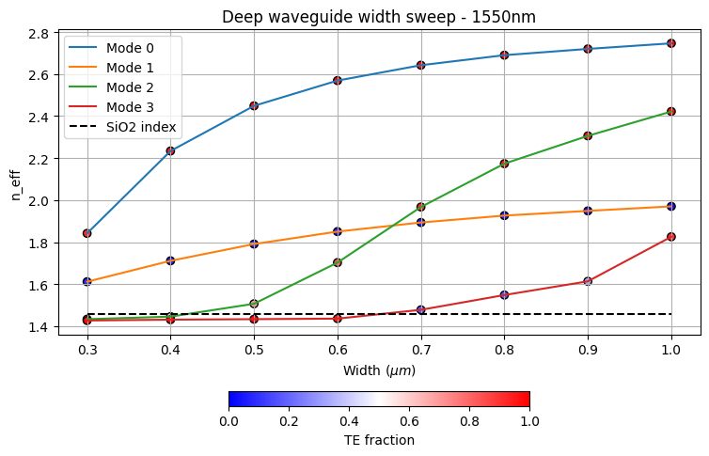
Learning outcome #2 – Width dependence
Width 0.6 - 1.6 µm (step 0.1 µm) – Wavelength 1.55 µm
Compared with the previous SiN deep waveguide, the Si waveguide exhibits significantly higher effective indexes and a much stronger variation along width.
The first highlights are the not-so-smooth behavior with increasing width and the mode crossing between modes 1 and 2 around 0.7 μm. We can tell apart the modes by looking at their polarization, which doesn’t change drastically when sweeping a geometrical parameter. Modes can hybridize at much, like the data shown for the mode 3. Although, we should do a more precise analysis to confirm if it really is an hybridization.
Although the Si waveguide thickness is slightly different from that of the SiN structure, these observations are mainly a direct consequence of the much larger refractive-index contrast between Si and SiO2. It provides stronger optical confinement and as a result, grater n_eff, higher-order modes appear at smaller widths and the waveguide becomes multimode more rapidly.

Slide 11
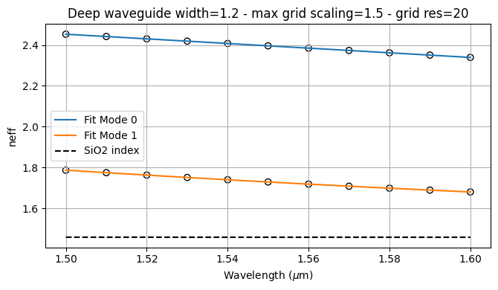
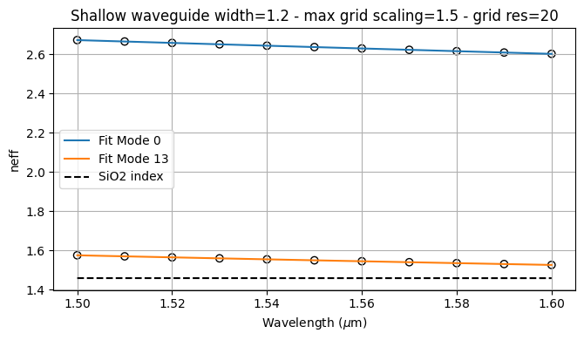
Learning outcome #3 – Waveguide compact model
Let’s model the waveguide using a second order polynomial: $n_{eff}\left(λ\right)=n_{1}+n_{2}\left(λ−λ_{0}\right)+n_{3}{\left(λ−λ_{0}\right)}^{2}$
Deep Si/SiO2 waveguide – width = 500 m
max_grid_scaling = 1.5 – grid_resolution = 60
Shallow Si/SiO2 waveguide – width = 500 nm
slab = 150 nm - max_grid_scaling = 1.5 – grid_resolution = 20
In these figures, we show the n_eff variation with wavelength for the TE0 and TM0 modes of a deep waveguide and a shallow waveguide, along with the respective polynomial fit of the compact model (equation shown above). Similar to the previous case, we had to look to the mode polarization to tell apart the fundamental modes, concluding that mode 0 is TE0 in both cases, and TM0 is mode 1 in the deep case, and mode 13 in the shallow case. This indicates already that the shallow Si/Sio2 waveguide supports more modes than the SiN/SiO2 waveguide (also happens with the deep one). The reason is again related to the high refractive index contrast between core and cladding. Besides that, for all guided modes, the effective index decreases with increasing wavelength, indicating less confinement at longer wavelengths as the field leaks out further into the cladding. This is the same behaviour as in the SiN/SiO2 waveguide. Its only difference is the n_eff magnitude, which is greater in the Si-core waveguide due to, also, the high indexes contrast.

Slide 12
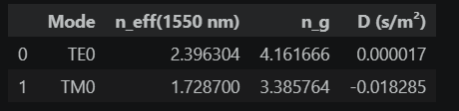
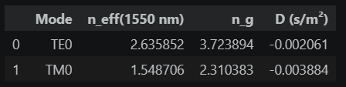
Learning outcome #3 – Waveguide compact model
Let’s model the waveguide using a second order polynomial: $n_{eff}\left(λ\right)=n_{1}+n_{2}\left(λ−λ_{0}\right)+n_{3}{\left(λ−λ_{0}\right)}^{2}$
Deep
waveguide
Shallow
waveguide
Compared with the previous SiN waveguides, the Si waveguides show higher effective indexes due to stronger confinement (higher core/cladding index contrast). The group indexes (n_g) are also higher, although it is not implied by the strong confinement, but the wavelength dependence, which is more related to the geometry and the high contrast core/cladding index contrast.
In this case, the shallow waveguide also shows a higher effective index.
We can conclude that geometrical and material changes affect not only confinement but also the modal dispersion. The strongest effect of the geometry is observed in the dispersion parameter (D). While the deep TE mode exhibits nearly positive zero dispersion (anomalous dispersion), the shallow TE mode shows a larger negative one. Similarly, the TM values are larger than the TE values, like in the SiN case, due to the greater sensitivity of n_eff(TM) with geometry and wavelength.

Slide 13
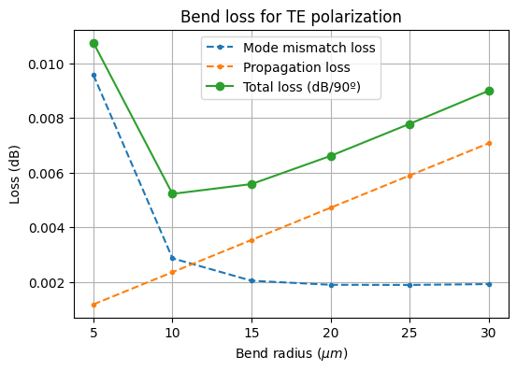
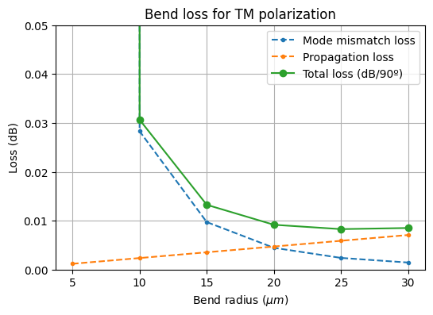
Learning outcome #4 – Bend waveguide radius vs. loss – deep
Find neff_TE0 for wvl 1.55 µm, width 1.0 µm for R=25,50,75,100, 125,150 µm
$α\left[\frac{dB}{90°}\right]=$ $R\frac{π}{2}α\left[\frac{dB}{µm}\right]$
The criteria for a safe bend radius (R) is that losses do not reach 0.1 dB/90º.
Total losses in TM polarization for R = 5 μm are extremely high (we have omited the data). We have visualized its modal field and it doesn’t seem to be any guided mode. The limit is around 10 μm of bend radius. We can, then, omit it for the conclusions.
Compared with the SiN waveguide, the Si waveguide shows lower bend losses due to its stronger mode confinement. As a result, the minimum safe bend radius decreases from approximately 50 µm (TE) and 100–125 µm (TM) in SiN to about 10 µm in Si. In both platforms, the TM mode remains the most sensitive to bending, confirming its weaker confinement and greater susceptibility to geometrical perturbations (losses skyrocket for R = 5 μm).
In addition, we must highlight the behaviour of TE bend losses in this case, where we observe the importance of propagation losses. They increase quite fast with R, leaving a “minimum” radius, although we still lack the contribution of the radiation losses, which can change substantially the results.

