Slide 1
HTML5
NEW FORM ELEMENTS

Slide 2
HTML Basics
All Content

Slide 3
HTML5 has 2 major advantages
New input types
Built in validations
Less Development time & improved user experience
HTML5 introduces 13 input types

Slide 4
Description
Sample

Slide 5
Attributes
PlaceHolder
Focus
AutoComplete
Required
Pattern attribute
Sample2.html

Slide 6
Form Override Methods
Form has following attribute
Novalidate
Action
Enctype
Method
Target
All these can be over ridden.

Slide 7
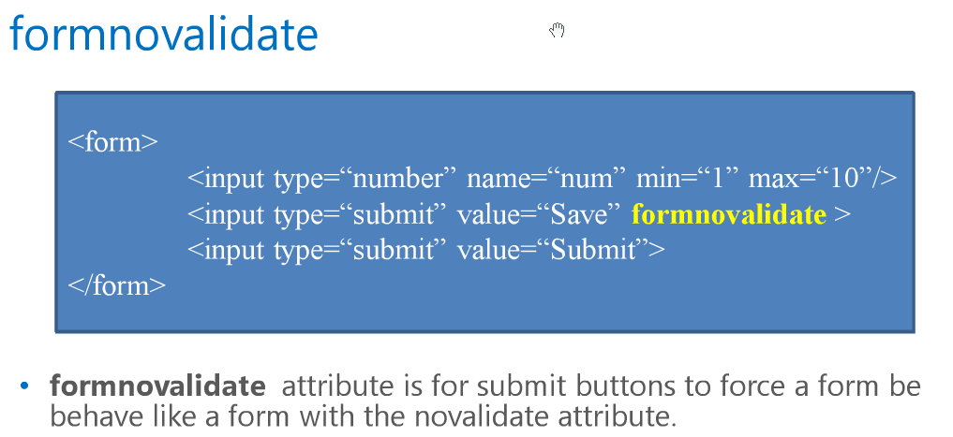

Slide 8
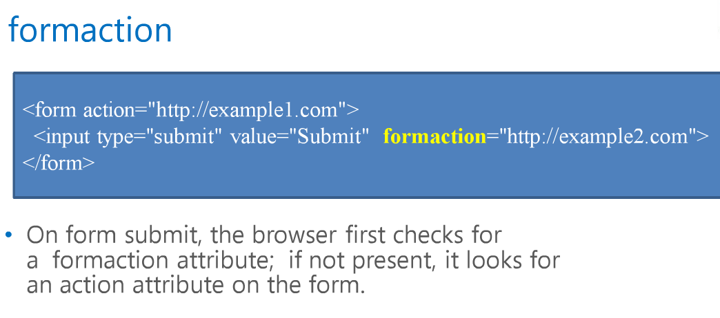

Slide 9
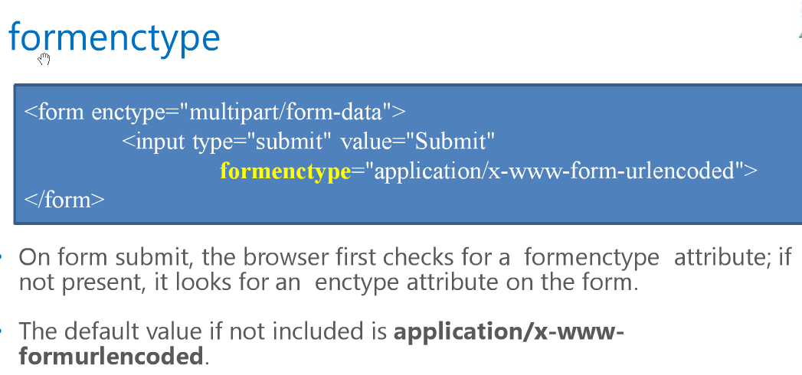

Slide 10
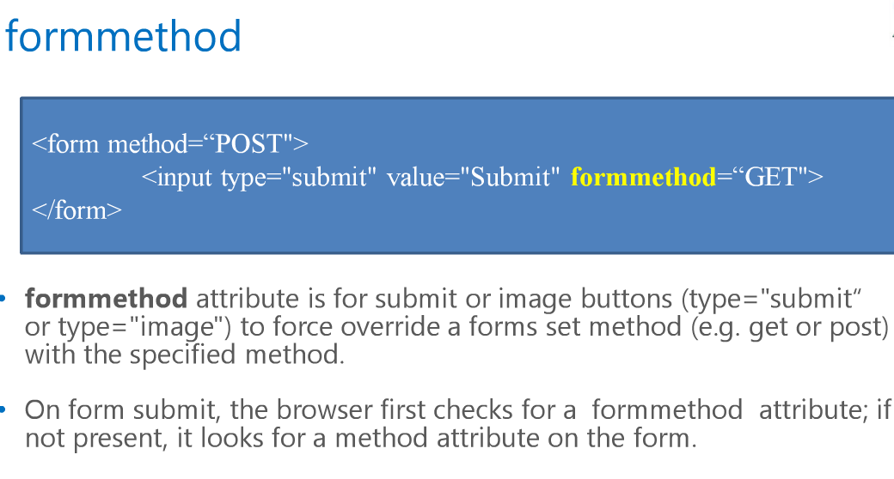

Slide 11
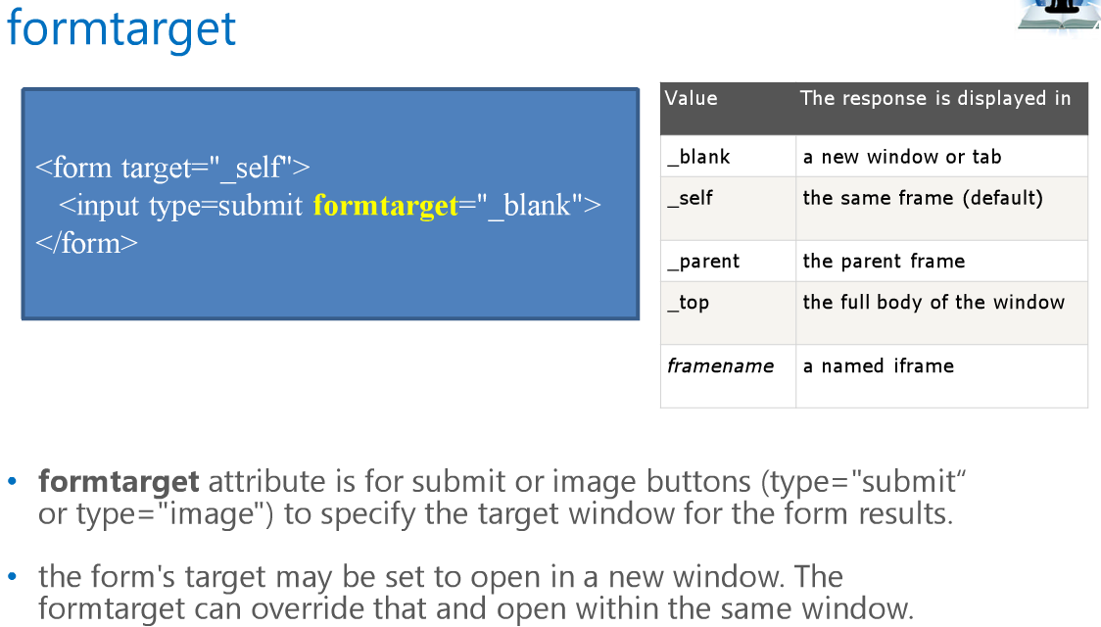

Slide 12
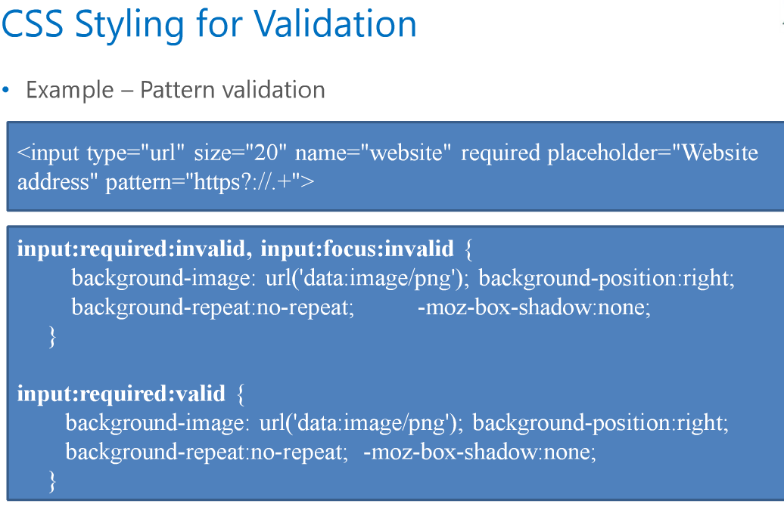

Slide 13
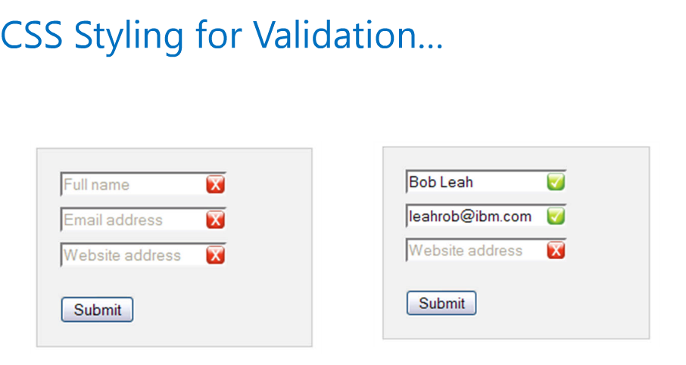

Slide 14
Graceful Degradation ??
Progressive Enhancement
AND
Graceful Degradation

