Slide 1
WebSockets

Slide 2
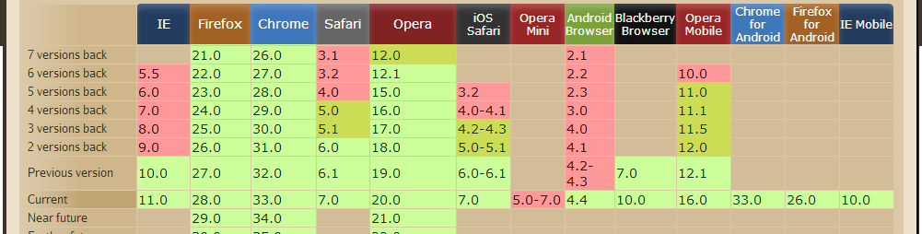
Browser Support

Slide 3
WebSocket … What is it?
provide two-way realtime communication between a client and server
a WebSocket is a bidirectional full duplex persistent TCP connection secured by a client-key handshake and an origin-based security model

Slide 4
Use Case
News
Stocks
Multi User Games (Multiplayer)
Etc {cric-info?}

Slide 5
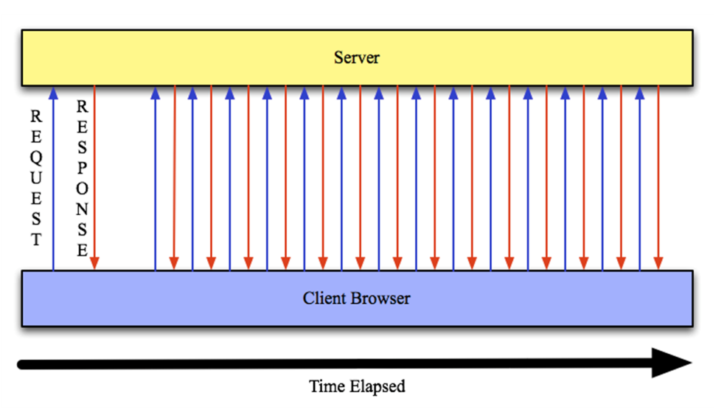
Before Websockets : Polling
Polling … was used extensively

Slide 6
Your Example ??

Slide 7
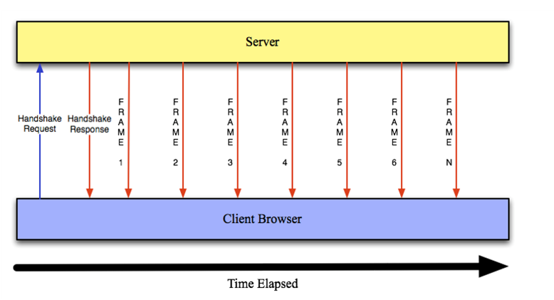
Websocket Architecture

Slide 8
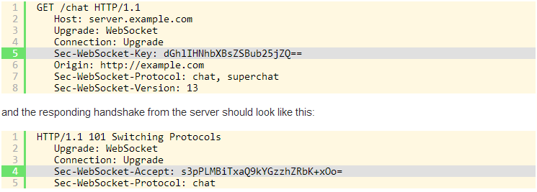
Handshake -

Slide 9
The client sends the Sec-WebSocket-Key string dGhlIHNhbXBsZSBub25jZQ==
The server appends the magic string to form the string dGhlIHNhbXBsZSBub25jZQ== 258EAFA5-E914-47DA-95CA-C5AB0DC85B11
Now the server generates the SHA-1 hash for this longer string, which isb37a4f2cc0624f1690f64606cf385945b2bec4ea
Finally, the server base64-encodes the hash string to give s3pPLMBiTxaQ9kYGzzhZRbK+xOo=
And this base64-encoded value is used in the Sec-WebSocket-Accept header in the server’s response

Slide 10
WebSocket
var Socket = new WebSocket(url, [protocal] );
url : specifies the URL to which to connect
Protocol : is optional, and if present, specifies a sub-protocol that the server must support for the connection to be successful.

Slide 11
WebSocket Events:
Socket.onopen : This event occurs when socket connection is established.
Socket.onmessage : This event occurs when client receives data from server.

Slide 12
WebSocket Events:
Socket.onerror : occurs when there is any error in communication.
Socket.onclose : This event occurs when connection is closed.

Slide 13
WebSocket Methods:
Socket.send() : The send(data) method transmits data using the connection.
Socket.close() : The close() method would be used to terminate any existing connection.

Slide 14
WebSockets on the Server
C++: libwebsockets
Errlang: Shirasu.ws
Java: Jetty
Node.JS: ws, socket.io
Ruby: em-websocket
Python: Tornado, pywebsocket
PHP: Ratchet, phpws

