Slide 2
Offline browsing - users can navigate your full site when they're offline
Speed - resources come straight from disk, no trip to the network.
Resilience - if your site goes down for "maintenance" (as in, someone accidentally breaks everything), your users will get the offline experience

Slide 3
Application Cache (or AppCache)
Allows developer to specify which files the browser should cache and make available to offline users
App will load and work correctly, even if the user presses the refresh button while they're offline

Slide 4
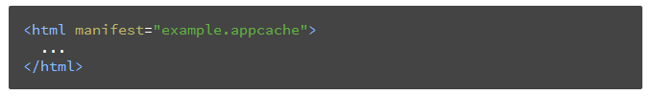
Cache Manifest file
Simple text file that lists the resources the browser should cache for offline access.
Referencing a manifest file

Slide 5
Cache Manifest File
App with multiple pages, should have the manifest attribute should be included on every page of your web application that you want cached
Browser does not cache a page if it does not contain the manifest attribute (unless it is explicitly listed in the manifest file itself

Slide 6
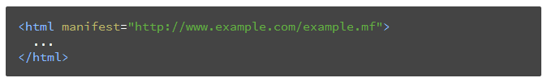
Cache Manifest File
manifest attribute can point to an absolute URL or relative path, but an absolute URL must be under the same origin as the web application

Slide 7
Changes on server
A manifest file must be served with the mime-type text/cache-manifest
May need to add a custom file type to your web server or .htaccess configuration

Slide 8
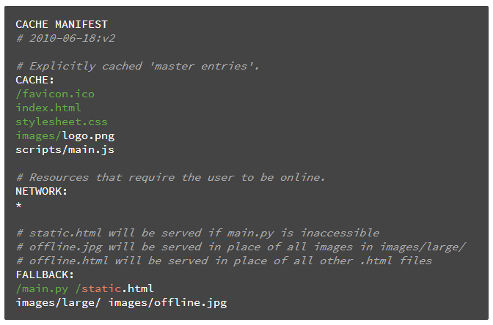
Structure of Manifest File

Slide 9
Structure of Manifest File
'#' are comment lines
Also it can server for following purpose
application's cache is only updated when its manifest file changes

Slide 10
Structure of Manifest File
It has three distinct sections: CACHE,NETWORK, FALLBACK
CACHE : default section for entries. Files listed under this header (or immediately after the CACHE MANIFEST) will be explicitly cached after they're downloaded for the first time.

Slide 11
Manifest File : CACHE,NETWORK, FALLBACK
NETWORK : Files listed in this section may come from the network if they aren't in the cache, otherwise the network isn't used, even if the user is online. You can white-list specific URLs here, or simply "*", which allows all URLs. Most sites need "*"

Slide 12
Manifest File : CACHE,NETWORK, FALLBACK
FALLBACK : An optional section specifying fallback pages if a resource is inaccessible. The first URI is the resource, the second is the fallback used if the network request fails or errors. Both URIs must from the same origin as the manifest file. You can capture specific URLs but also URL prefixes. "images/large/" will capture failures from URLs such as "images/large/whatever/img.jpg"

Slide 13
AppCache :Updating the cache
an application is offline it remains cached until one of the following happens
The user clears their browser's data storage for your site
The manifest file is modified

Slide 14
AppCache - CacheStatus
window.applicationCache object is your programmatic access the browser's app cache
Its status property is useful for checking the current state of the cache

Slide 15
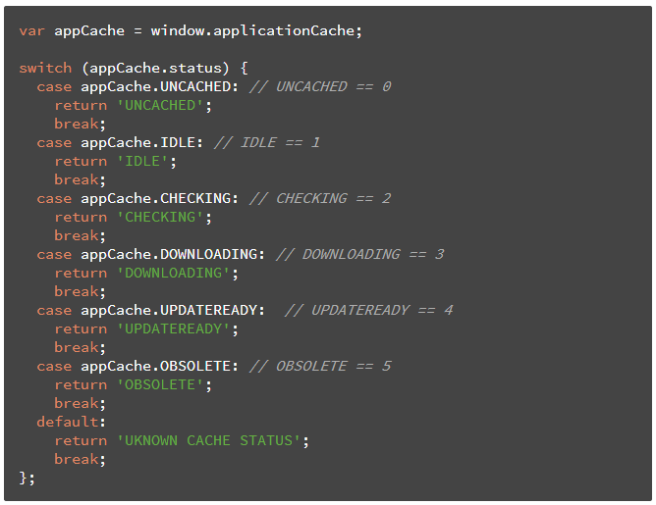
AppCache - CacheStatus

Slide 16
AppCache - CacheStatus
programmatically check for updates to the manifest - applicationCache.update()
This will attempt to update the user's cache

Slide 17
AppCache events
browser fires events for things like download progress, updating the app cache, and error conditions
Event List
Cached : Fired after the first cache of the manifest.
Checking : Checking for an update

Slide 18
AppCache events [Cached, Checking ]
Error : manifest returns 404 or 410, the download failed, or the manifest changed while the download was in progress
Noupdate : Fired after the first download of the manifest.

Slide 19
AppCache events [Cached, Checking, Error, Noupdate ]
Progress : Fired for each resource listed in the manifest as it is being fetched
Updateready :Fired when the manifest resources have been newly redownloaded

Slide 20
AppCache events [Cached, Checking, Error, Noupdate, Progress, Updateready ]
Obsolete : Fired if the manifest file returns a 404 or 410. This results in the application cache being deleted
Downloading: The browser is fetching resources

Slide 21
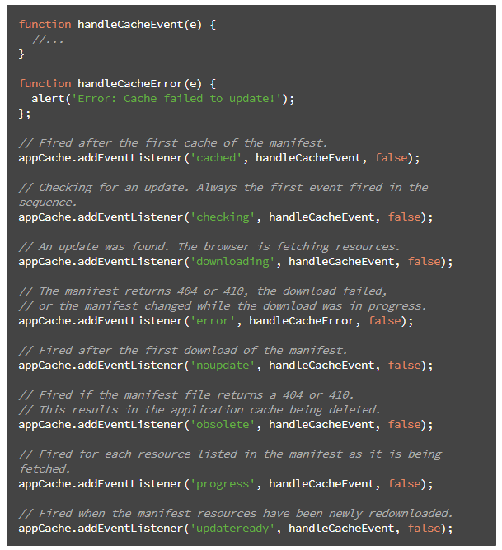
AppCache events

