Slide 1

KPMG AWS Audit Automation Tools
KPMG LOGIN
Username :
Enter Username
Password :
Enter Password
SIGN IN

Slide 2
KPMG AWS Audit Automation Tools
User : Tejas Z
Project Explorer
Project Options
MUFG
Create New Project
Go-Digit
Add member to project
Disney
Delegate ownership
Check Status
Set Status

Slide 3
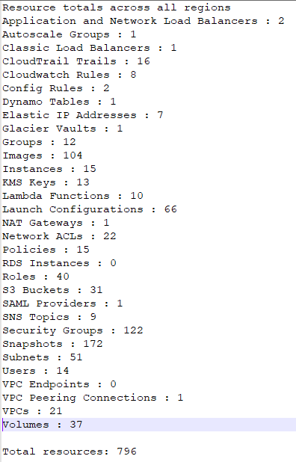
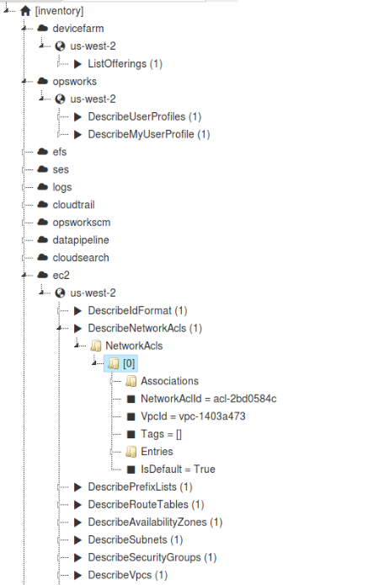
KPMG AWS Audit Automation Tools
User : Tejas Z
Project Explorer
MUFG
Asset Inventory List
Cloud Architecture
Report Generator

Slide 4
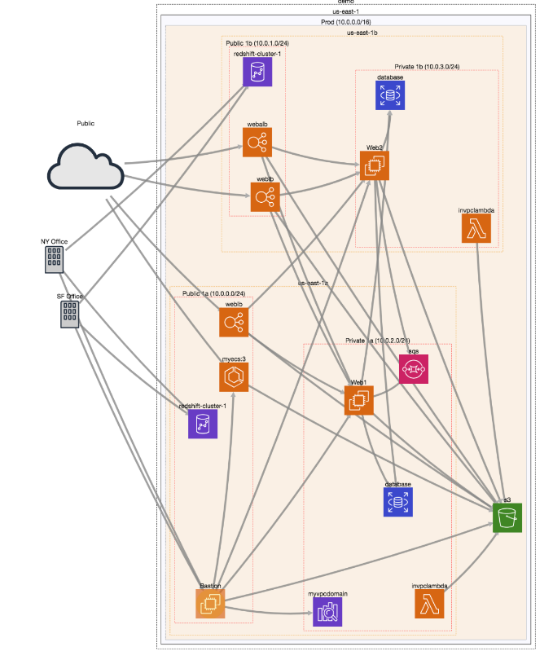
KPMG AWS Audit Automation Tools
User : Tejas Z
Project Explorer
MUFG
Asset Inventory List
Cloud Architecture
Report Generator
NEXT

Slide 5
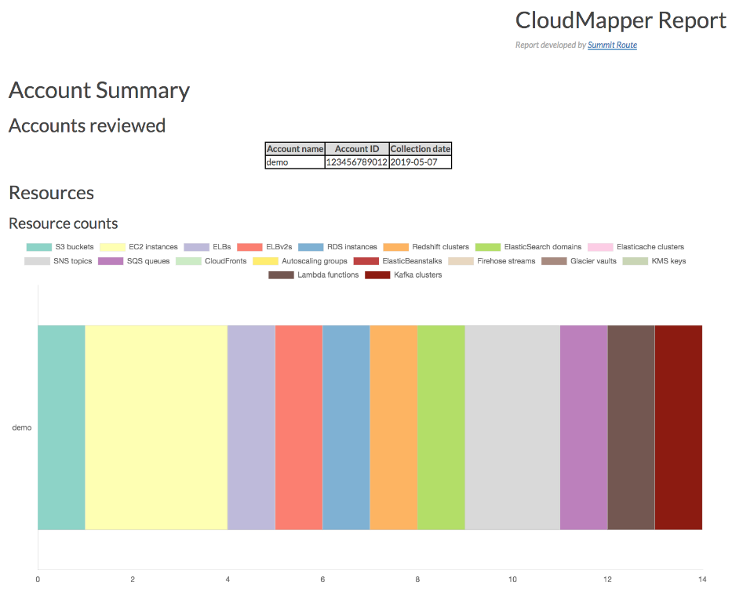
KPMG AWS Audit Automation Tools
User : Tejas Z
Project Explorer
MUFG
Asset Inventory List
Cloud Architecture
Report Generator
NEXT

Slide 6
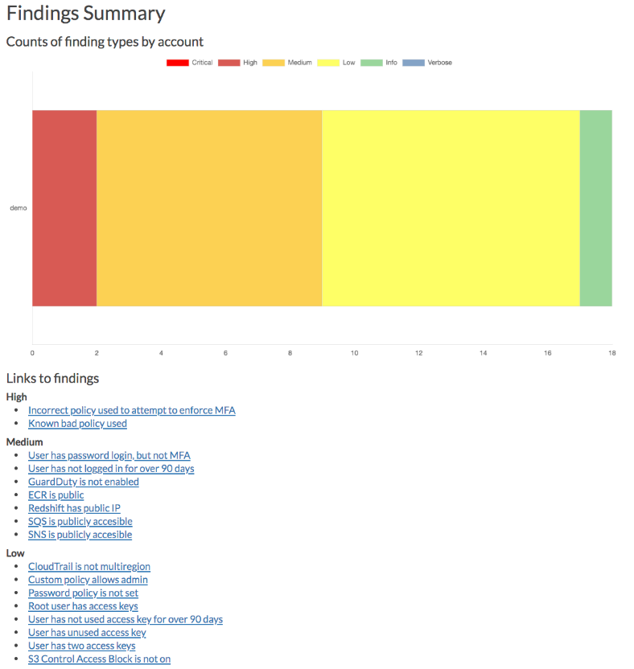
KPMG AWS Audit Automation Tools
User : Tejas Z
Project Explorer
MUFG
Asset Inventory List
Cloud Architecture
Report Generator
NEXT

Slide 7
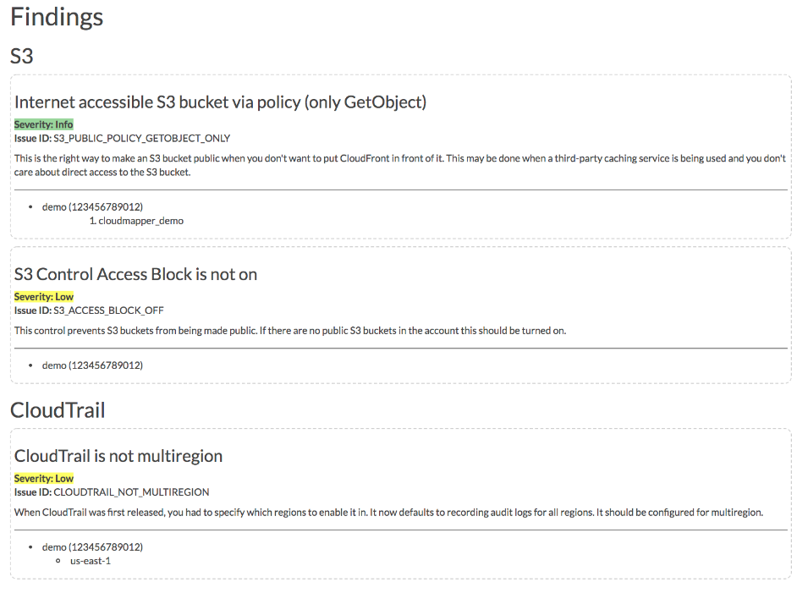
KPMG AWS Audit Automation Tools
User : Tejas Z
Project Explorer
MUFG
Asset Inventory List
Cloud Architecture
Report Generator
NEXT

Slide 8
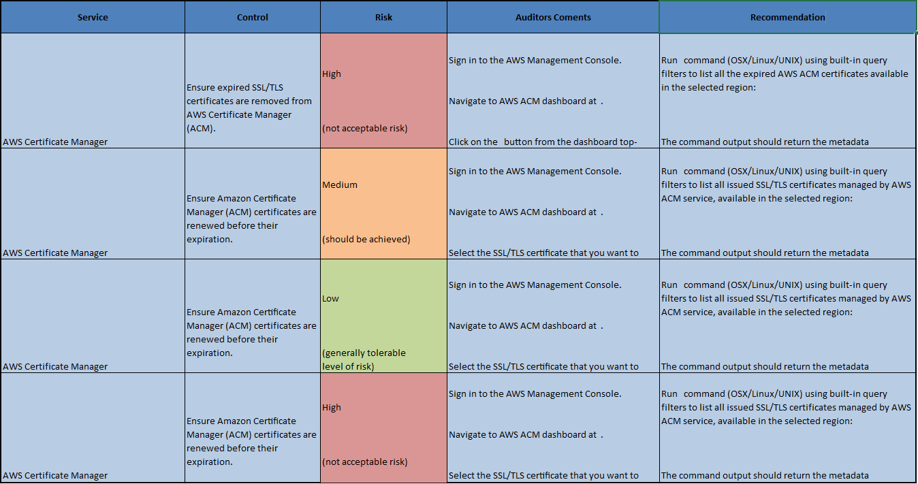
KPMG AWS Audit Automation Tools
User : Tejas Z
Project Explorer
Format: XLSX
Submit Changes
MUFG
Download Report
Asset Inventory List
Cloud Architecture
Report Editor

