Slide 1
SLOUCHING DETECTION

Slide 2
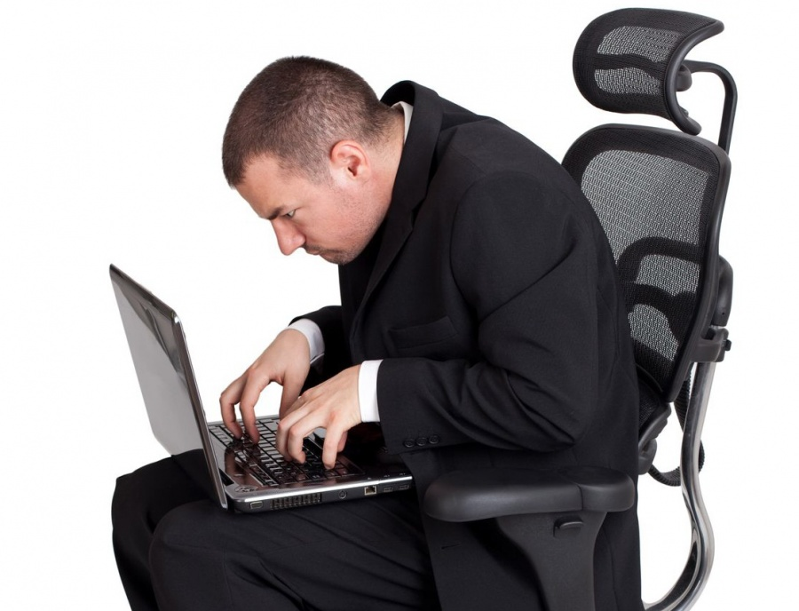
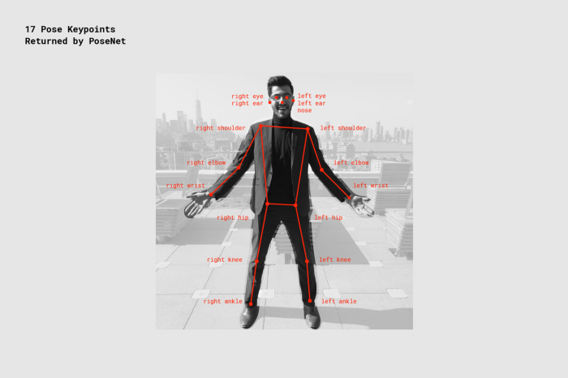
POSENET
Basic PoseNet Implementation (easy to launch)
Comparison to OpenPose (failed to train)
Advanced techniques to detect slouching
The main task is to detect whether there is an issue with slouching.
PoseNet architecture is readily available.

Slide 3
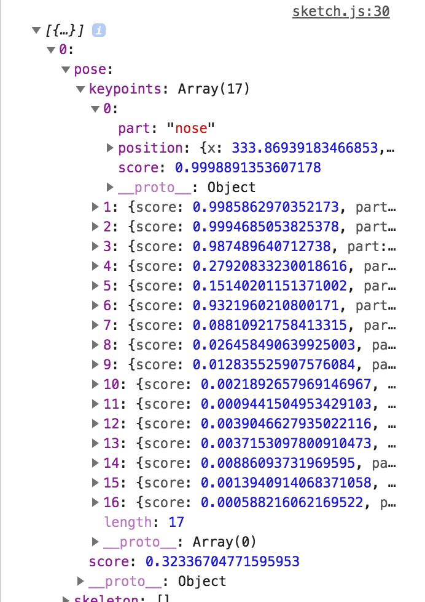

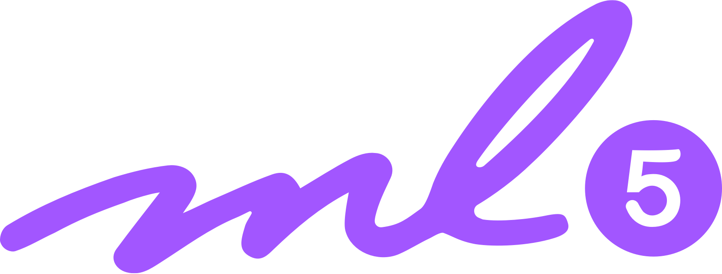
TECHNOLOGY STACK
p5.js (Graphics)
ml5.js (Pre-Trained Models + API)
PoseNet (Coordinates + Confidence Level)

Slide 4
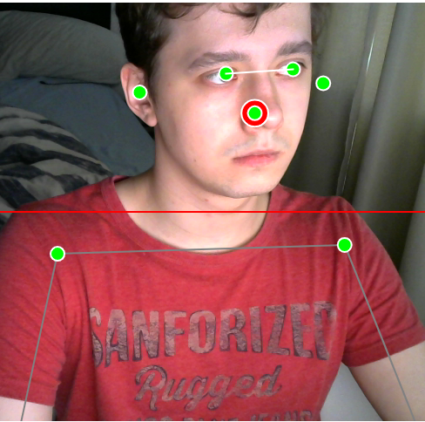
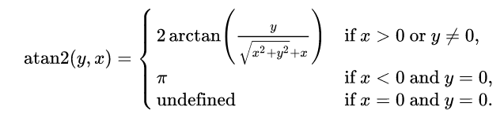
DETECTION PRINCIPLES
A simple horizontal line acting as a point of reference, to detect vertical slouching.
Angle between two lines, to detect side slouching
A reference body part can be changed within a line of code
Coordinates of different body parts are obtained via PoseNet
To be helpful, a sound is played if the permissible angle exceeds certain threshold (30°)
NB! This PoC does not take movements into account, position is assumed to be static.

Slide 5
THANKS FOR YOUR ATTENTION!

