Slide 1

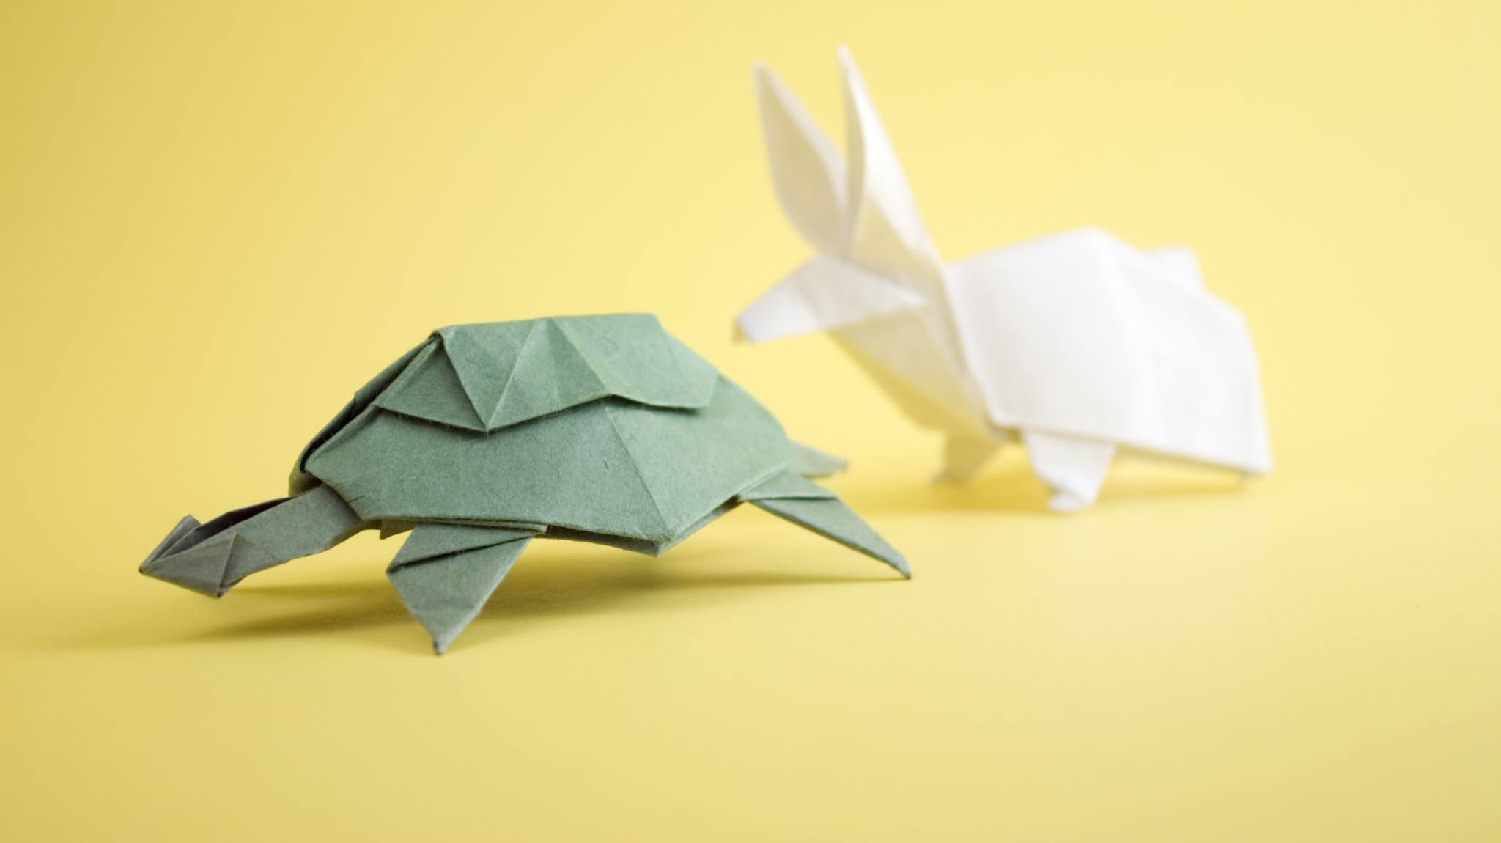
The Tortoise and the Hare
How slow and steady can be agile and win the race
Notes:
Greetings
Share lessons of the last 2 years at BOKF
Counterintuitive notion that small or slow improvement can be “agile.”
I’d like to show you how tortoise-like movements, combined with commitment and determination over time can yield surprising agility.

Slide 2
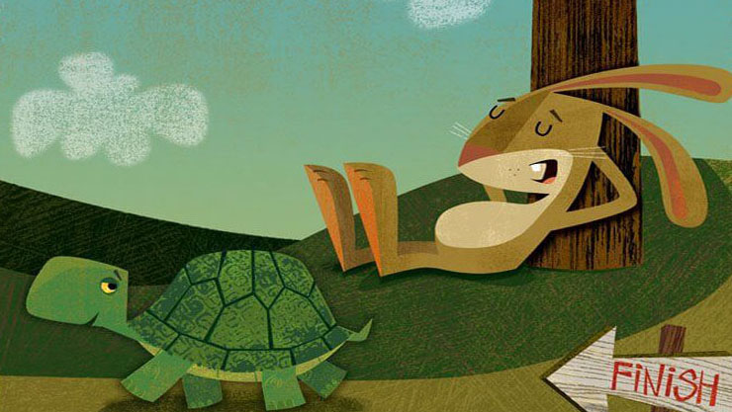
The Fable
Hare was making fun of tortoise, “Do you ever get anywhere?”
“Let’s race and I’ll prove it!”
The hare was amused and agreed.
The hare outpaced the tortoise quickly and stopped to nap
Slowly and steadily, the tortoise passed the hare.
The hare woke too late to catch the tortoise.
The tortoise won!
Notes:
There's an old story that many of you have heard before.
A Hare was making fun of the Tortoise one day for being so slow.
"Do you ever get anywhere?" he asked with a mocking laugh.
"Yes," replied the Tortoise, "and I get there sooner than you think. I'll run you a race and prove it."
The Hare was much amused at the idea of running a race with the Tortoise, but for the fun of the thing he agreed. So the Fox, who had consented to act as judge, marked the distance and started the runners off.
The Hare was soon far out of sight, and to make the Tortoise feel very deeply how ridiculous it was for him to try a race with a Hare, he lay down beside the course to take a nap until the Tortoise should catch up.
The Tortoise meanwhile kept going slowly but steadily, and, after a time, passed the place where the Hare was sleeping. But the Hare slept on very peacefully; and when at last he did wake up, the Tortoise was near the goal. The Hare now ran his swiftest, but he could not overtake the Tortoise in time.

Slide 3
The BOKF Tortoise…
Clunky, slow processes
Fledgling understanding of agility and Scrum
No shippable product each Sprint
No cross-functionality
No Definition of “Done”
Manual regression
Vendor Software
Manual deployments
Notes:
BOKF as the tortoise
- clunky, slow processes. I was actually sent home my first day because my user hadn't been completely added to our Active Directory system.
- Fledgling understanding of Scrum and agility
- Scrum wasn't producing potentially shippable product
- 2 teams, neither was cross-functional
- no definition of "Done" to speak of
- out of about 12 Developers, only 2 had significant programming experience. The rest were BA's.
- long, costly manual regression. No automated tests or skill in writing automated tests
- The software we were developing was from a vendor; limited control and significant problems in the relationship.
- deployment to DEV and QA process was manual: 3 "slots" for manual deployments each day. Had to manually copy changed files, including instructions. Error prone, frustrating, costly in terms of time
Competitors as the hare? Not really.
Most were just as bad as us or worse
I realized that I was the hare!
My expectations of “agility”
Honestly, I looked down on our technology, practices, etc for a short time.
Temptation was to abandon hope and be self-rigtheous
Reality defies simple explanation. It's easy to think of agility as a hare. Words like quick, nimble, energetic, explosive, etc, etc.
It's easy to think of BOKF like a tortoise. Big, slow, heavy, 0-60 maybe.
Yet fable you heard presents a paradoxical truth: that focus and determination can produce remarkable results.

Slide 4
…and the Hare?
Competitors? Not really
I was the hare!
Prideful expectations
Condescending thoughts
Temptation to abandon hope
Notes:
BOKF as the tortoise
- clunky, slow processes. I was actually sent home my first day because my user hadn't been completely added to our Active Directory system.
- Fledgling understanding of Scrum and agility
- Scrum wasn't producing potentially shippable product
- 2 teams, neither was cross-functional
- no definition of "Done" to speak of
- out of about 12 Developers, only 2 had significant programming experience. The rest were BA's.
- long, costly manual regression. No automated tests or skill in writing automated tests
- The software we were developing was from a vendor; limited control and significant problems in the relationship.
- deployment to DEV and QA process was manual: 3 "slots" for manual deployments each day. Had to manually copy changed files, including instructions. Error prone, frustrating, costly in terms of time
Competitors as the hare? Not really.
Most were just as bad as us or worse
I realized that I was the hare!
My expectations of “agility”
Honestly, I looked down on our technology, practices, etc for a short time.
Temptation was to abandon hope and be self-righteous
Reality defies simple explanation. It's easy to think of agility as a hare. Words like quick, nimble, energetic, explosive, etc, etc.
It's easy to think of BOKF like a tortoise. Big, slow, heavy, 0-60 maybe.
Yet fable you heard presents a paradoxical truth: that focus and determination can produce remarkable results.

Slide 5
The Race We Started
What is your favorite game to play?
One I’m invited to play
One I want to play
One I can win
The game race we started:
We wanted to improve.
They wanted me to play.
They didn’t take themselves too seriously.
Notes:
What is your favorite game to play?
One I’m invited to play and not made to play
One I want to play
One I can win
The game or race we started had a few important things about it:
The need for improvement was obvious and accepted by everyone. They wanted to improve…badly
They wanted me to play it with them and trusted me…a lot
Humor is very important, perhaps the 6th scrum value?

Slide 6
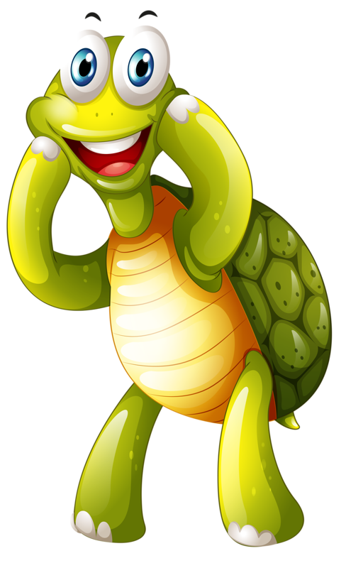
The Agility of the Tortoise
Agility is speedy revolution
Revolution
Speedy Change
Agility
?
Notes:
My grandma started walking a mile a day when she was 45. She's 84 now and we have no idea where she is!!
small improvements add up over time...if you don't quit.
not very exciting and generally don't make for good talks IMHO.
Big improvements are exciting, revolutionary, and make for great presentations
Time as a factor in the equation?
How long can you sustain speedy revolution?
Big changes make wow and sizzle for short periods. When they become status quo, that steady state becomes the next launching point for a new revolution. Big changes are dramatic, chaotic, exciting, tiring, troublesome, draining, and unsustainable IMHO. After a time of status quo, a new revolution may come around after a good long while.
Small changes are much less difficult,
can be more orderly,
a bit boring,
less troublesome,
energizing and
much more sustainable.
But...is this agile? I would say so.

Slide 7

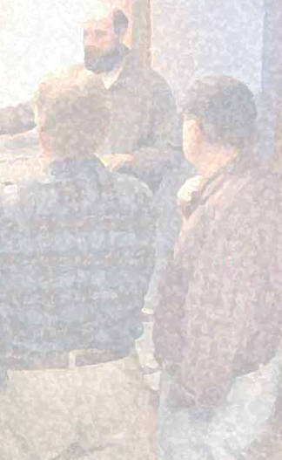
The Agility of the Sustainable Tortoise
Agile processes promote sustainable development. The sponsors, developers, and users should be able to maintain a constant pace indefinitely.
Notes:
>Agile processes promote sustainable development. The sponsors, developers, and users should be able to maintain a constant pace indefinitely.
- Organizations need to balance the risk of their activities.
Big risks can lead to big failures. The bigger the bet, the fewer you're inclined to take and the more unbalanced your approach. Eggs in one basket, and all that.
Small risks lead to small failures.
More palatable as learning experiences.
Smaller bets means more bets.
More baskets, fewer broken eggs.
Sustainable tortoise says choose the right problems to fix next; don’t boil the ocean.
Still agile.

Slide 8
The Agility of the Technically Excellent Tortoise
Continuous attention to technical excellence and good design enhances agility.
Notes:
>Continuous attention to technical excellence and good design enhances agility.
Continuous, not just during times of rapid or revolutionary improvement.
Not all technical improvements are small, but many are.
Small improvements like introducing your first unit tests or writing your first user story
Uncle Bob’s “Boy Scout Rule”
Deciding to trust the team to facilitate their own Daily Scrum
Learning for 30 minutes each week adds up over time.
There’s plenty of small things to improve all around you.
Still agile.

Slide 9
The Agility of the Simple Tortoise
Simplicity--the art of maximizing the amount of work not done--is essential.
Notes:
>Simplicity--the art of maximizing the amount of work not done--is essential.
Big change quickly risks all kinds of mistakes.
Buy-in,
oversights,
unintended consequences, etc.
Recovering from and reworking problems inherent in big-bang change is wasteful.
All that time spent reworking,
rearchitecting, and
even rehiring
Think of all the time and energy you could be spending on valuable work. If you have the time to spare, make the small, step by step improvements you need towards achieving the big goal over time. Still agile.

Slide 10
The Agility of the Reflective Tortoise
At regular intervals, the team reflects on how to become more effective, then tunes and adjusts
its behavior accordingly.
Notes:
>At regular intervals, the team reflects on how to become more effective, then tunes and adjusts
its behavior accordingly.
Small improvements occasionally are not sufficient to solve big, pervasive problems. Revolutionary change occasionally might (remember the risk). Small improvemets continuously can solve big, pervasive problems. Still agile.

Slide 11

Tradeoffs in Organizational Change
Urgency
Breadth
Commit.
Slowly
Small
With
Quickly
Big
Without
Notes:
The tortoise’s pace is slow and steady. Keyword steady.
Org change can easily falter if the wrong trade-offs are taken.
When can we safely improve quickly vs proceed slowly and carefully?
When should we change big, risky things vs small, safer things?
When should we proceed without consensus vs wait to build it?
I’m here to argue for why smaller, steady improvements with consensus can still win you the race.
small improvements over time establish trust and track record. Hard to argue with consistent success.
Trust makes everything faster and cheaper.
The next change becomes easier because of the solid foundation added to by previous, incremental changes.
Creates opportunities for bigger, faster change
I’ll focus for a minute on how a form of consensus, commitment, plays a key role in producing a steady pace of improvement for a team/organization

Slide 12


The Project Management Iron Triangle
Scope
Quality
Time
Notes:
The Scrum practitioner community is fond of using three terms to describe the tradeoffs made in a software development project. They are:
- Scope
- Quality
Time
Flex on Scope and Time, but not on quality.
What if your craft is not software development but organizational change via continuous improvement?

Slide 13
The Organizational Change Triangle
Breadth
Commitment
Urgency
Notes:
#### Breadth
This is the scope of the organizational change. I would define it as a function of number of people affected, how each affected person’s work must change, and how the affected person’s mindset must be changed.
#### Urgency
This is the time constraint of the organizational change. We need to get Agile by the end of the year. We need to re-organize all our teams to be co-located this quarter. Effective immediately, everyone needs to use the new TPS report cover sheets.
#### Commitment
This the quality of the organizational change. People resist being coerced to change as a natural instinct. An organizational change that is forced may garner compliance but it will rarely accomplish commitment. Commitment implies workers agree and would do it even if they were not required.
Insisting on high quality:
guards broken software and technical debt
craftsmanship ensures workers are encouraged to expand their personal mastery of necessary skills and aptitudes.
workers receive the pride of their workmanship.
Insisting on high commitment:
guards an organization from the false change, dishonesty and the division organizational debt inevitably brings.
requiring genuine leadership ensures leaders expand their personal mastery of necessary skills and aptitudes.
these managers receive the pride of their workmanship.
The next time a leader forces others to just, “Do what they say” consider it the equivalent of an irresponsible, untested hack made in production that will probably cause more defects than it fixes.

Slide 14

Compliance vs Commitment
Compliance
Acting in accordance with a wish or command.
Commitment
The state or quality of being dedicated to a cause, activity, etc.

Slide 15
The Killing of Continuous Improvement
No Vision
No Leadership or Bad Leadership
No Commitment
Notes:
Many of you know what I’m proposing is easier said than done.
I’ll talk about 3 things that will stop your tortoise dead in its tracks and could kill continuous improvement.

Slide 16

No Vision
If it ain’t broke, don’t fix it.
Leave well enough alone.
Inattention to results
Lack of Courage
Notes:
If it ain't broke, don't fix it.
Leave well enough alone.
Inattention to results.
Complacency.
Lack of courage.

Slide 17
No Vision
“Where there is no vision, there is no hope.” – G.W. Carver
There must be a reason to do the hard things.
Notes:
There must be a reason to do the hard thing. Otherwise, why suffer? Why not take it easy, be apathetic and comfortable?
Some may realize that standing still can mean falling so far behind, a crash is inevitable. The fear of this is not a sustainable force to compel through sizable difficulty.
George Washington Carver is quoted as saying, “Where there is no vision, there is no hope.”

Slide 18

No Leadership or Bad Leadership
Power is only ever given
Notes:
Forgetting that power is given
# Power Is Only Given
Gun to your head example

Slide 19
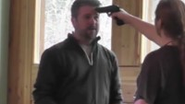
No Leadership or Bad Leadership
Notes:
Forgetting that power is given
# Power Is Only Given
Gun to your head example

Slide 20
No Leadership or Bad Leadership
1
Rewarding
2
Problems ☹
Coercive
3
Given / Formal / Legitimate
4
Expert
5
Referent
6
Informational*
Notes:
Forgetting that power is given
Bringing expertise to an expertise fight
# Power Is Only Given
Being in charge means caring for those in your charge
The servant as leader vs the leader as servant
[The Servant as Leader](http://www.ediguys.net/Robert_K_Greenleaf_The_Servant_as_Leader.pdf)
[6 Forms of Power](https://controlyourchaos.wordpress.com/2013/12/17/scrum-masters-toolkit-french-ravens-5-6-forms-of-power/)
[Psychological Models in Scrum](https://www.youtube.com/watch?v=fyDYpGCuvaA&t=1322s)
Gun to your head example.
##### 1 Reward and 2 Coercive
These two forms are the most common in nature. Every animal is susceptible to those. Basically they mean that you can do something for someone in order to receive a reward or avoid punishment. This is exactly the carrot & stick. If you use this power, you will get obedience. But nothing more. So if you want your dog to obey, you can give him or her treats to reinforce good behavior and punish bad. But remember, even if you do that , you might not be able to take control over your dog. Because when you turn around, the sausage will still disappear. Exactly the same applies to humans. If you reward and punish, everything will go towards what you reward and what you punish will be hidden. But apart from that, no creativity can be expected.
##### 3 Given / Formal / Legitimate
This power is only present in creatures who build societies. Did you ever watch The Dog Whisperer with Cesar Millan? If you did, try to remember what he wanted to achieve. He was the Pack Leader for the dog and taught owners how to do the same. He wanted the dog to be submissive. And this is exactly what you will have if you have formal power over someone – like a manager or a police officer. Someone who is high in social ranks, somehow culturally above someone else. But if you operate with this power, you will have submission and submission only. There is still very little creativity involved.
##### 4 Expert
Expert power is something that can be described as being respected, because you know a lot or can do something. This is something that has not been observed in any creatures, besides human. Some researchers believe dolphins, elephants, apes and crows may exhibit that power as well, but no hard proof has been found yet. Working with someone with that power over you, gives you wings to learn. You want to become just like this example someone, so you listen, follow footsteps and try to master this subject. This power gives you learning and conquering difficulties.
##### 5 Referent
This is a power that’s closest to trust. In large quantities it’s perceived as Charisma. It’s something that produces good feelings and engagement. It’s a power that’s easiest to lose and hardest to gain. You feel that this person is just right, you follow their lead. It’s something good leaders have.
##### 6* Informational
Why is there an asterisk here? Because this power was added later on, it wasn’t in the original research. This is a power that is present only in informational societies. Where having, withholding or manipulating information is possible. Some also argue if this is not only a different manifestation of a rewarding or coercive power. I will leave it for your consideration.
##### Why do I care?
Because the higher the power number is, the harder it is to gain, but the bigger the benefits are. It’s easy to coerce someone to do something, threatening them to sack them or promising a yearly bonus.
Also because coercive and rewarding powers are encoded in our reptilian brain, they are our instincts and it’s extremely hard in a critical situation not to use them. Same applies to given power – only if you give in to your instincts, the more primitive one will take over – the carrot and the stick.
And in critical situations we need creativity, learning and engagement the most – to quickly get out of that crisis.
That’s why Scrum Masters have to have Expert and Referent power but not formal, coercive or rewarding ones. So that they can get the most of people any time.s

Slide 21
Have you been led by someone who…
Doesn’t care to listen or understand you?
Seems consumed with powerful drive for power and material accumulation?
Doesn’t say, “Come with me” but rather “Get going!” and “Do as I say!”
Ignores the negative effects their leadership is clearly having on you, the world, and even themselves?
Notes:
How many here have been lead by someone who:
Doesn’t care to listen or understand you?
Seems consumed with powerful drive for power and material accumulation?
Doesn’t say, “Come with me” but rather “Get going!” and “Do as I say!”
Ignores the negative effects their leader is clearly having on you, the world, and even themselves?
This sort of leadership is all to common. I can work for short periods and with some people.
Ultimately, it is not sustainable and has the effect of stamping out commitment and creativity.
Speaking of commitment…

Slide 22
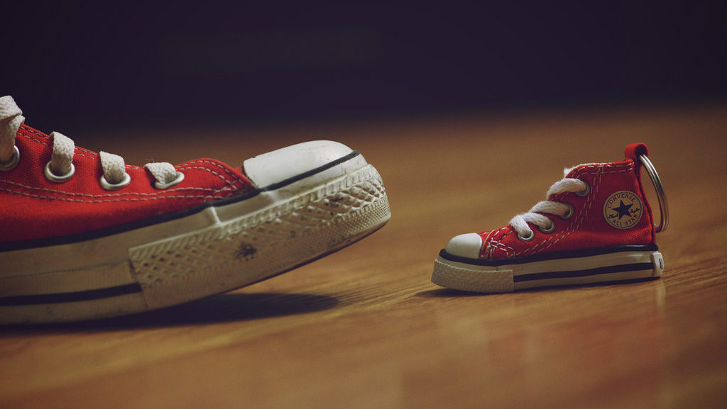
No Commitment
Little quits…
…lead to big failures
Faithful attention to small things…
…leads to success in the big things.
Notes:
Even with a compelling vision, habitual patterns can torpedo the commitment of a culture along it’s journey
### Little Quits
It’s rare that one quits something big without first quitting many times on something small.
When the “bigness” of the thing I’m wanting seems too daunting, I’m tempted to quit little and fail big.
To reverse this, we must believe that faithful attention to the small things will lead to success in the big things. We must have this hope.
Start saying no to the little quits, and you start saying yes to the big successes.
What are your little quits?

Slide 23

No Commitment
“A bad system will beat a good person every time.” – W. Edwards Deming
The Incentives that Bind Us
Individual rewards that conflict with the team goals
Leaders modeling bad behavior
Short-term, finite thinking
Notes:
A bad system beats a good man every day. – Deming
Paid for finding and fixing bugs.
Individual rewards that conflict with team collaboration.
Leaders who model “If it ain’t broke, don’t spend time improving it.”
Short-term, finite thinking.

Slide 24
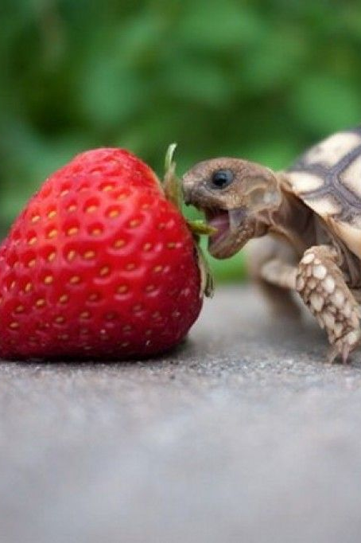
The Sustaining of Continuous Improvement
Now that you’ve seen ways to kill continuous improvement…
…what can be done to nurture and sustain it?
Notes:
Now that you’ve seen some ways to kill continuous improvement, here’s how I’ve learned to encourage and sustain continuous improvement to keep that agile tortoise steadily stepping toward the finish line.

Slide 25
Servant Leadership
“The best test, and difficult to administer, is: Do those served grow as persons? Do they, while being served, become healthier, wiser, freer, more autonomous, more likely themselves to become servants? And, what is the effect on the least privileged in society; will they benefit, or, at least, not be further deprived?”
Notes:
I asked you all before, who had experienced bad leadership.
How many here have been lead by a servant leader? Here’s the test.
Being in charge means caring for those in your charge.
[The Servant as Leader](http://www.ediguys.net/Robert_K_Greenleaf_The_Servant_as_Leader.pdf)

Slide 26
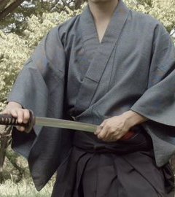
Gently wielding the power entrusted to us
Check for alignment
Be quick to understand
Watch for ability and willingness
Choose moments wisely
Act with restraint
Be ready to back off
Notes:
Servant leaders wield the power given to them, but gently.
The picture of gentleness here is like one who has a sword and knows how to use it but keeps it sheathed.
Choose moments wisely and act with restraint.
Too many mistakes, I’ll quickly lose trust and those who have given me power over them will take it back.
Careful to check for alignment and hesitance.
Quick to understand and empathize.
Watch carefully for the interplay between ability and willingness to know when to support and when to direct.
After directing, I’m on the hunt for the moment when I should back off.

Slide 27
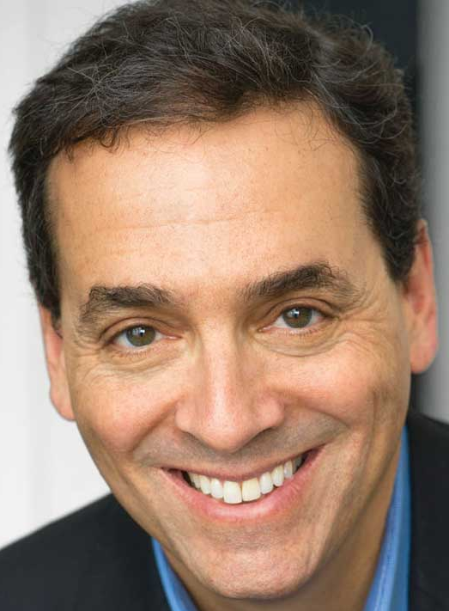
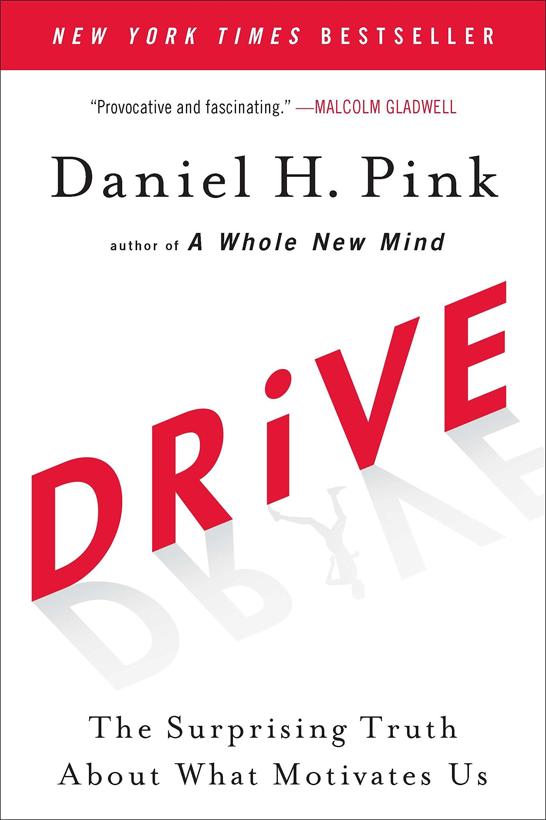
"Drive"ing results
The desire for autonomy.
The Pursuit of mastery.
The desire to have purpose, connection, or belonging.
Notes:
I’m a little annoyed with how one or our core values can be used. Driving results is important at BOKF. I’m sure you can imagine how this can be abused by the heavy-handed leader, the micromanager, or some other legitimate power to otherwise abuse those in their charge.
For me, this takes on a different form. I do my best to draw from Dan Pink’s wisdom. In his book “Drive” he outlines 3 basic motivational forces common to human beings.
The desire for autonomy.
The Pursuit of mastery.
The desire to have purpose, connection, or belonging.
look for ways to encourage doing what they think is best and to expect the same of each teammate.
creating the opportunity, providing equipment, and encouragement to improve towards master.
Don’t steal pride of workmanship.
Tend the garden, Fruits of focus, courage, commitment, openness, respect and humor.
Uproot that which threatens this place of meaning, purpose and belonging.
This is how I “Drive” results.

Slide 28
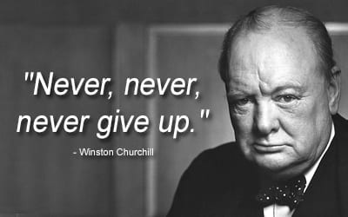
Jealously guarding hope
Guard against:
Naysayers
Excessive challenge
Too little challenge
Conflicting visions
Notes:
Hope is a cross-cutting concern, especially at beginnings.
Vision is distant.
Have you ever climbed a mountain? The peak can seem intolerably distant.
Looking back can fortify hope. I’ve come this far, maybe I can keep going?!
Jealously guard hope against:
Naysayers
Excessive challenge
Too little challenge
Conflicting visions

Slide 29
The Winning of the Race
Notes:
Now we come to the end.
I’ll share how all these things lead to the BOKF tortoise is winning its race.

Slide 30
The race as marathon
Infinite game
Insist on commitment
Be agile like tortoise
Notes:
Key to winning at this race has been correctly seeing the game we’re playing as an infinite one.
We are not playing it to beat competitors
We stay sufficient near or ahead of them.
We play keep playing without compromising the rules we have chosen – the things we value.
We insist on commitment as an important marker of the quality and staying power of our improvements.
We do our best to work sustainably.
We insist on an ever improving standard of technical excellence.
We reflect regularly and often to avoiding waste and improve what we can.

Slide 31
The Race as Life
““My job is to honor the ideas, structures, and processes that are dying and serve as midwife to those being born.”
Notes:
For me personally, I do my best to respect the lives of those with whom I work.
Serve as leader, gently wielding the power entrusted to me.
The life metaphor has even given me a motto I try to live by:
“My job is to honor the ideas, structures, and processes that are dying and serve as midwife to those being born.”
When processes, ideas and structures that have worked in the past are clearly no longer useful, I honor them and do my best to lessen the pain of their passing.
I do my best to joyfully welcome the new and guard it against that which might end it prematurely.

Slide 32
The race we're running (at BOKF)
We’re playing the game we want
We’re winning
Notes:
As for my Scrum team, the BOKF tortoise, we’re playing the game we want to play.
We’ve come a long way from where we were in December 2019.
We have been continuously integrating and delivering our work since mid-last year.
We can deploy on demand.
This very Sprint, we’re releasing an API that is covered by a significant suite of automated unit and integrations tests. We used test driven development to design features and bug fixes every chance we get.
We’ve worked with our Product Owner daily to ensure the work we deliver is of the highest value we can manage.
We use reflection, reframing, and impact feedback to respectfully and effectively communicate with each other.
I could go on.
Like my grandma who started walking a mile a day, in two more years time, there’s no telling where we’ll end up. However, I’m confident that we’ll probably still be playing the game we want to play and running our race like a tortoise.

Slide 33
Thank you

Slide 34
Credits and More Learning

