Slide 1
The Tortoise and the Hare
How Continuous Improvement is Great

Slide 2
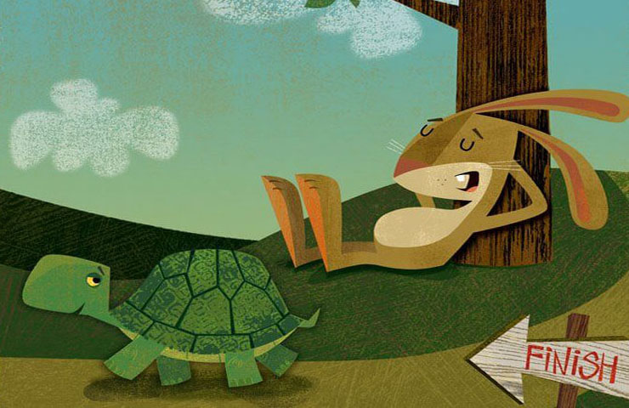
The Fable
Notes:
There's an old story that many of you have heard before.
A Hare was making fun of the Tortoise one day for being so slow.
"Do you ever get anywhere?" he asked with a mocking laugh.
"Yes," replied the Tortoise, "and I get there sooner than you think. I'll run you a race and prove it."
The Hare was much amused at the idea of running a race with the Tortoise, but for the fun of the thing he agreed. So the Fox, who had consented to act as judge, marked the distance and started the runners off.
The Hare was soon far out of sight, and to make the Tortoise feel very deeply how ridiculous it was for him to try a race with a Hare, he lay down beside the course to take a nap until the Tortoise should catch up.
The Tortoise meanwhile kept going slowly but steadily, and, after a time, passed the place where the Hare was sleeping. But the Hare slept on very peacefully; and when at last he did wake up, the Tortoise was near the goal. The Hare now ran his swiftest, but he could not overtake the Tortoise in time.

Slide 3
The BOKF Tortoise
Notes:
Reality defies simple explanation. It's easy to think of agility as a hare. Quick, nimble, energetic, explosive, tight corners, etc, etc. It's easy to think of big, stilted organizations as the tortoise. Slow, heavy, 0-60 maybe. Yet this story presents a paradoxical truth: that focus and determination can produce can produce remarkable results.
The sotry of my time at BOKF is a bit like the tortoise. There's no hare in my story like there was in the fable. We market position was and remains seemingly stable. But that's what makes our progress even more remarkable. Who keeps pushing constantly? The team that feels under threat by a rival competitor, not the insulated team with a successful product inside a company that's surved over a hundred years. We have every reason to take it easy. Why bother? Leave well enough along. IF IT AIN'T BROKE, DON'T FIX IT!
For those of you know who me, you know the passion I have for calling people forth to improve and change things for the better. Faced with many seemingly intractable problems, my frustrations can get the better of me causing me to disengage. With this team however, what seem like intractable problems at first glance, proved to be anything but. Almost as bad as "If it ain't broke, don't fix it" is the sentiment I've encountered often, "It'll never change." Both act to sap the motivation. One denies a problem, the other denies hope. My job, as it turns out was to illustrate problems and jealously guard hope.

Slide 4
The Race We Started
Notes:
When I started, the first things I saw were difficulties:
- clunky, slow processes. I actually was sent home my first day because my user hadn't been completely added to our Active Directory system.
- Fledgling understanding of Scrum and agility
- Scrum wasn't producing potentially shippable product
- 2 teams, neither was cross-functional
- no definition of "Done" to speak of
- out of about 12 Developers, only 2 had significant programming experience. The rest were BA's.
- long, costly manual regression. No automated tests or skill in writing automated tests
- The software we were developing was from a vendor; limited control and significant problems in the relationship.
- deployment to DEV and QA process was manual: 3 "slots" for manual deployments each day. Had to manually copy changed files, including instructions. Error prone, frustrating, costly in terms of time
What is your favorite game to play?
When you're invited to play and not made to play
That I want to play, and that I can win
One that, after a while, I realize I actually do love instead of dislike.
Humor is very important, perhaps the 6th scrum value?
I worried if this talk would be compelling, give it a simplicity and lack of novelty. Then I remembered how influential it was when I learned that the most successful scrum adoptions take about 5 years
Learn to trust the team all over again.
My resting state is something like active not caring. This is my happy place, where I ignore conflict and experience the Peace of blissful apathy.
When I care about something a lot, I moved to act and seek results. This can very easily turn into worry, coddling, anxiety, and command and control.
Trusting the team means you believe and act as if you believe that they can manage themselves and self-organize to accomplish the goals they set for themselves.
But, let's be real. An individual or a team isn't always trustworthy. They could lack the competence, clarity, and personal integrity to warrant that trust.

Slide 5
Conflating Agility with Revolution
Notes:
My grandma started walking a mile a day when she was 45. She's 84 now and we have no idea where she is!!
small improvements add up over time...if you don't quit. small improvements are are not very exciting and generally don't make for good talks IMHO. Big improvements are exciting, revolutionary, and make for great presentations
What happens when you add time as a factor in the equation? Well, how long can you sustain revolutionary change? Big changes make wow and sizzle for short periods. When they become status quo, that steady state becomes the next launching point for a new revolution. Big changes are dramatic, chaotic, exciting, tiring, troublesome, draining, and unsustainable IMHO. After a time of status quo, a new revolution may come around after a good long while.
Small changes are much less difficult, can be more orderly, a bit boring, less troublesome, energizing and much more sustainable. Over time, like with grandma, those changes can add up to extraordinary progress.
But...is this agile? I would say so.

Slide 6
The Sustainable Tortoise
Notes:
>Agile processes promote sustainable development. The sponsors, developers, and users should be able to maintain a constant pace indefinitely.
I've told why I think small changes are more sustainable. Organizations need to balance the risk of their activities. Big risks can lead to big failures. Small risks lead to small failuers that are more palatable as learning experiences. The bigger the bet, the fewer you're inclined to take and the more unbalanced your approach. Eggs in one basket, and all that. Smaller bets means more bets, more "better" failures balanced with success. More baskets, fewer broken eggs. Still agile.

Slide 7
The Technically Excellent Tortoise
Notes:
>Continuous attention to technical excellence and good design enhances agility.
Continuous, not just during times of revolutionary improvement. Not all technical improvements are small, but many are. Small improvements like introducing your first unit tests and getting those tests into a build and release pipeline are fairly small, if you have a build and release pipeline. the Pipeline can be big. Uncle Bob's "Boy Scout Rule" in code is an example to continuous attention to technical excellence. Learning for 30 minutes each week adds up over time. Still agile.

Slide 8
The Simple Tortoise
Notes:
>Simplicity--the art of maximizing the amountof work not done--is essential.
Big change quickly risks all kinds of mistakes. Buy-in, oversights, unintended consequences, etc. Recovering from and reworking problems inherent in big-bang change is wasteful. All that time spent reworking, rearchitecting, and even rehiring is time and energy you could be spending on valuable work. If you have the time to spare, make the small, step by step improvements you need towards achieving the big goal over time. Still agile.

Slide 9
The Reflective Tortoise
Notes:
>At regular intervals, the team reflects on howto become more effective, then tunes and adjusts
its behavior accordingly.
Small improvements occasionally are not sufficient to solve big, pervasive problems. Revolutionary change occasionally might (remember the risk). Small improvemets continuously can solve big, pervasive problems. Still agile.

Slide 10
The Tradeoffs of Organizational Change
Notes:
small improvements over time establish trust and track record. Hard to argue with consistent success. Trust makes everything faster and cheaper. The next change becomes easier because of the solid foundation added to by previous, incremental changes.
[picture of pearl](https://s26162.pcdn.co/wp-content/uploads/2021/08/close-up-of-pearl-in-oyster-shell-82136435-59cab4cbaf5d3a0011308d9e.jpeg)

Slide 11
Flex on Scope and Time, Not on Quality
Notes:
The Scrum practitioner community is fond of using three terms to describe the tradeoffs made in a software development project. They are:
- Scope
- Quality
- Time
What if your craft is not software development but organizational change?

Slide 12
The Org Change Triangle
Notes:
#### Breadth
This is the scope of the organizational change. I would define it as a function of number of people affected, how each affected person’s work must change, and how the affected person’s mindset must be changed.
#### Urgency
This is the time constraint of the organizational change. We need to get Agile by the end of the year. We need to re-organize all our teams to be co-located this quarter. Effective immediately, everyone needs to use the new TPS report cover sheets.
#### Commitment
This the quality of the organizational change. People resist being coerced to change as a natural instinct. An organizational change that is forced may garner compliance but it will rarely accomplish commitment. Commitment implies workers agree and would do it even if they were not required.

Slide 13
Flex on breadth and urgency, not on commitment

Slide 14
The Killing of Continuous Improvement

Slide 15
No Vision

Slide 16
No Leadership

Slide 17
No Leadership
Leadership without service

Slide 18
No Leadership
Abuse of power
Forgetting that power is given
Bringing expertise to an expertise fight

Slide 19
No Commitment
Little Quits
Notes:
### Little Quits
It’s rare that one quits something big without first quitting many times on something small.
Do you remember that essay project in school? It seemed so imposing until you wrote the first draft then got someone to give you feedback on it? Maybe it was something different, like quitting a habit. it seemed impossible until you saw a plan to ween yourself from a behavior and got someone to check up on your progress?
If you’re like me, there are many little things that lead up to big things. Too often, I’m thwarted in the little things because I’m thinking of the big thing. The small thing is really not that hard but the big thing looms large and seems impossible. In these cases, I find myself quitting little and failing big.
I propose that when I fail big it’s because I quit little; little quits led to a big quit. I didn’t believe in the big triumph and therefore couldn’t believe in the success of the little.
What if we reversed it? What if we start believing in the importance of the little things that seem possible rather than the big things that feel out of reach? We may find we succeed more and more in the little things and end up succeeding more and more in the bigs.
Start saying no to the little quits, and you start saying yes to the big successes.
What are your little quits?

Slide 20
No Commitment
The Incentives that Bind Us

Slide 21
The Sustaining of Continuous Improvement

Slide 22
Gently weilding the power entrusted to us

Slide 23
"Drive"ing results

Slide 24
Jealously guarding hope

Slide 25
The Winning of the Race

Slide 26
The race as marathon
Infinite game
Insist on commitment
Be agile like tortoise

Slide 27
The Race as Life
Honor what is ending
Nurture what is emerging

Slide 28
The race we're running (at BOKF)
We’re playing the game we want
We’re winning

Slide 29
Thank you

Slide 30
Credits and More Learning

