Slide 1
scala days 2010
exmachina

Slide 2
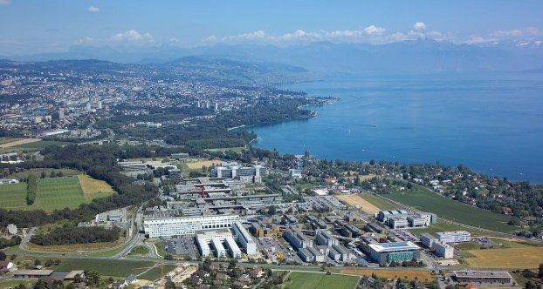
location

Slide 3
People
150 registrations
10 epfl scala team
10 stanford ppp
30 speakers
40 not classified
60 industry

Slide 4
presentations
How to exploit scala to:
  translate to another language
  create a DSL
  type-safe extension of the language
Parallel computing
Distributed computing
Tools
Move from java to scala

Slide 5
How scala compiler works
two phase process:
  from scala to java
  from java to bytecode
scalac is pluggable

Slide 6
From scala to javascript
Simil GWT from scala (?)
Generation of javascript from bytecode
Runtime mode in the client
Debug mode with remote calls

Slide 7
scala at NASA
The goal: launch a missile
The problem: requirements in excel
Use high level language: python (slow)
Implementation of a DSL with scala

Slide 8
Type safe SQL embedded in scala
Is it possible to write SQL in scala and the compiler check the syntax?
Yes! With a compiler plugin
At the end the speaker won a thesis

Slide 9
Pervasive Parallel processing
Stanford
Scala and actors to express the operations through a DSL
Compilation in a language specific to runtime environment

Slide 10
Parallel processing
Library with internal parallel data management
delayed execution of statements (vertical parallelization)
Used for scientific computing

Slide 11
Distributed computing
@Linkedin
Norbert is a framework written in Scala that makes it fast and easy to write asynchronous, cluster aware, message based client/server applications
Used to develop the social graph engine
Open source

Slide 12
Akka
"Let it crash"
Actors
Remote Actors
Agents
STM
Distributed STM (Transactors)
Weird syntax ! !! !!!

Slide 13
Tools
SBT
  'All scala' building tool
  Uses Ivy to resolve dependencies
eclipse plugin
  difficult integration with JDT
  scalac modified to simplify integration with IDEs

Slide 14
From java to scala
Scala binding to Fly Object space
  translation 1 to 1 from java to scala
  application of scala features
How to introduce scala
  use it for tests
  define a simple DSL
  do not use 'alien' syntax
  introduce slowly new syntax (avoid magic)

Slide 15
Conclusions
Edge use of scala
Tendency to use a naive syntax
most used scala features:
  traits (multiple inheritance)
  anonymous functions and closures

