Slide 1

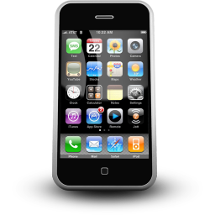
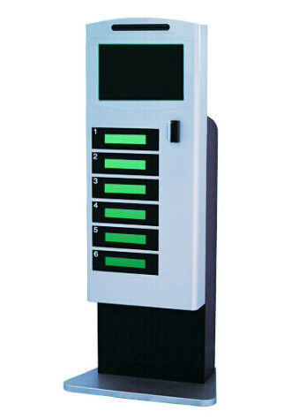


Controller
Control Center
Mobile Phone
Controller
Controller
Controller
…
Smart Power Station
Authoring Tool
Controller Manager

Slide 2
CMP Client
CMP Server
TCP/IP Connect
Send Binding Request
Send Binding Response
Session established then start to communication …
Send Non Binding Request
Send Non Binding Response
Session closed and communication ending …

