Slide 1
Youtube Video Popularity Statistics
CSE 564 – Visualization
Prof. Klaus Mueller
Jugu Dannie Sundar (110455279)
Venkateswara Prasad Pandeti (110396994)

Slide 2












Pipeline

Slide 3
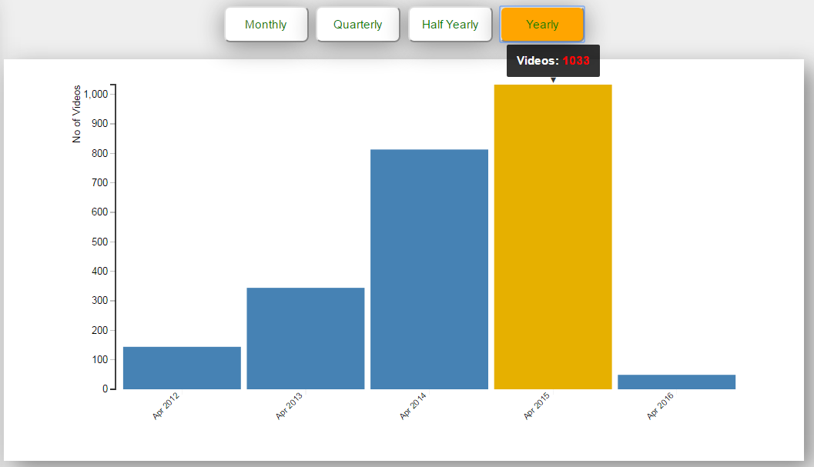
How active a channel is?
Here the timescale is Monthly, Quarterly, Half-Yearly and Yearly
The above graph is for Jimmy Fallon show. Initially, the show witnessed only a few hosts. Gradually, it became very popular and has hosted many celebrities and uploaded many videos

Slide 4

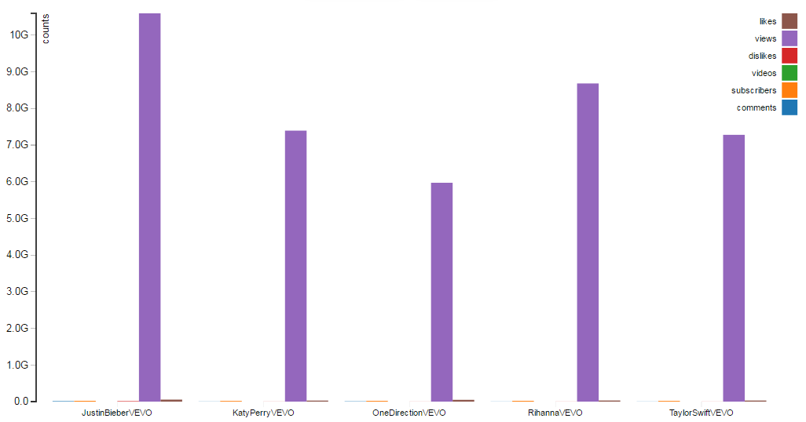
How popular a channel in a category is?
Bieber fever

Slide 5
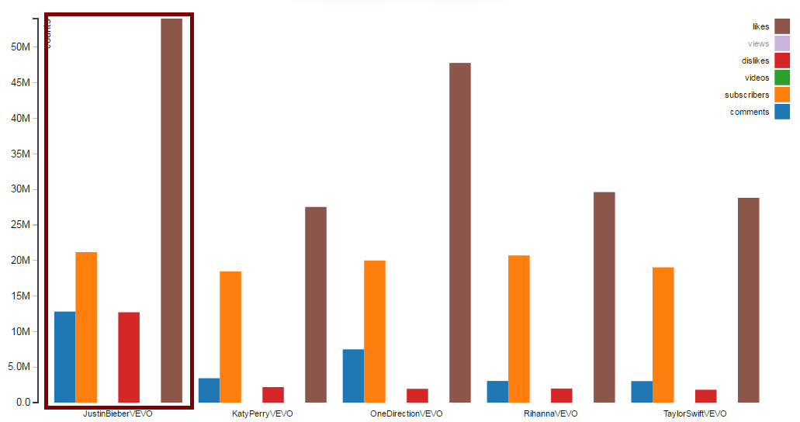
How popular a channel in category is? contd.
The Curious case of Justin Bieber

Slide 6
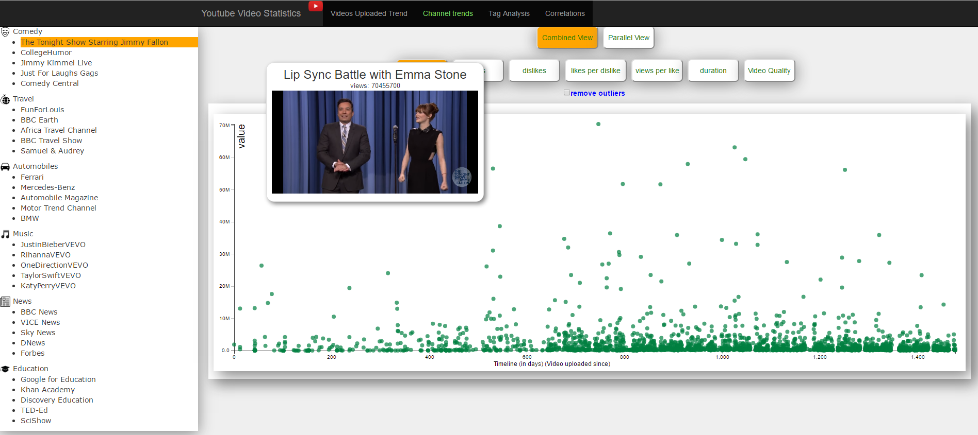
Which is the most viewed video for a channel?

Slide 7
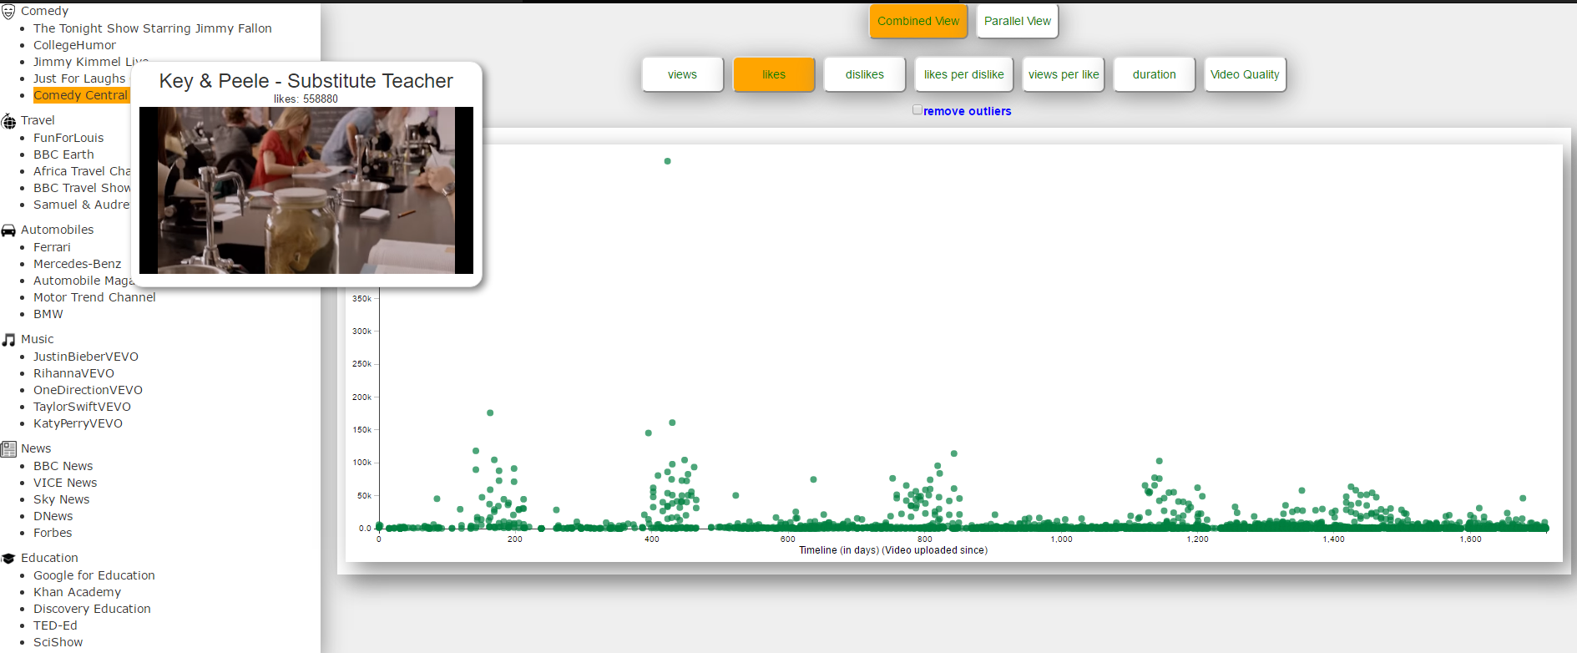
What patterns can we observe about channel videos?
Key and Peele Series (Season 1)
Key and Peele Series (Season 2)
Key and Peele Series (Season 3)
Key and Peele Series (Season 4)

Slide 8
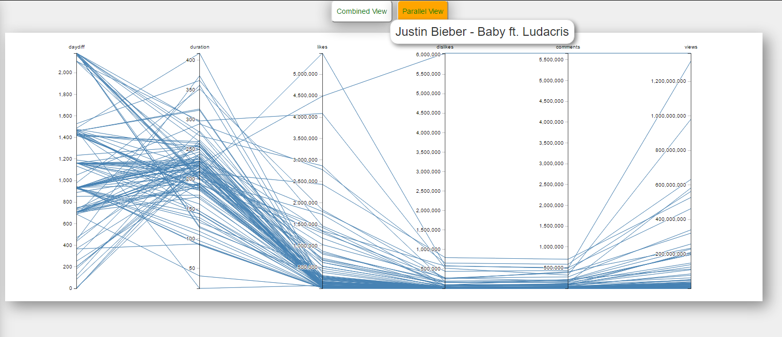
Multi Dimensional approach
Outlier: More dislikes and less likes
Dislikes
Dislikes
Comments
Likes
Comments

Slide 9
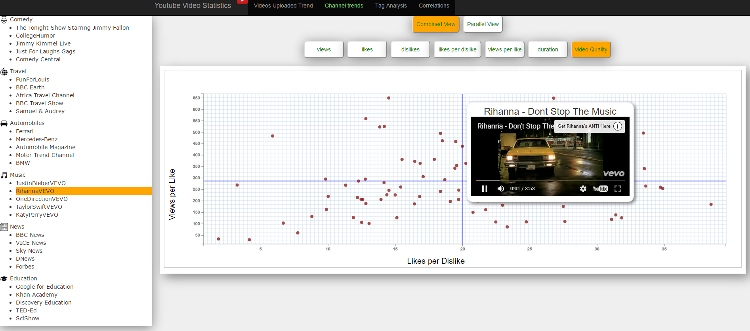
What about video quality(popularity+likes)?

Slide 10
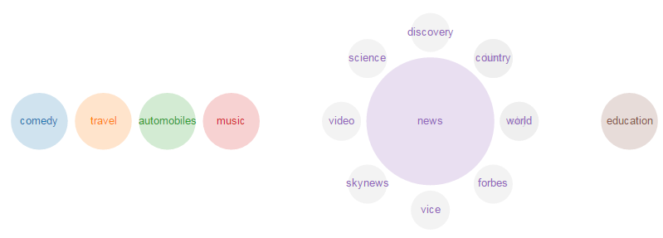
Latent Semantic Analysis for Tags
Most of the videos that are uploaded in news category belong to science

Slide 11
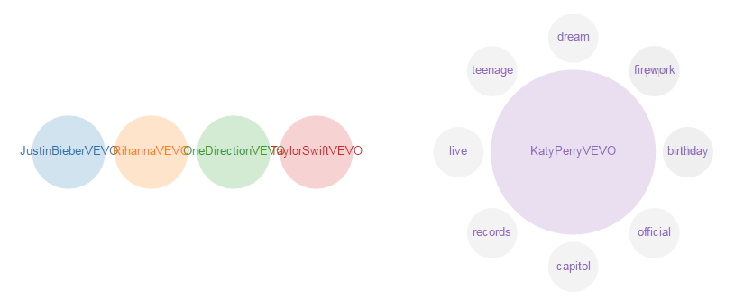
Latent Semantic Analysis for Tags contd.
Katy Perry uploaded more videos on teenage and life

Slide 12
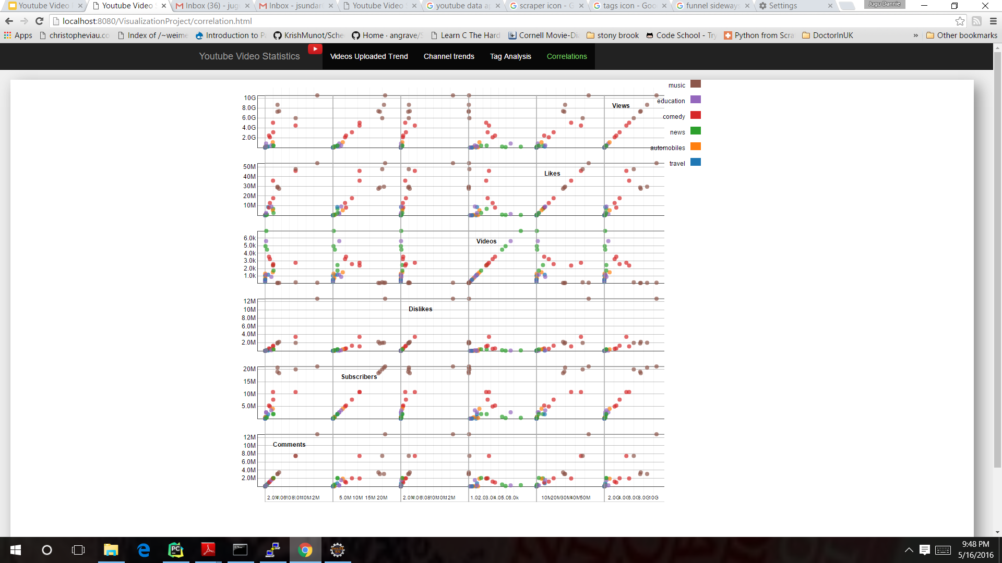
What can we infer from SPLOM?
views
likes
likes
videos

