Slide 1
Linux debugging and tracing tools

Slide 2
Agenda
Introduction
Userland debugging mechanisms
Kernel code debugging
Linux tracers
Reverse anti-debug
Conclusion

Slide 3
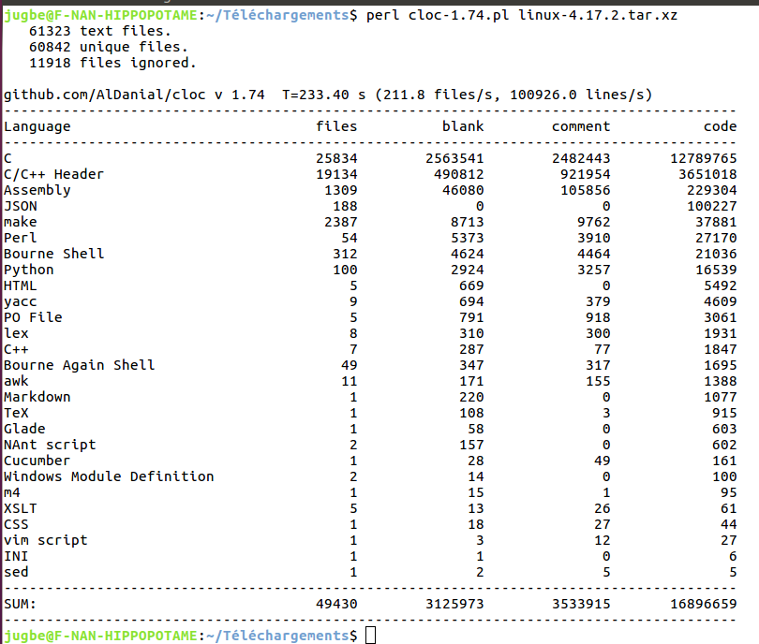
How difficult is Linux ?

Slide 4
Userspace

