Slide 1


Master 2 degree final defense – Software for embedded systems
Linux debugging
and tracing methodologies
By :
Jugurtha BELKALEM
Tutor :
David GARRIOU
Supervisor :
Jalil BOUKHOBZA
Notes:
Good evening ladies and gentleman, members of the jury and welcome to this presentation.
My Name is Jugurtha BELKALEM and today i’m going to summarize the results of my intreship at SMILE-opensource on Linux debugging;
without further waiting; let’s start the talk.

Slide 2





















SMILE OpenSource
1st integrator and European expert in open source solutions (27 years of experience)
1300 contributors working across 15 agencies (in 7 countries)
More on smile : https://www.smile.eu/en/company/who-are-we
Notes:
Who is SMILE. The official definition says : 1st integrator of opensource solutions in europe, which means for every service we provide :. web development, business apps to monitor data, building innovative software for embedded system or private cloud computing. We use an opensource solution to do it.
I work at embedded & IOT by the way.

Slide 3

Big story made short – Goals of internship
Overflows
Memory leaks
Access permissions
NULL pointers
Return values
SMILE Requires
Better testing methodologies of our product before deployment (before handed to clients)
Quickly detect problems during production (memory leaks, sources of latencies, kernel panics, …, etc) when encountered by the client.
Locate malicious code infections that tampered the solution (and defeat Anti-debug).
Notes:
But what motivated the internship? As developers we work in teams; inside a team;we have different skills, not everyone checks for return values, memory leaks, null pointers, overflows to list only few; in fact no one writes perfect code.
We need to satisfy more our clients :
To test better our products before deployement
If they are deployed we need to quickly figure out bugs when they rise.
Defeat Malicious code that may comprise a solution.
We are going to talk more about in the next slides

Slide 4
Agenda
Introduction
Userland debugging mechanisms
Kernel code debugging
Linux tracers
Reverse Anti-debug
Conclusion
Notes:
We are going to follow this agenda along the way.
Let’s start debugging Linux.

Slide 5
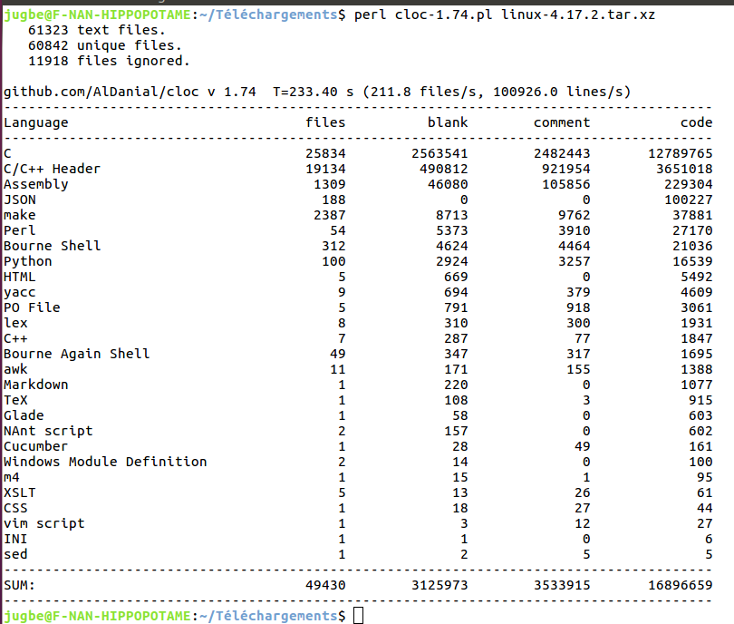
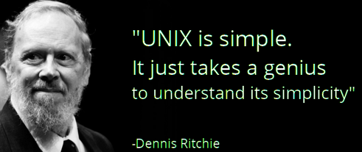
Introduction
Linux complexity ?
Cloc (Count Lines of Code) :
Accounts for files, languages and sources that make up a project
Need efficient debugging tools
Notes:
How complex is linux?
a utility called cloc can be used to account for statistics of a given project.
Here is Cloc used against linux sources. the result shows that Linux goes beyond 16 million lines of code written in different languages (C/C++ are predominant).
This is the case of all Unix-like systems.
Now We are aware that we need tools that can scale and debug effectively such complex system.

Slide 6
Agenda
Introduction
Userland debugging mechanisms
Kernel code debugging
Linux tracers
Reverse Anti-debug
Conclusion

Slide 7
Userspace debugging tools
Userspace
Notes:
In the userspace we can query the file system hierarchy.

Slide 8
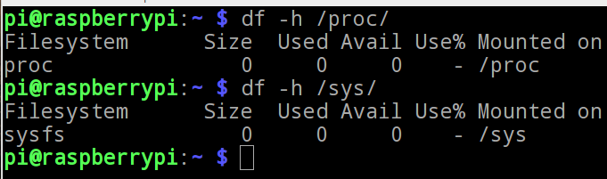
Userspace debugging tools
Userspace
Do not exist on disk
ProcFS
Filesystem
Two pseudo filesystems – they are created at system’s boot
SysFS
Share some kernel’s knowledge to userspace
Some important files :
- /proc/pid/status : process states (running or idle), debugger attached?, ...etc.
- /proc/pid/limits : displays process resources limits (there are 16 limits in Linux).
- /sys/module : stores information associated with each loaded module.
Notes:
Procfs and sysfs are pseudofile systems created during system’s boot. They do not exist on the disk. They allow the kernel to share some of it’s knowledge to the userspace.
We can highlight some the files that we find there :
the status file to get process state and whether a debugger is attached to it or not?
limits : shows limits associated with each process
sys/module showing every information about modules (it is required when debugging modules)

Slide 9
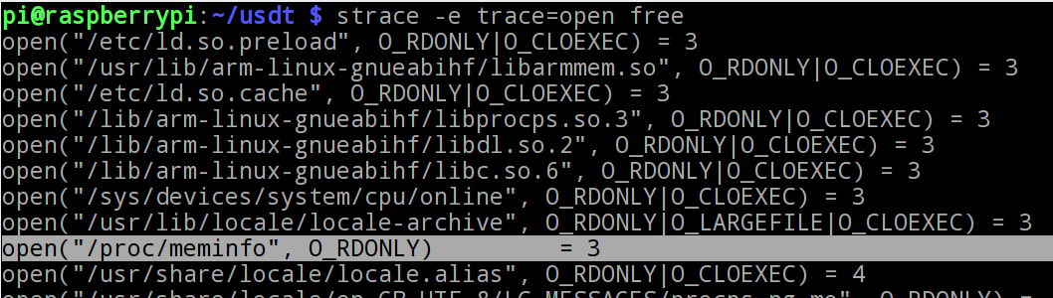

Userspace debugging tools
Userspace
ProcFS
System calls are requests to the kernel to perform a service (openning a file, allocating memory, …,etc).
Filesystem
System
calls
SysFS
kernel
Userspace
strace
Sys Requests
Sys Answers
End user
strace
Reports
Notes:
System calls are requests to the kernel to do something or perform a service.
In fact, they are the only legal way to get into the kernel.
strace can catch those system calls and reports them to end user.
here is a quick example where strace shows that free utility is actually making an open system call to read /proc/meminfo file from where it gets it’s data

Slide 10
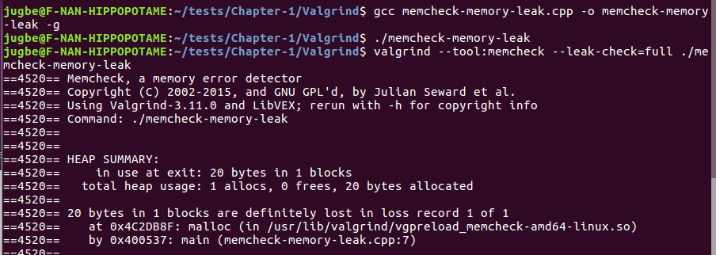
Userspace debugging tools
Userspace
ProcFS
Valgrind : instrumentation and profiling framework for userspace applications
Filesystem
System
calls
SysFS
Valgrind
strace
Callgrind - CPU profiler
Helgrind - Posix Thread analyser
Memcheck (default) - mem Leaks
Cachegrind - cache simulator
Massif - memory footprint
Notes:
it is a collections of 11 tools, We are going to see the most relevant in practice :
Memcheck is default tool used for memory leaks
Helgrind for analyse threading issues
Callgrind is the new generation gprof (it’s a CPU profiler)
Cachegrind : program’s to cache interaction simulator
Massif to monitor memory usage during program’s lifecycle

Slide 11
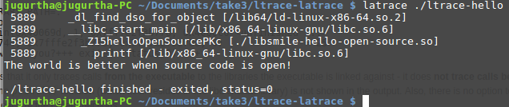
Userspace debugging tools
Library calls : are calls to functions stored in libraries (printf, strcmp, alloca, ...,etc).
Userspace
ProcFS
ltrace catches library calls
Filesystem
System
calls
Library
calls
latrace is the evolution of ltrace which can even catch calls between libraries
SysFS
Valgrind
strace
ltrace
(latrace)
Callgrind - CPU profiler
Helgrind - Posix Thread analyser
Memcheck (default) - mem Leaks
Cachegrind - cache simulator
Massif - memory footprint
DHAT - Heap analyser
Notes:
Library calls : executables access functions defined in external libraries (printf, strcmp, alloca, ).
ltrace catches those calls and reports them. There is also latrace the evoltuion of ltrace which allows to record calls between libraraies. useful testing our calls to our custom libraries, viewing if we are talking the right version of the function.

Slide 12
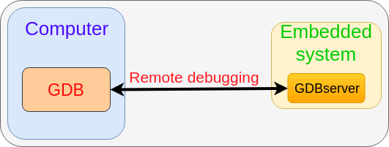
Userspace debugging tools
GDB : Gnu debugger allows to inspect deeply a program.
Userspace
GDBserver : allows remote debugging of a remote application using GDB
ProcFS
Filesystem
System
calls
Library
calls
GDB/gdbserver
SysFS
Valgrind
strace
ltrace
(latrace)
Callgrind - CPU profiler
Helgrind - Posix Thread analyser
Memcheck (default) - mem Leaks
Cachegrind - cache simulator
Massif - memory footprint
DHAT - Heap analyser
Notes:
We close userspace discussion with the most famous debugger GnuDebogger, enabling us to see inside an application and set breakpoints, watchpoints, catchpoints and change the control flow. gdbserver (lightwight agent) allows GDB to debug remotely an application through serial port or ethernet.

Slide 13
Agenda
Introduction
Userland debugging mechanisms
Kernel code debugging
Linux tracers
Reverse Anti-debug
Conclusion
Notes:
that was the easiest part, let’s go to the kernel

Slide 14
Dive into Kernel-land
Kernel states
S
Stable
P
Partially stable
Linux Kernel debugging
U
Unstable (PANIC)
Notes:
the kernel undergoes 3 different states : each debugged differently.

Slide 15
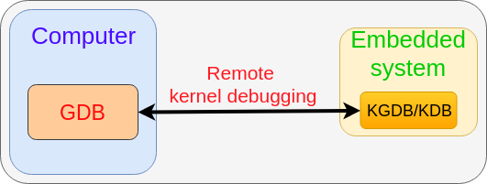
Dive into Kernel-land
Kernel states
KGDB : source level debugger (breakpoints, catchpoints, watchpoints, …,etc).
S
Stable
P
Partially stable
Linux Kernel debugging
KDB : raw level debugger (active processes, CPU backtraces, memory usage, …, etc).
U
Unstable (PANIC)
Kernel
debuggers
KGDB/KDB
[Target Kernel compiled with debugging
symbols]
S
Notes:
KGDB/KDB are the equivalent of GDBserver in the kernel land. Once enabled, We connect to them using GDB
Pay attention that target kernel must be compiled using debugging symbols (which is not the case in production).

Slide 16

Dive into Kernel-land
Kernel states
S
Stable
P
Partially stable
Linux Kernel debugging
U
Unstable (PANIC)
Kernel
debuggers
System
Faults
System responsive
KGDB/KDB
[Target Kernel compiled with debugging
symbols]
Kernel oops
(dmesg to read oops)
S
P
P
Notes:
when the kernel gets instable (but it is not in PANIC), the kernel is in system fault state, we may be facing two different scenarios :
The kernel is responsive, We can read the error messages from the kernel’s ring buffer using dmesg command, Those errors are called kernel oops. An example of oops is telling us that some kernel code derefenreced a NULL pointer

Slide 17
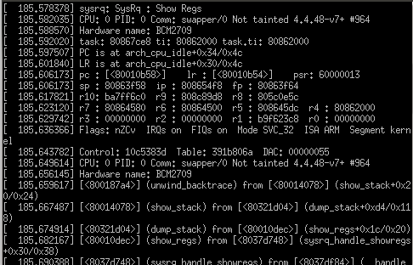
Dive into Kernel-land
Kernel states
Stable
Alt + Print + p : Dump registers contents (Raspberry PI 3)
S
P
Partially stable
Linux Kernel debugging
U
Unstable (PANIC)
Kernel
debuggers
System
Faults
System responding
System not
responding
KGDB/KDB
[Target Kernel compiled with debugging
symbols]
Kernel oops
Kernel hangs
Magic SysRq
Keys
(Alt + Imp + Key)
S
P
P
Notes:
the kernel does not respond to user input, and seems like frozen(fro example when the graphical interface is not respensive). We can still interact with the kernel using Something called SysrQ keys which allows to execute low level functions of the kernel.
Here is an example showing how to get registers contents through serial communication.

Slide 18
Dive into Kernel-land
Kernel states
S
Stable
P
Partially stable
Linux Kernel debugging
U
Unstable (PANIC)
Kernel
debuggers
System
Faults
Kernel PANIC
System responding
System not
responding
KGDB/KDB
[Target Kernel compiled with debugging
symbols]
Kernel oops
Kernel hangs
Magic SysRq
Keys
(Alt + Imp + Key)
Kernel core dump
(kdump + kexec)
Analyse dump with crash
U
S
P
P
Notes:
in kernel panic, the system is dead.
kdump and kexec are used to get a dump file of kernel’s address space
The dump file can be analysed later using GDB or a more specialized tool like crash.

Slide 19
Dive into Kernel-land
Kernel states
GDBremote compliant JTAG/SWD (for ARM) - OpenOCD
Stable
S
P
U
S
P
Partially stable
Linux Kernel debugging
U
Unstable (PANIC)
Kernel
debuggers
System
Faults
Kernel PANIC
System responding
System not
responding
KGDB/KDB
[Target Kernel compiled with debugging
symbols]
Kernel oops
Kernel hangs
Magic SysRq
Keys
(Alt + Imp + Key)
Kernel core dump
(kdump + kexec)
Analyse dump with crash
U
S
P
P
Notes:
All debugging solutions that we have seen were sotftware based, there is much more better. The last method is hardware debugging, I spent 3 weeks with this. This is one of the most powerful debugging techniques as it enables physical access to the target through JTAG or SWD for ARM OpenOCD is a opensource solution enabling to manipulate JTAG/SWD signals at software level. We can upload even firmwares, changing the first instruction executed by the processor

Slide 20
Agenda
Introduction
Userland debugging mechanisms
Kernel code debugging
Linux tracers
Reverse Anti-debug
Conclusion

Slide 21
Linux tracers
A tracer shows every low level event happening in the system (userspace + kernel) in chronological order
A tracer output
Timestamp PID Command Function Latency
000000001 1125 Chromium do_sys_open (Disk read access) 125ms
………………………………………………………………………………………………………………………………………...
………………………………………………………………………………………………………………..…………………….....
000000005 775 Vmware kmem_cache_alloc (mem allocation at 0xfff000ccccc0) 50ms
000000012 1125 Chromium ip_recv (receive TCP/IP packet) 230ms
………………………………………………………………………………………………………………...…………………….....
………………………………………………………………………………………………………………...…………………….....
000000017 6 kworker write_dirty_page (synchronize buffers with disk) 400ms
Notes:
A tracer shows every single event happening in the system in chronological order.
Chromium is reading from a file on disk
Then vmware allocted some memory
Then chromium which receievd a TCP/IP packet
Kworder kernel thread is synchronizing disrty buffers to disk.

Slide 22
Linux tracers
Variety of tracers exist on Linux
Tool | Linux mainline | Front-end tool | Real time report | GUI trace parsing tool | Remote tracing | More practical tools
Ftrace | Since 2.6.27 | Trace-cmd | no | Kernelshark | yes | perf_tools
Perf | Since 2.6.31 | Perf | no | Hostspot | no
eBPF | Since 4.4 | BCC | yes | no | no | no
LTTng | No | Lttng | no | Trace compass | yes | LTTng toolkit analyses
Notes:
Ftrace, Perf and eBPF are in the mainline, Lttng is not; all of them have front end tool to make them easy to use. Ftrace and LTTng can trace an embedded system remotely.
This is not an exhaustive list of tracers but are those are the tracers that the industry is relying on..

Slide 23
Agenda
Introduction
Userland debugging mechanisms
Kernel code debugging
Linux tracers
Reverse Anti-debug
Conclusion

Slide 24


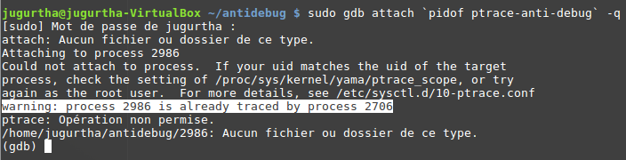
Anti debug
Why is it crucial to know ?
Anti debugging makes all the tools that we have seen (strace- ltrace- GDB, oops, …, etc) useless.
LD_PRELOAD injection
Simple Anti-debug example
Only one debugger can be attached to a process at time t
Module tampering (inject module to another)
Notes:
why anti debugging, because anti debugging makes all the tools that we have talked about useless.
Here is a quick example :
the folliowing code snipet causes the current process to be traced and attached to it’s parent.
And we know that only one debugger can be attached to a particular process at a given time.
Trying to start a debugging session using GDB will fail (process already being traced).
This is intimidating and We see even more in practice. That’s why we need to be prepared for such cases.

Slide 25
Agenda
Introduction
Userland debugging mechanisms
Kernel code debugging
Linux tracers
Reverse Anti-debug
Conclusion

Slide 26
Conclusion
Debugging tools improve software reliability.
Locating bottlenecks using tools is much more faster and safer than « printf » or « printk » (which may hang the system).
Tracers can save hours of debugging by monitoring, measuring performances of a system and reporting them to end users.
Care must be taken when using debugging tools as they can bring the system down easily.
Notes:
because we test solutions before they are given to clients
We cannot put printf for 16 million lines of code.
Tracers can figure out quickly Why I/O operations are slow?, why do we have latencies when tasks are scheduled? why ethernet frames are corrupted?
Those tools must be used with care as they have side effect on the system.

Slide 27
Internship results
At the end of internship :
Step by step debugging manual (over than 200 pages) + sample codes at : https://github.com/jugurthab/Linux_kernel_debug
4 articles on SMILE’s Blog :
OpenOCD from scratch : http://www.linuxembedded.fr/2018/08/openocd-from-scratch/
Linux debugging tools (currently in review).
Unmask kernel activity with tracers (currently in review).
Secrets of eBPF (currently in review).
OESdebug : OpenOCD wrapper utility. It generates OpenOCD scripts, supports autoprobing feature and makes it easy to share config files (https://github.com/jugurthab/Linux_kernel_debug/tree/master/DebugSoftware/OpenOCD-wrapper)
Notes:
At the end :
I wrote a 200 pages manual on debugging.
4 articles in french, OpenOCD from scratch is already online, the others need to be reviewed before publication.
OpenOCD is difficult to take in hand as we need to write scripts, OESdebug is a GUI wrapper utility which generates scripts and makes easy to use som OpenOCD features.

Slide 28


Thank you
Always keep SMILING

