Slide 1


Master 2 Degree Defense – Software for embedded systems
Linux Kernel debugging
and tracing methodologies
By :
Jugurtha BELKALEM
Tutor :
David GARRIOU
Supervisor :
Jalil BOUKHEBZA

Slide 2




















SMILE OpenSource
1st integrator and European expert in open source solutions (27 years of experience)
1300 contributors working across 15 agencies
More on smile : https://www.smile.eu/en/company/who-are-we

Slide 3
Big story made short – Goals of internship
Better solution testing before integration (enables to anticipate bugs)
Quickly detect problems during production (memory leaks, sources of latencies, kernel panics, …, etc).
Locate malicious code infections that tampered the solution (and defeat Anti-debug).

Slide 4
Agenda
Introduction
Userland debugging mechanisms
Kernel code debugging
Linux tracers
Reverse Anti-debug
Conclusion

Slide 5
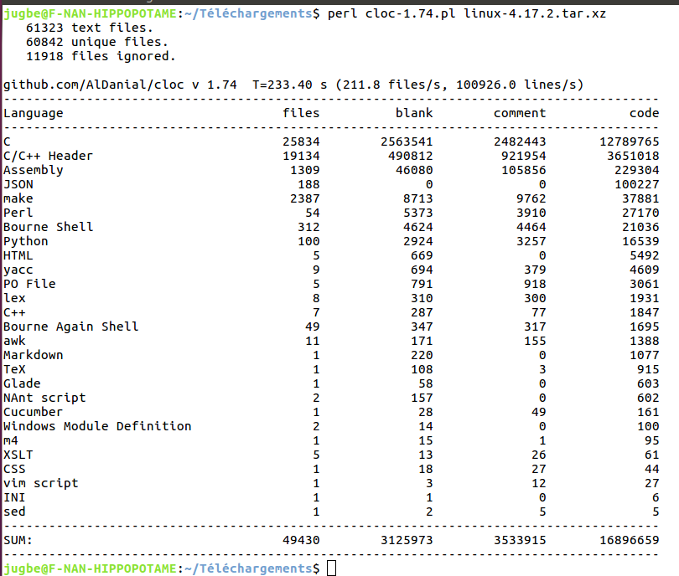
Introduction
Linux complexity ?
Cloc (Count Lines of Code) :
Accounts for files, languages and sources that make up a project

Slide 6
Userspace debugging tools
Userspace

Slide 7
Userspace debugging tools
Userspace
ProcFS
Filesystem
Two pseudo filesystems – they are created at system’s boot
SysFS
Some important files :
- /proc/meminfo : displays memory states
- /proc/pid/maps : process address space layout
- /proc/pid/limits : process resources limits (there are 16 limits in Linux)
- /proc/pid/status : process states (running or idle, debugger attached, …,etc)
- /sys/module : stores information associated with each loaded module

Slide 8
Userspace debugging tools
Userspace
ProcFS
Filesystem
System
calls
Library
calls
GDB/gdbserver
SysFS
Valgrind
ltrace
(latrace)
strace
Callgrind
Helgrind
Memcheck
Cachegrind
Cachegrind
DRD

Slide 9
Dive into Kernel-land
Gdbremote compliant JTAG/SWD (OpenOCD)
Linux Kernel debugging
Kernel
debuggers
System
Faults
Kernel panic
KGDB/KDB
(debugging
symbols
are required)
Kernel oops
Magic SysRq
Keys
(Alt + Imp + Key)
Ex : Alt + Imp + l
Kernel core
Dump
(kdump+kexec)
Analyse with crash

Slide 10
Linux tracers
Variety of tracers exist on Linux
A tracer shows kernel and userspace activities at function granularity level (even kernel primitives), measures their latencies, order of execution
Tool | Linux mainline | Front-end tool | Real time report | GUI trace parsing tool | Remote tracing | More practical tools
Ftrace | Since 2.6.27 | Trace-cmd | no | Kernelshark | yes | perf_event
Perf_events | Since 2.6.31 | Perf | no | Hostspot | no
eBPF | Since 4.4 | BCC | yes | no | no | no
LTTng | No | Lttng | no | Trace compass | yes | LTTng toolkit analyses

Slide 11

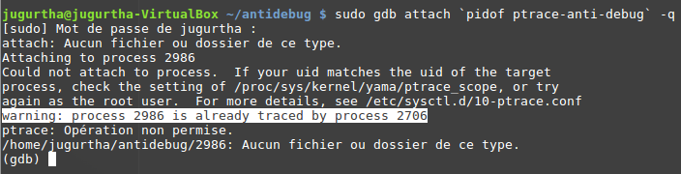
Anti debug
Why it is crucial to know ?
Anti debugging makes all the tools that we have seen (strace- ltrace- GDB, oops, …,etc) useless.
Simple Anti-debug example

Slide 12
Internship results
At the end of internship :
Step by step debugging manual (over than 200 pages) + sample codes at :
https://github.com/jugurthab/Linux_kernel_debug
4 articles on SMILE’s Blog :
  OpenOCD from scratch : http://www.linuxembedded.fr/2018/07/openocd-from-scratch/
  Linux debugging tools :
  Unmask kernel activity with tracers
  Secrets of eBPF :
OESdebug : OpenOCD wrapper utility. It generates OpenOCD scripts, supports autoprobing feature and makes it easy to share configuration files (https://github.com/jugurthab/Linux_kernel_debug/tree/master/DebugSoftware/OpenOCD-wrapper)

Slide 13
Conclusion
Debugging tools improve software reliabity.
Locating bottlenecks is much more faster and safer than « printf » or « printk » (which may hang the system).
Tracers can save hours of debugging by monitoring, measuring performances of a system and reporting them to end users.
Debugging and tracing are used extensively in security.
Care must be taken when using debugging tools as they can bring the system down easily.

Slide 14

Thank you

