Slide 1
How would a brain protection firewall work?
A brief description of online information flood problem.
What could be the ideal solution?
And very hacky scripts that try to take small steps.

Slide 2
New problems are arising fast
Flood of useless information
News, emails, messages, ads…
Addictive click-machines
Attention span problems – click and go
Facebook… and others
Fake news, manipulation...
Even information warfare

Slide 3
Extract valuable information from the flood
We would like to select what is good for us
However, our devices try to force feed us with distractions
We could filter annoying, addictive and harmful content

Slide 4

Some tools are already here

Slide 5
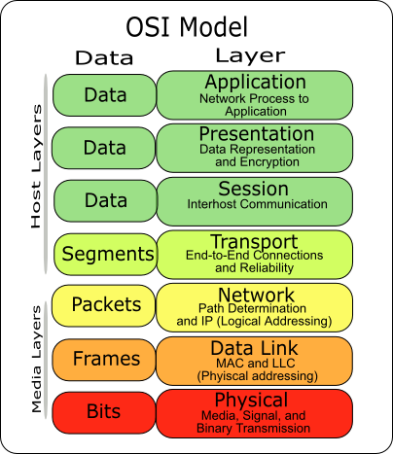
Brain protection firewall –
How the ideal solution could work?

Slide 6
Whitelisting solutions
Whitelisting with IP tables firewall
Audit traffic a few days and generated a whitelist
Easy for almost every application
But, unfortunately, modern web pages are too complex to whitelist based on IP/domain names
→ Did not work well

Slide 7
Take full control over your devices
Take full control over your devices
What if you could actually control this?
“New incoming IP address X.X.X.X. Allow?”
“Block this page: it will make me stupid!”

Slide 8

This is the planned situation

Slide 9

This is what we get

Slide 10

Maybe it is too much

Slide 11
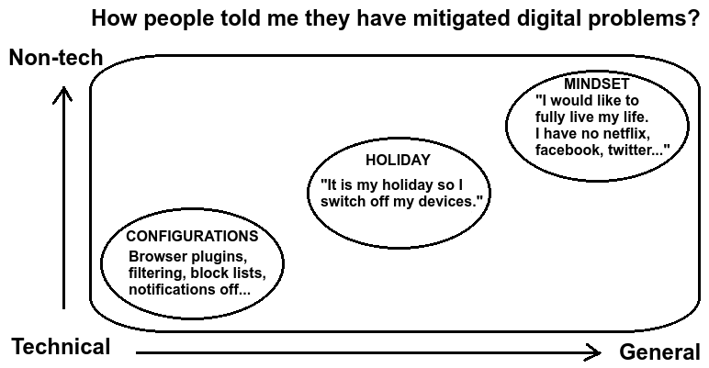

Slide 12
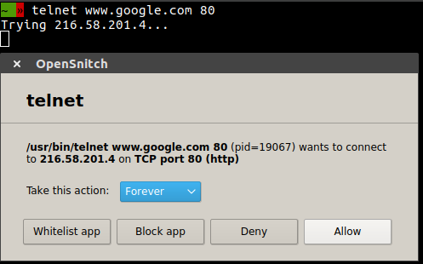
Some projects try to help
https://github.com/evilsocket/opensnitch

Slide 13
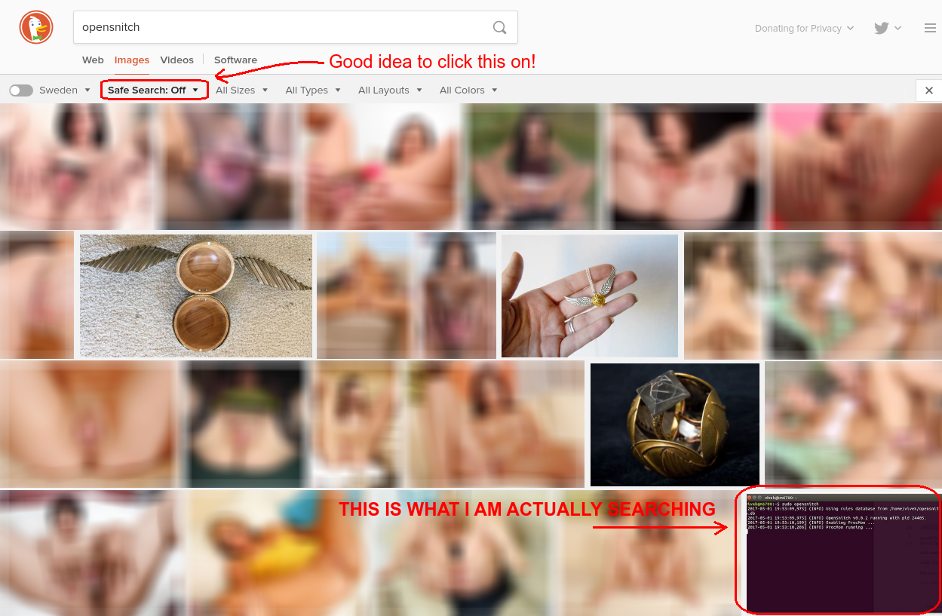
Good idea to adjust search engines

Slide 14
Some projects try to help
https://github.com/juhanurmi/safe-internet-blocklist
$ grep "iltasanomat" /etc/hosts
0.0.0.0 iltasanomat.fi www.iltasanomat.fi
$ wc -l /etc/hosts
75638 /etc/hosts
$ grep -c "facebook" /etc/hosts
746
$ grep -c "twitter" /etc/hosts
70

Slide 15
Good old small Facebook block list
http://campaigns.ahmia.fi/delete-facebook/

Slide 16
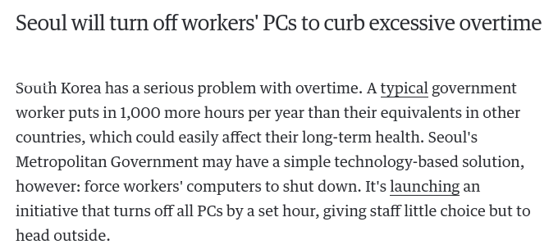
Shutdown automatically phones and computers

Slide 17
Other hacks
Automatically dim your screen away after work
For instance, automatically dim screens 6pm
Scheduled script to linux crontab
#!/bin/bash
# Adjust screen brightness with xrandr and crontab
export DISPLAY=:0.0 # Crontab needs this
xrandr --output DVI-I-1 --brightness 0.1

Slide 18
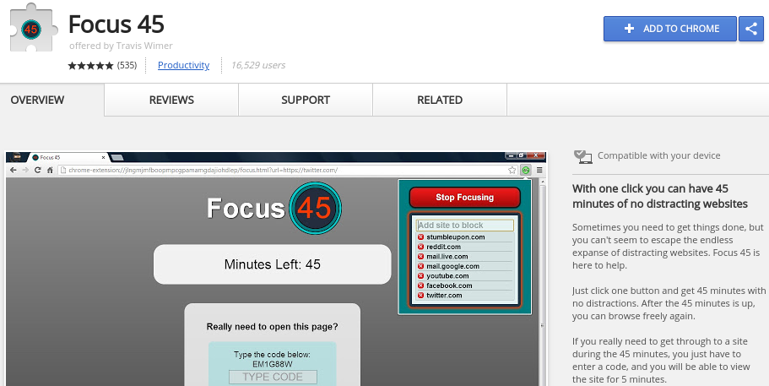
Some projects try to help

Slide 19
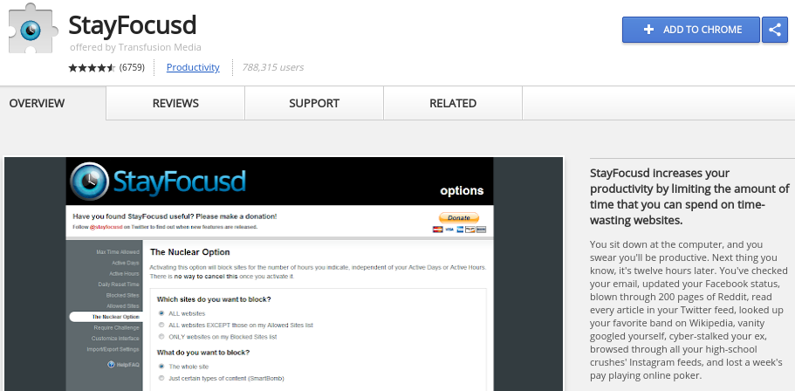
Some projects try to help

Slide 20
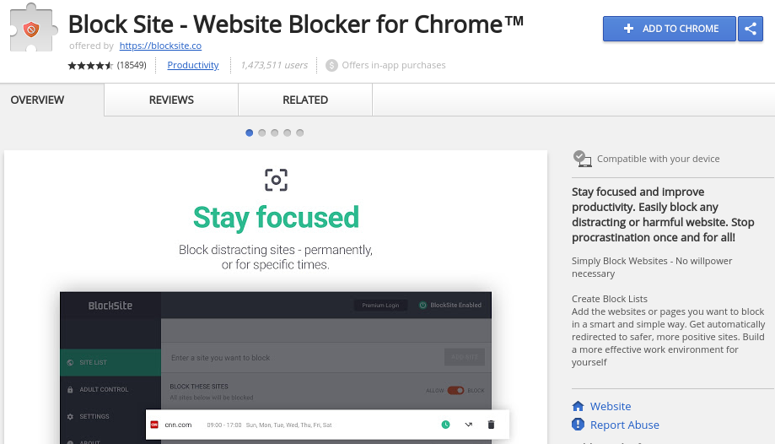
Some projects try to help

Slide 21

Some projects try to help

Slide 22
Good old slow TorBrowser
Slow life against attention span killers
How about creating a web browser plugin that automatically slows down web browsers?
Automatic 10 seconds delay before open a new page

Slide 23
Easy solutions
Crontab to shutdown screens, for example, 7pm
Good old TorBrowser makes it slow
Remove applications from your phone
DNS or iptables blacklisting
Web browser plugins
HTML element blacklisting plugin to web browsers
Major proof-of-work operations to open content
Delays

