Slide 1
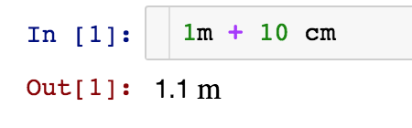
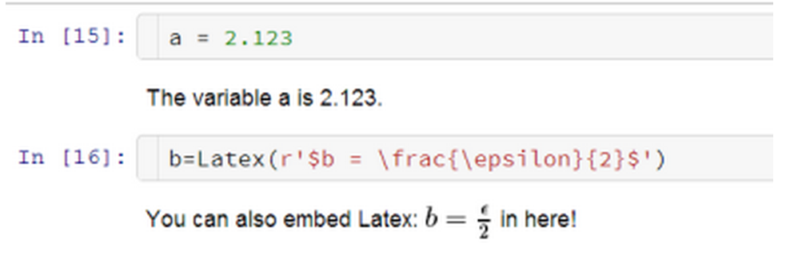
Using the IPython Notebook as Lab Notebook
Juergen Hasch
The lab notebook is a scientist’s most valuable tool
The IPython / Jupyter notebook enables a similar workflow:
Easy to use, just start scribbling your notes
Add text, formulas, graphics, plots and do calculations
Works for different programming languages
Highly flexible and extendible
Example
IPython extensions
Notebook extensions
e.g. input transformers for units:
e.g. Python code in markdown

