Slide 1
GPU/CUDA Implementation of Image Processing Algorithm
By:
Juhi Kumari(IIT2013153)
Sneha Jha(IIT2013174)
Tanushree Anand(IIT2013192)
Mansi Jaiswal(IIT2013209)
Yashika Singh(IIT2013211)
Nikita Agarwal(ISM2013016)

Slide 2
Current Scenario
Today users demands are growing in terms of resolution, signal-to-noise ratio or dynamic range. This results in large computation time in image processing techniques.
GOAL: To optimize the algorithms to enhance its performance in reasonable amount of time
Methods for enhancement:
Increasing clock speed of CPU
Using multiple CPU’s (cluster)
Multiple Cores (i5, i7 etc.)
GPU (Graphics Processing Unit)

Slide 3
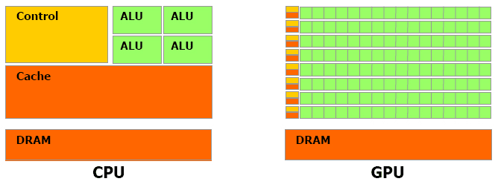
CPU Vs GPU
The GPU is specialized for compute-intensive, highly parallel computation
composed of hundreds of cores that can handle thousands of threads simultaneously
The GPU is a type of single instruction, multiple data (SIMD) processor
GPU is having many functional units like arithmetic-logic units (ALUs) that share a control unit
A CPU is the general purpose "brain" of the computer
composed of just few cores with lots of cache memory that can handle a few software threads at a time

Slide 4
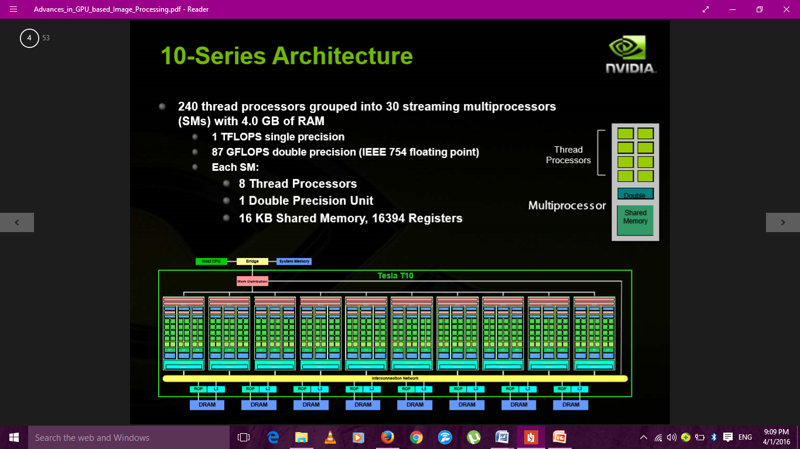
10-Series Architecture (Tesla C1060)

Slide 5
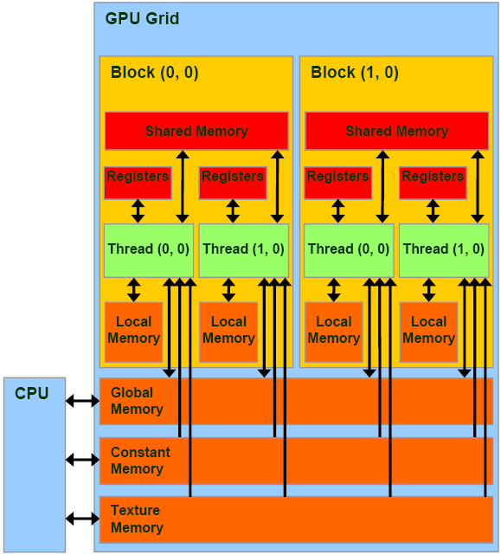
General-Purpose Computation on GPU
The basic optimization principles are
maximizing the ratio of floating-point operations,
hiding global memory latency by high streaming processor’s occupancy,
balancing the usage of global memory, shared memory, and registers,
in order to achieve optimal memory bandwidth.

Slide 6
ADVANTAGES
higher global memory bandwidth and floating-point operation performance,
Hardware scatter-gather support
acceleration of transcendental (e.g. exponential and trigonometric) functions, and fast texture lookup capability.
kernels, such as bilateral filter, GJK collision detector, SAXPY (basic linear algebra task αx + y), and Lattice Boltzmann method are accelerated by rate of 5 × and higher on GPU.
WEAKNESSES
non-cached global memory (which does not stand for a new FERMI architecture)
reduction overhead, and synchronization overhead.
Thus, radix sort and constraint solver perform better on CPU than on GPU;

Slide 7
Parallel Computing Architectures and Models
NVidia CUDA
CUDA is a compiler and toolkit for programming NVIDIA GPUs.
CUDA API extends the C programming language.
CUDA is a parallel computing platform.
Give a high level abstraction from hardware.
It allows software developers to use a CUDA-enabled GPU for general purpose processing – an approach known as GPGPU.
OpenCL
Open Computing Language (OpenCL) is a framework for writing programs that execute across heterogeneous platforms consisting of central processing units (CPUs), graphics processing units (GPUs), digital signal processors (DSPs), field-programmable gate arrays (FPGAs) and other processors or hardware accelerators

Slide 8
Image Processing Acceleration
Based on algorithm characteristics, they divided the functions into four categories:
data independent (e.g. image intensity adjustment) : The functions in this category map naturally on a GPU and achieve high kernel performance. They are usually limited by memory bandwidth and data transfer overhead.
algorithm dependent (Euclidean distance transform) : These functions often require to be fundamentally revised, with respect to architecture differences.
data dependent (dither) : They are usually limited by memory bandwidth and data transfer overhead.
data sharing (edge detection) : The data sharing algorithms are excellent candidates for massive parallelization. With some optimization strategies, tremendous speedups can be achieved.

Slide 9
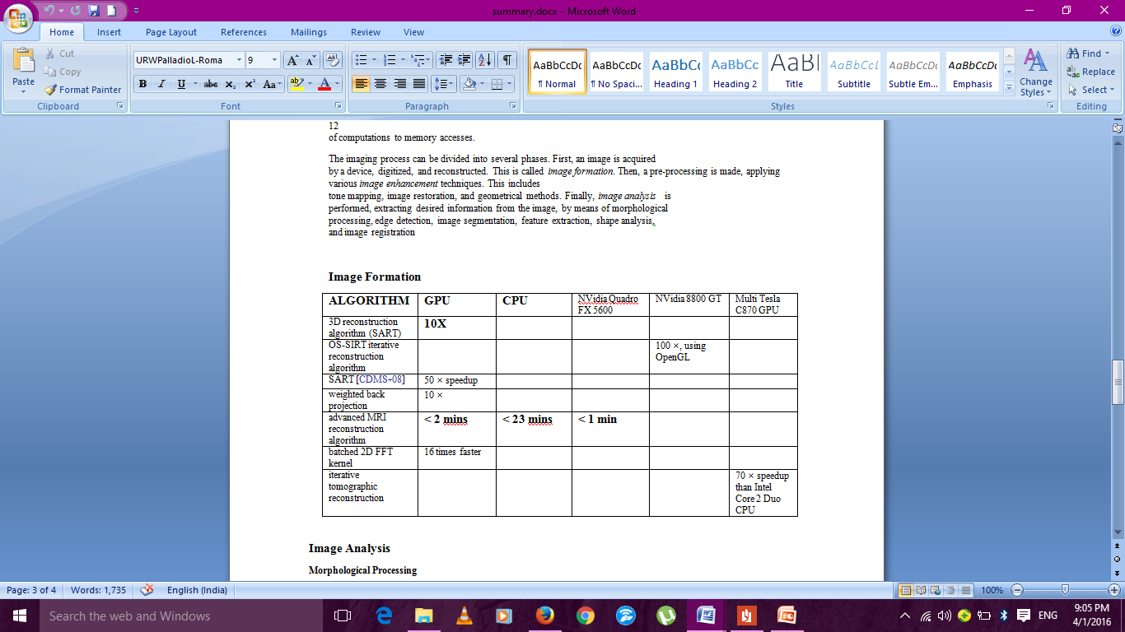
IMAGING PROCESS
Image Formation : First, an image is acquired by a device, digitized, and reconstructed. This is called image formation.
Image enhancement : A pre-processing step which includes tone mapping, image restoration, and geometrical methods.

Slide 10
Image Analysis
MORPHOLOGICAL PROCESSING
Mathematical morphology is based on analysis and processing spatial structures in images. . Morphological methods can be used both for image pre-processing and for image analysis. For example, opening and closing can be adopted for smoothing contours of objects or eliminating small holes in objects. Dilation and erosion are two fundamental morphological operations.

Slide 11
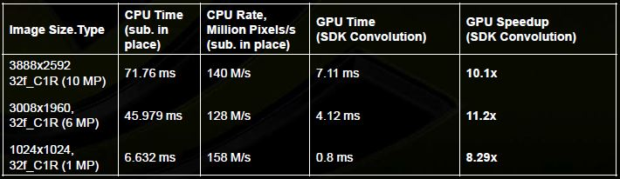
Edge Detection
Edges, i.e. changes or discontinuities in image luminance or color values, represent important regions in image. Edges are often detected by derivative-based operators, for example, first-order derivative methods (based on gradient or directional derivatives) and second-order derivative methods (eg. Laplacian operator). Canny is one of widely used edge detectors, based on first-order derivatives.
Laplacian Pyramid Construction

Slide 12
Image Segmentation
Image segmentation aims to recognize objects in images. There are many approaches to image segmentation, namely
pixel-based (e.g. thresholding),
edge-based (derivativebased approaches),
region-based (split-and-merge and region-growing),
Model based (Hough transform).
Segmentation by global optimization leads to more complex regularization techniques.
Feature Extraction
The goal of feature extraction is to transform input data, that can be very large, into a reduced set of information, which is used for consequential analysis and classification. Measures describing an image histogram, such as mean, standard deviation, skewness, or energy, often aid in amplitude feature extraction.

Slide 13
Shape Analysis
Shape-analysing techniques are useful tools for classification of objects within an image, including both qualitative and quantitative approaches. Many shape properties can be described, such as topological attributes, size measurements and other geometric attributes, shape orientation descriptors, spatial moments, and Fourier descriptors.
Image Registration
Geometrical alignment of images is called image registration. Basically, there are two groups of image registration methods, area-based and feature-based.

Slide 14
PURPOSE
To create a fast and generic method with sufficient quality for extracting tubular structures such as blood vessels and airways from different modalities (CT, MR and US) and organs (brain, lungs and liver) by utilizing the computational power of graphic processing units (GPUs). and comparing different methods and its speed and memory usage.

Slide 15
METHODS FOR EXTRACTING TUBULAR STRUCTURE:
Tubular structures are usually extracted from volumes in two different ways:
As a segmentation, either as a binary classification where each voxel in the volume is given a non-zero value if it belongs to the tubular structure or as a surface model of the structure.
As a centerline, i.e. a line that goes through the center
of the tubular structures.
The centerline is very useful for registration while the segmentation is useful for volume estimation and visualization of the structures’ surface.

Slide 16
Tube Detection Filters (TDFs):
TDFs are used to detect tubular structures and calculates a probability that a specific voxel is inside a tubular structure. Most TDFs use gradient information, A centerline can be extracted directly from the TDF result using ridge traversal or segmentation.

Slide 17
METHODOLOGY
The implementation consists of five main steps that are all executed on the GPU .
Cropping : To reduce the total memory usage
Pre Processing : To make the results less sensitive to noise and differences in tube contrast and size.
TDF : the model-based TDF.
Centerline Detection : From the TDF result, the centerlines are extracted using a new parallel algorithm.
Segmentation : Segmentation is performed using the centerlines as seeds for a region growing procedure.

Slide 18
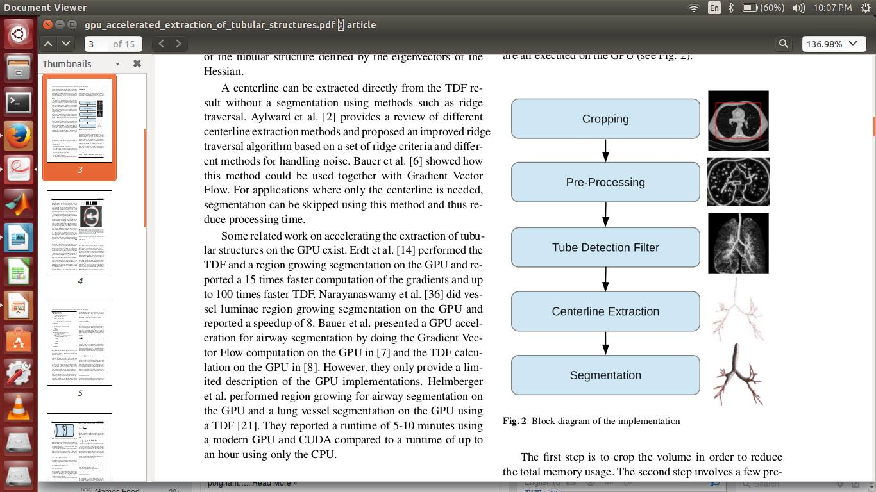

Slide 19
CROPPING:
Most medical datasets contain a lot of data that is not part of the structures of interest. Usually these areas are located at the borders of the image.will reduce memory usage and execution time.
Cropping Algorithm:
The function CALCULATEL is used for estimating L for each slice in a given direction and the function FINDCROPBORDERS is used to find the cropping borders for a specific direction given L and using the threshold Lmin.
Each direction and slice can be processed in parallel on the GPU.The parts of this cropping method that is application dependent, aside from the parameter Lmin, is the estimation of Ls and whether the search for cropping borders starts from the middle or at the ends of the dataset in a given direction

Slide 20
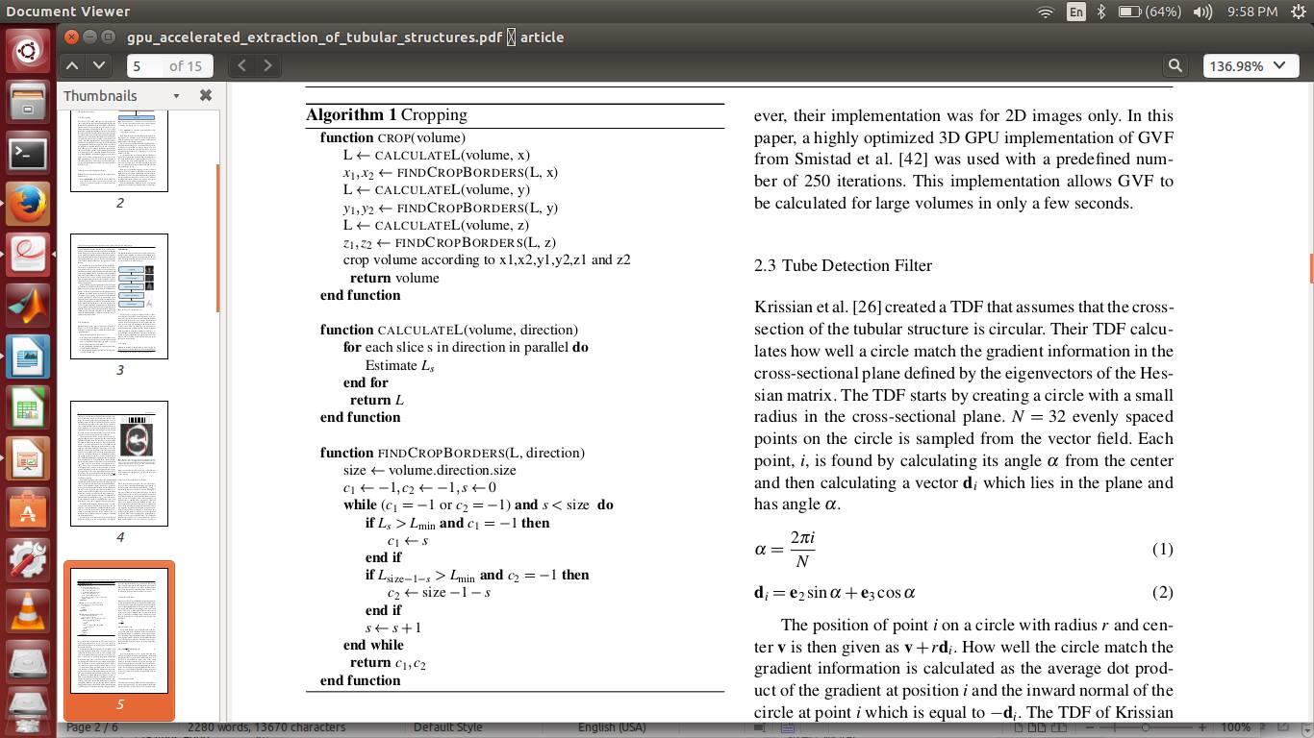

Slide 21
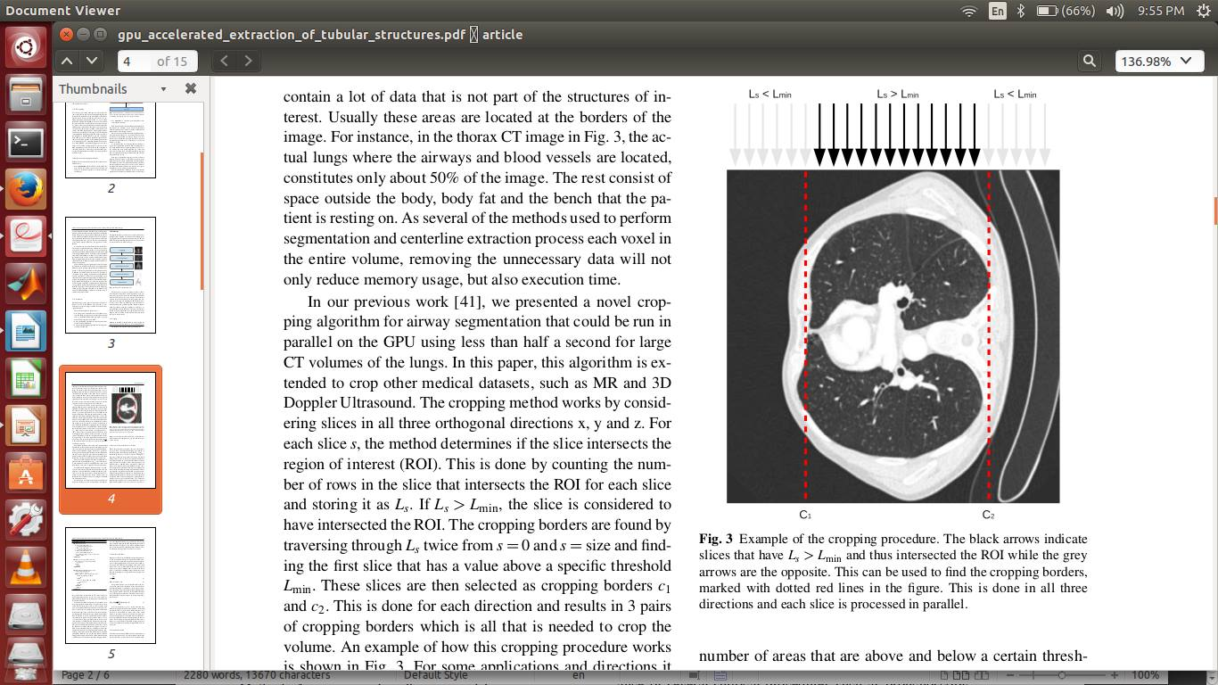

Slide 22
Pre-processing and Gradient Vector Flow:
First, an optional thresholding is performed on the dataset using a lower and upper threshold (Imin and Imax). The thresholding is done to remove unnecessary gradient information in the image which may lead to unwanted tubular structures being detected.
Second, some noise suppression is performed. This is done by blurring the dataset using Gaussian smoothing with standard deviation σ.
Afterwards, the gradient vector field V is created and normalized using a parameter called Vmax. All gradients with a length above this parameter will be set to unit length and the others will be scaled accordingly. The gradient normalization is necessary for contrast invariance. Vmax should beadapted to the expected level of contrast and noise.
All of these preprocessing parameters (Imin, Imax, σ, Vmax) are modality dependent.

Slide 23
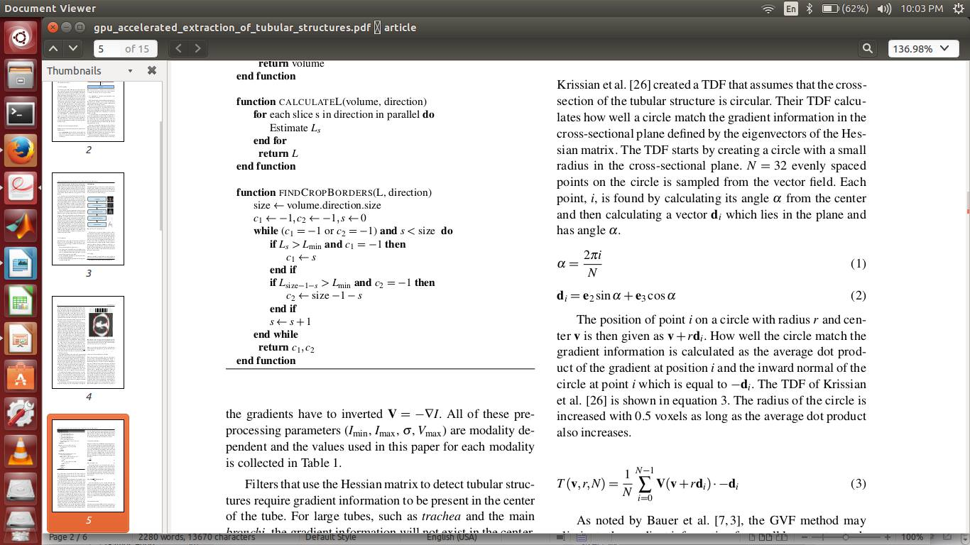
Tube Detection Filter :
The TDF starts by creating a circle with a small radius in the cross-sectional plane. N = 32 evenly spaced points on the circle is sampled from the vector field. Each point, i, is found by calculating its angle α from the center and then calculating a vector di which lies in the plane and has angle α.
The position of point i on a circle with radius r and center v is then given as v + rdi. How well the circle match the gradient information is calculated as the average dot product of the gradient at position i and the inward normal of the circle at point i which is equal to −di. The radius of the circle is increased with 0.5 voxels as long as the average dot product also increases.

Slide 24
Centerline Extraction:
Parallel centerline extraction (PCE) algorithm is used for centerline extraction from TDF results.
The method has 4 main steps: Identifying center points, filtering center points, link center points and centerline selection.
Identify candidate center points :
identifying all possible center points. This is done by creating a 3D structure with the same size as the dataset. This structure is initialized to 0 for each voxel and all voxels with a TDF value above the threshold Tc = 0.5 is set to 1.
Filter center points :
The next step removes center points that are either not in the center of a tube or too close to other center points.
First, a vector from the centerpoint x to a neighbor voxel n is calculated:
r = n − x

Slide 25
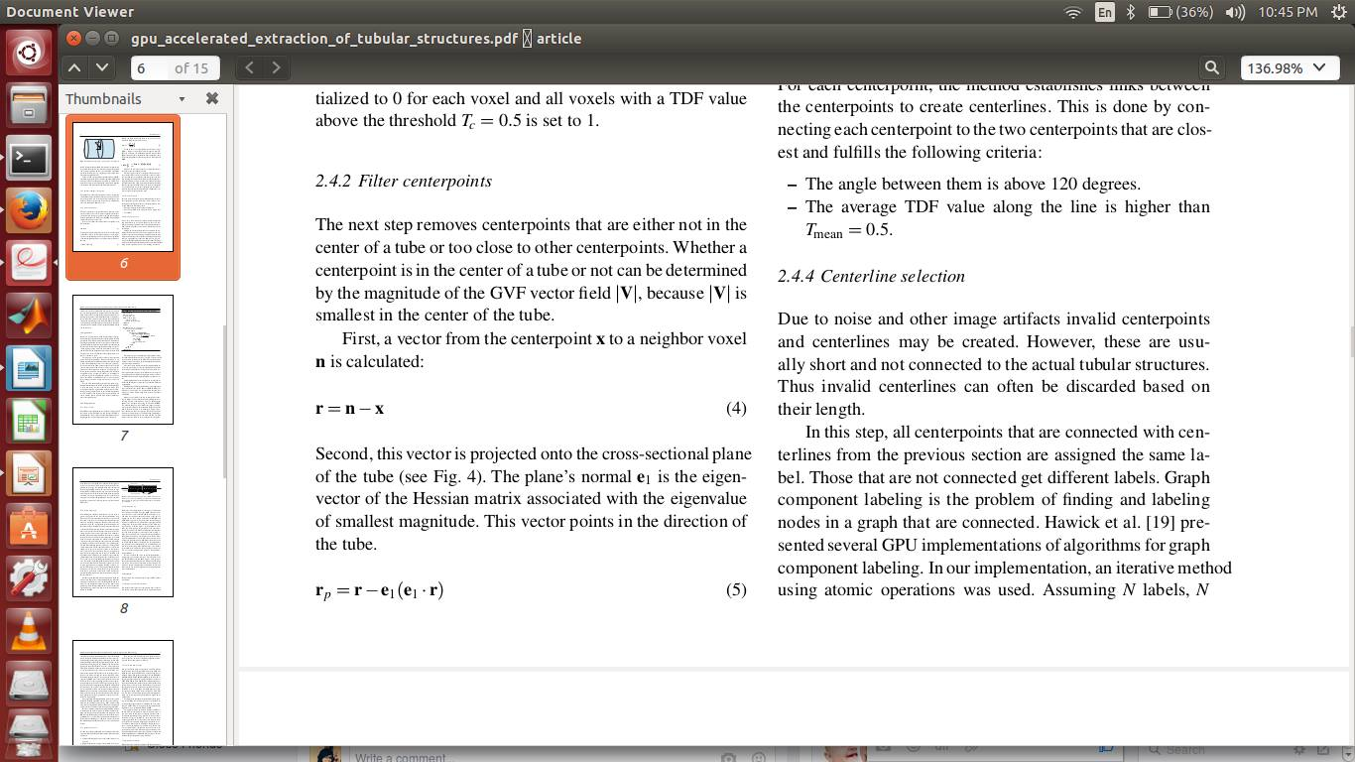
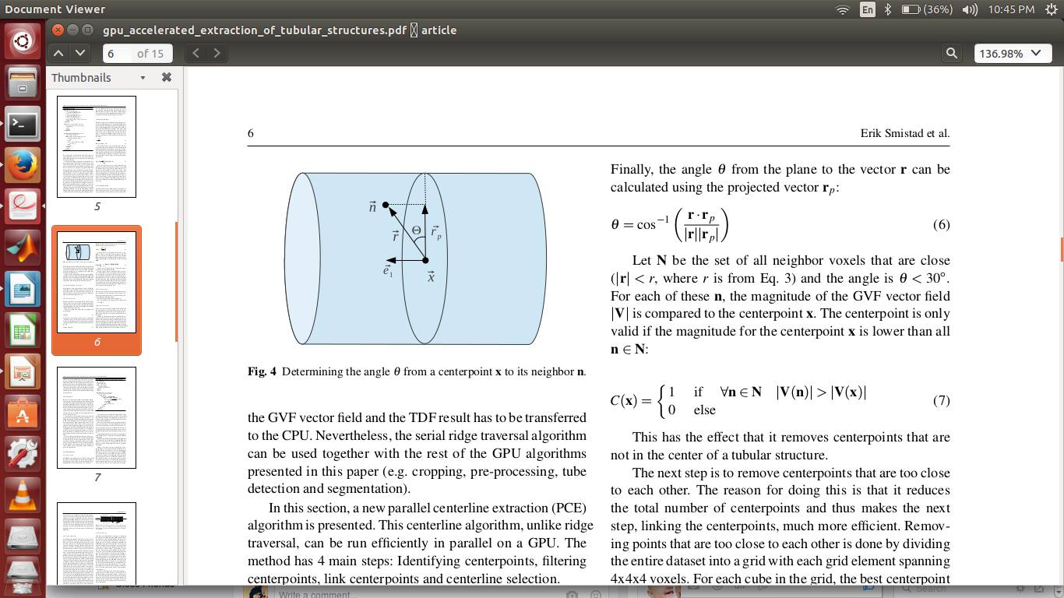
Second, this vector is projected onto the cross-sectional plane of the tube
Finally, the angle θ from the plane to the vector r can be calculated using the projected vector r p :
The centerpoint is only valid if the magnitude for the centerpoint x is lower than all n ∈ N:

Slide 26
Link center points : For each center point, the method establishes links between the center points to create centerlines.
Centerline selection : Due to noise and other image artifacts invalid center points and centerlines may be created. However, these are usually short and not connected to the actual tubular structures. Thus invalid centerlines can often be discarded based on their length

Slide 27
Segmentation:
Segmentation from the centerline can be generated using the already computed GVF vector field. This method is called Inverse Gradient Flow Tracking Segmentation because it for each voxel tracks the centerline using the directions of the GVF vector field, but in the inverse direction.
Parallel Inverse Gradient Flow Algorithm
The centerlines, C, are dilated in parallel on the GPU and added to the segmentation S.
Next the neighboring voxels of S is added to a queue Q.
For each iteration, the GROW function runs a kernel on each voxel x in the entire volume. If the voxel x is part of Q, the gradients of all unsegmented neighbors are checked to see
If they point to x and has a larger magnitude than x. If such a neighbor voxel y is found, x is added to S, its neighbor y is added to Q and the stop Growing variable is set to false. Since this variable is initialized to true for every iteration, the growing procedure will stop when no more voxels are added.

Slide 28
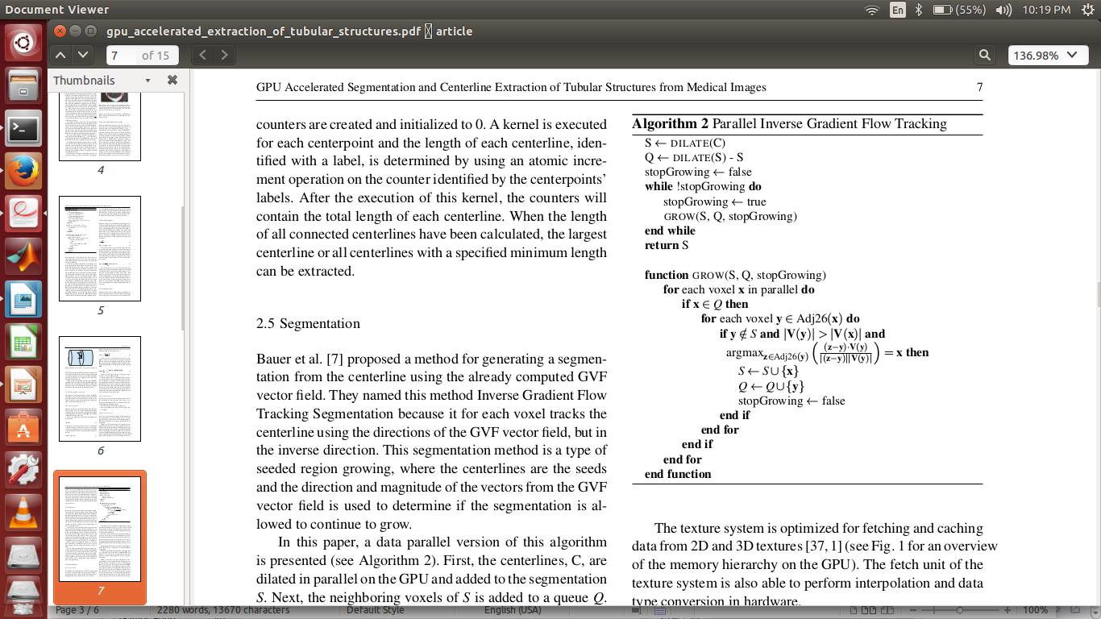

Slide 29
GPU Optimization:
Texture system
The GPU has a specialized memory system for images, called the texture system.
By storing the volumes as 3D textures and using the texture system , it increases the speed of fetching data and trilinear interpolation which is used in the TDF calculation when sampling arbitrary points on a circle.
Stream compaction
Stream compaction removes voxels that should not be processed from the volume so that the kernel is only run for the valid voxels, thus no if statement is needed.
Two methods for performing stream compaction is parallel prefix sum and Histogram Pyramids

Slide 30
Work-group size
Work-items, also called threads, are instances of a kernel and are executed on the GPU in groups. The work-items are also grouped together at a higher level in software. These groups are called work-groups in the OpenCL terminology
If the number of work items in a work-group is not a multiple of the unit of execution size, some of the GPUs’ functional units will be idle for each work-group that is executed.Thus, the work-group sizes can greatly affect performance and optimal size can vary a lot from device to device.

Slide 31
Evaluation And Result :
Comparison with other methods:
The proposed GPU implementation can be used together with both the PCE algorithm and the ridge traversal algorithm for the centerline extraction step. Thus, with the serial ridge traversal algorithm a hybrid solution is used where all steps except the centerline extraction step is run on the GPU
Qualitative analysis
For each modality, several datasets were processed using the proposed GPU implementation together with the PCE and the ridge traversal centerline algorithms and region growing /thresholding together with skeletonization.
These results indicate that the method is able to extract tubular structures from several modalities and organs with comparable quality by changing only a few parameters (I min, I max, σ small , σ large V max, r min , r max, L min) .

Slide 32
Speed and memory usage
The implementation was run using both 16-bit normalized integers and 32-bit floating point vectors on all the clinical datasets using three different GPUs from both AMD and NVIDIA.
The results show that using 16-bit normalized integers is faster than 32-bit on AMD GPUs, and opposite on NVIDIA GPUs. The GPU methods are much faster than the simple serial segmentation and skeletonization method.
The memory usage significantly reduced when cropping and 16-bit normalized integers are used.

Slide 33
Quantitative analysis
The quantitative analysis was performed using the proposed GPU implementation with both PCE and ridge traversal and thresholding+skeletonization together with 16-bit normalized integers and 32-bit floating point numbers.
Results show that using the 16-bit normalized integer format does not affect the quality compared to using the standard 32-bit floating point numbers.

Slide 34
Libraries and resources dedicated to GPU imaging & vision NVIDIA Performance Primitives library (NPP) is a collection of GPU-accelerated image, video, and signal processing functions that deliver 5x to 10x faster performance than comparable CPU-only implementations.
Filter Functions
(FilterBox, Row, Column, Max, Min, Median, Dilate, Erode, SumWindowColumn / Row)
Geometry Transforms
(Mirror, WarpAffine / Back/ Quad, WarpPerspective/ Back / Quad, Resize)
Computer Vision
(ApplyHaarClassifier, Canny)
Arithmetic & Logical Ops
(Add, Sub, Mul, Div, AbsDiff)
Data exchange & initialization
(Set, Convert, Transpose, CopyConstBorder, Copy,, SwapChannels)
Color Conversion
(RGB To YCbCr (& vice versa), ColorTwist, LUT_Linear)
Statistics
(Mean, StdDev, NormDiff, MinMax, Histogram, SqrIntegral, RectStdDev)

Slide 35
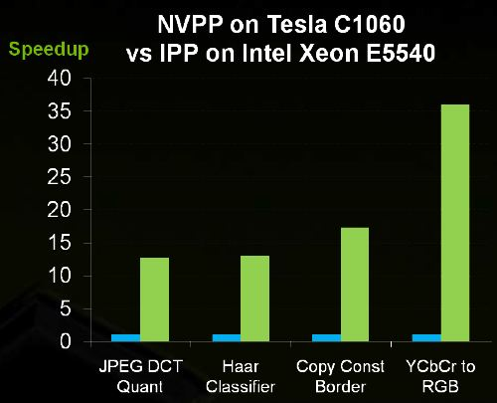
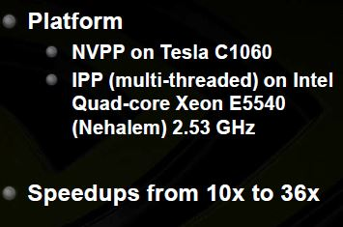

Slide 36
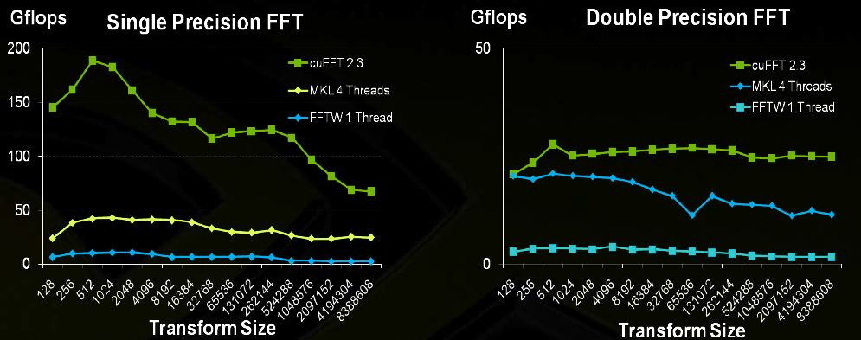

cuFFT : CUDA FFT Libraries
Frequency Domain Processing is applied for Deconvolution FFT based processing (deblurring)

Slide 37
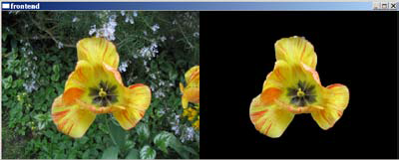
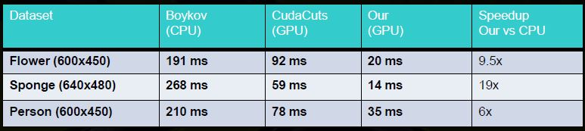
GrabCuts : CUDA Graph Cuts GrabCut Applications:
Based on Color models for FG and BG(foreground & background)
– User specifies a rectangle around the object to cut – Initialize GMM model of FG and BG colors – Graph Cut to find labeling – Use new labeling to update GMM – Iterate until convergence
Full CUDA implementation

