Slide 1
Inventory Management System
Group 15 Members-iit2013192(tanushree)
Project 7 iit2013153(juhi)
ism2013016(nikita)

Slide 2
Objective
Inventory management software is a computer-based system for tracking inventory levels, orders, sales and deliveries. It is used to avoid product overstock and outages. It is a tool for organizing inventory data that before was generally stored in hard-copy form or in spreadsheets. It is often associated with and is similar to distribution software, as distributors that can compete with less cash tied up in inventories have a distinct advantage over their competitors.
We have made an inventory systems which involves the electronic items only.

Slide 3
Functionalities
Manage the quantity of goods
Manage the types of goods
Manage the supplied items by dealer
Manage the items available to sell
Keep record of items sold
Analysis of the items sold i.e. which item is in more demand and less demand
Print invoice
Login facility for all 3 types of users (encrypted password)

Slide 4
Manager functions
Login
Update information of administrator
Print Invoice
Change password
View orders of customers
Manage inventory
Change location
Order new items from dealers
Analysis of daily transactions
View daily financial reports
goods
Money

Slide 5
Customer functions
Login
Information about items
Select an Item
Order an item
Search information of product
Change of password

Slide 6
Dealer functions
Login
Enter personal details
Submit the details of the items which he could supply
Edit the above given information
Supply the product ordered by the administrator

Slide 7
Types of users
USER
Manager
Customer
Dealer

Slide 8
No. Of Sections in Inventory
Sections
Television(TV)
Laptops(LP)
Refrigerator(FR)
Air Conditioner (AC)

Slide 9
Subsection (Television)
Model 2
Samsung
Model 1
Sony
Model 2
LG

Slide 10
Entity-Relationship DIAGRAM

Slide 11
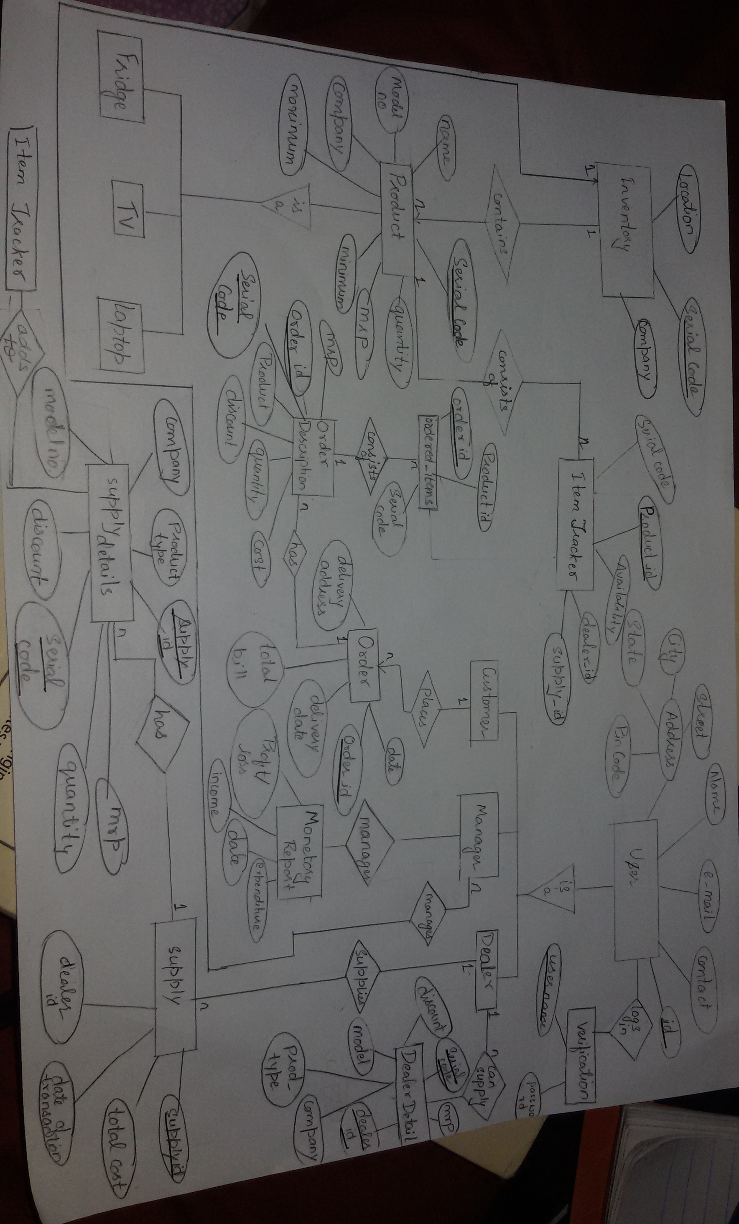

Slide 12
List of Entities
Customer
Admin(Manager)
Dealer
Verification
Dealer_item_list
Supply, Supply Details
Inventory
Order, Order Description, Ordered_items
Monetary_report
Product, Item Tracker

Slide 13
Customer
This table contains basic information of each customer associated with the inventory
Cust_id | Cust_Name | Contact | Email_id | Street | City | State | Pincode
VARCHAR2(15) | VARCHAR2(15) | INT(10) | VARCHAR2(15) | VARCHAR2(15) | VARCHAR2(15) | VARCHAR2(15) | INT(7)
cu001 | Niketan | 9454097327 | niketan@gmail.com | MG Road | Bangalore | Karnataka | 832764

Slide 14
Admin
This table contains basic information of each administrator/Manager associated with the inventory
Admin_id | Admin_Name | Contact | Email_id | Street | City | State | Pincode
VARCHAR2(15) | VARCHAR2(15) | INT(10) | VARCHAR2(15) | VARCHAR2(15) | VARCHAR2(15) | VARCHAR2(15) | INT(7)
ad001 | Rajkumar | 8746829456 | rj100@gmail.com | Orchid Road | Mumbai | Maharashtra | 462536

Slide 15
Dealer
This table contains basic information of each dealer associated with the inventory
dealer_id | Dealer_Name | Contact | Email_id | Street | City | State | Pincode
VARCHAR2(15) | VARCHAR2(15) | INT(10) | VARCHAR2(15) | VARCHAR2(15) | VARCHAR2(15) | VARCHAR2(15) | INT(7)
dl001 | Wheeler Sons | 783654627 | wheelers@gmail.com | Tashkand Road | Allahabad | Uttar Pradesh | 8636453

Slide 16
Verification
Username | Password | Cust_id
Niketan123 | 5f85808b1d4a922b0d1206bc1420ff01030d96e7 | cu001
prachi | 672d14fef69846058a295765855859aec0325d63 | cu002
VARCHAR2 (15) | VARCHAR2(50) | VARCHAR2(15)

Slide 17
Dealer_Item_list
Table to maintain the list of dealers along with their possible supply items
Dealer_id | Product_type | Company | Model_no | Serial_code | MRP | discount
VARCHAR2(15) | VARCHAR2(15) | VARCHAR2(15) | VARCHAR2(15) | VARCHAR2(15) | FLOAT(12) | FLOAT(4)
dl001 | refrigerator | Whirlpool | wc0167 | FRWHwc0167 | 20000 | 10%

Slide 18
The invoice of the supply from dealers is divided in the following 2 tables for normalization :
Supply
Supply_id | Dealer_id | Date of Transaction | Total_cost
VARCHAR2(10) | VARCHAR2(10) | DATETIME | FLOAT(12)
sup001 | dl001 | 12-February-2015 | 200000
Supply Details
Supply_id | Serial_code | Product_type | Company | Model_no | MRP | quantity | discount
VARCHAR2(10) | VARCHAR2(12) | VARCHAR2(15) | VARCHAR2(15) | VARCHAR2(15) | FLOAT(12) | INT(4) | FLOAT(4)
sup001 | FRWHwc0167 | refrigerator | Whirlpool | wc0167 | 20000 | 10 | 10%

Slide 19
Product
This table contains details about each type of product (Serial_code) and not of individual units/items
Serial_code | Name/Type | Model_no | company | MRP | minimum | maximum | quantity
VARCHAR2(12) | VARCHAR2(15) | VARCHAR2(10) | VARCHAR2(12) | FLOAT(12) | INT(5) | INT(5) | INT(5)
 |  |  |  |  | Min qty and max qty that must be in stock |  | Present no of items in stock
FRWHwc0167 | Refrigerator | wc0167 | Whirlpool | 20000 | 5 | 30 | 10

Slide 20
Item_Tracker to find the availability, dealer_id and the supply slot in which a given item of a particular type (serial_code)
Product_id | Serial_code | Availability | Dealer_id | Supply_id
VARCHAR2(15) | VARCHAR2(15) | TINYINT | VARCHAR2(15) | VARCHAR2(15)
pw223adeXXX | FRWHwc0167 | 0 | dl001 | sup001
pw223adeXXX | FRWHwc0167 | 0 | dl001 | sup001
pw224adeXXX | FRWHwc0167 | 1 | dl001 | sup001
pw225adeXXX | FRWHwc0167 | 1 | dl001 | sup001
pw226adeXXX | FRWHwc0167 | 1 | dl001 | sup001
pw227adeXXX | FRWHwc0167 | 1 | dl001 | sup001
pw228adeXXX | FRWHwc0167 | 1 | dl001 | sup001
pw229adeXXX | FRWHwc0167 | 1 | dl001 | sup001
pw229adeXXX | FRWHwc0167 | 1 | dl001 | sup001
pw229adeXXX | FRWHwc0167 | 1 | dl001 | sup001

Slide 21
Inventory
Serial_code | Company | Location
VARCHAR2(12) | VARCHAR2(20) | TEXT
Unique code for each type of product |  | Unique location for each serial_code
FRWHwc0167 | Whirlpool | WHABC

Slide 22
The invoice /order of the customer is distributed in the following 3 tables for normalisation :
Order
Order_id | date | Delivery_date | Delivery_address | Total_bill
integer(10) | datetime | date | Text | float
Primary key
1 | 15-Febuary-2015 | 21-Febuary-2015 | 1376, Ganga Enclave | 45000
Order Description
Order_id | Serial_code | Product_type | Quantity | Discount | MRP | Cost
1 | FRWHwc0167 | Refrigator | 2 | 10% | 25000 | 45000
Composite key |  | Varchar(10) | int | float
Ordered_items – maps quantity to product_id
Order_id | Product_id | Serial_code
1 | Pw223adeXXX | FRWHwc0167
1 | Pw224adeXXX | FRWHwc0167

Slide 23
Monetary Report
Generates date-wise day to day total money spent , received and the resultant profit / loss accordingly
Date | Total_income | Total_expenditure | Profit/Loss
DATE | FLOAT(12) | FLOAT(12) | FLOAT(12)
12-Febuary-2015 | 0 | 200000 | -200000
15-February-2015 | 45000 | 0 | 45000

Slide 24
After Modification

Slide 25
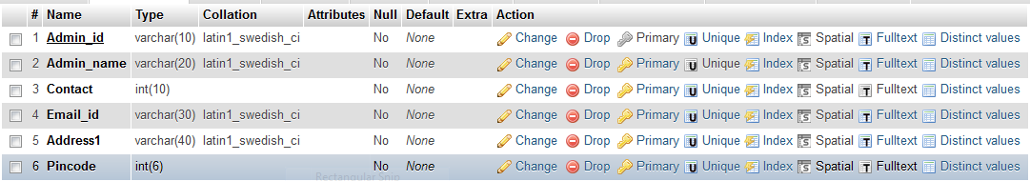
Admin

Slide 26
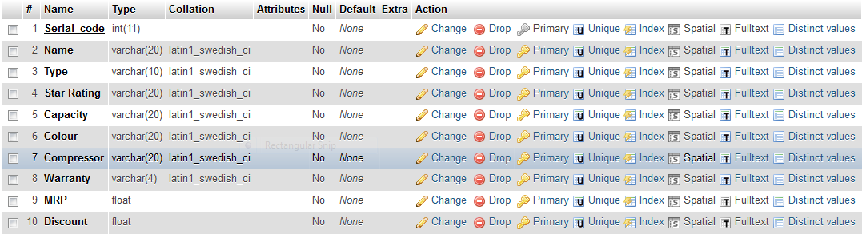
Air_conditioner

Slide 27
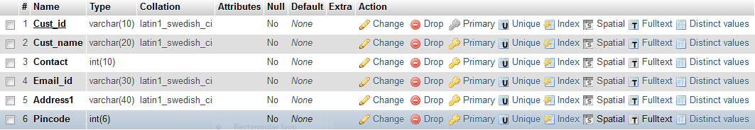
customer

Slide 28
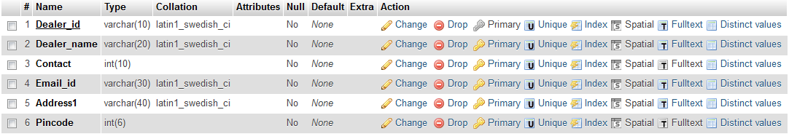
dealer

Slide 29
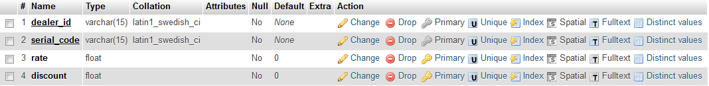
Dealer_item_list

Slide 30
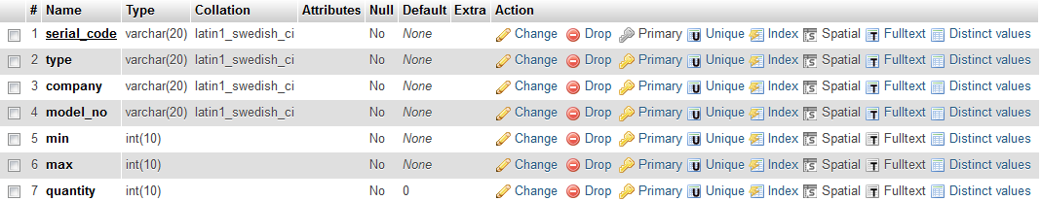
Inventory_item

Slide 31
Inventory_location

Slide 32
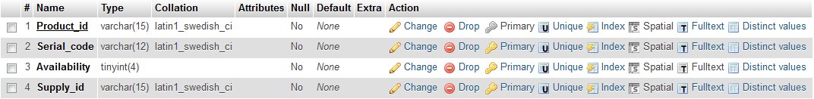
Item_tracker

Slide 33
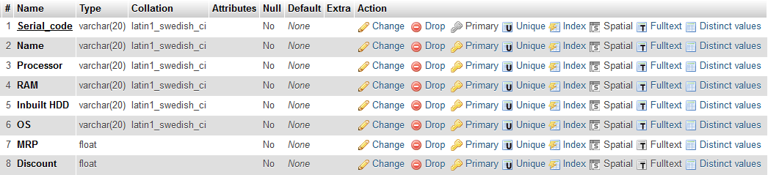
laptop

Slide 34
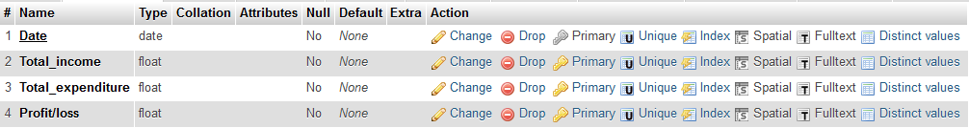
Monetary_report

Slide 35
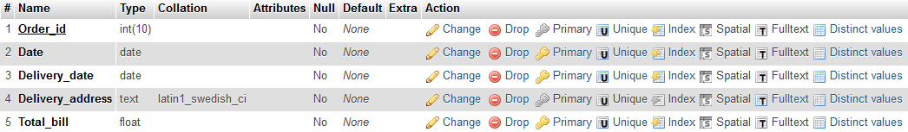
order

Slide 36
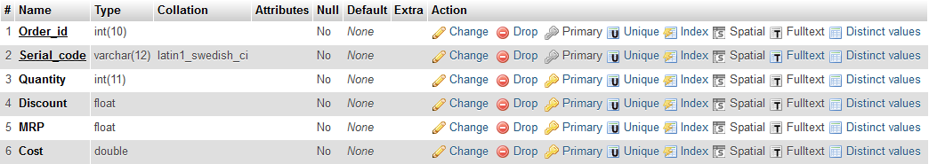
order_description

Slide 37
Order_items

Slide 38
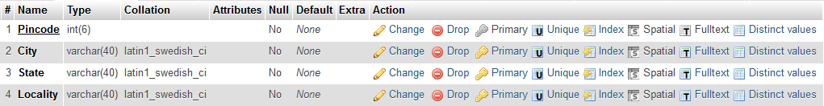
pincodes

Slide 39
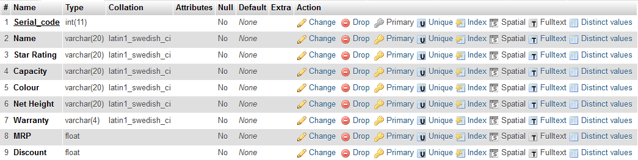
refrigerator

Slide 40
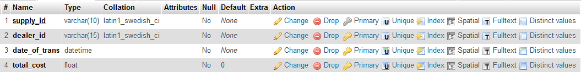
supply

Slide 41
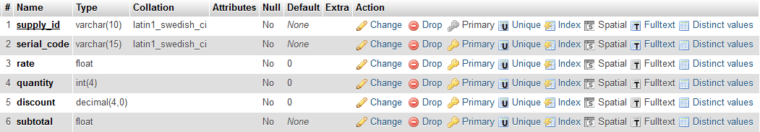
Supply_details

Slide 42
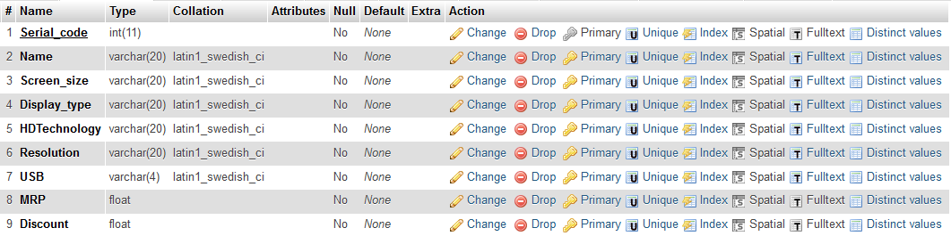
television

Slide 43
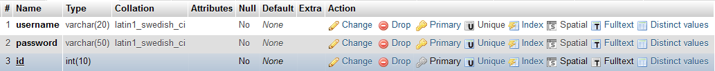
verification

Slide 44
“Thank You”

