Slide 1
Image Classification using Convolutional neural networks
Juhi shrivastava
16212548
CA864 Machine learning

Slide 2
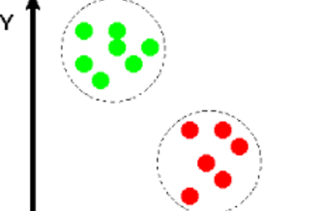
Image Classification
Image Classification is a process of identifying the images based on the assumption that the Image to be identified has a number of features and these features belong to one or more distinct class.

Slide 3

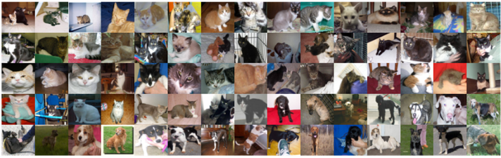
Dataset used
CAT vs DOG High dimensional Images
Training data – 25000 Images
Testing Data – 12500 Images

Slide 4



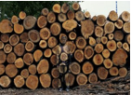
Challenges
Variations in the viewpoint
Difference in Illumination
Hidden Parts of image
Background Clutter

Slide 5
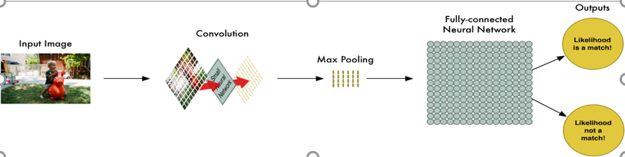
Convolutional neural network
First layer - Detect Edges
Subsequent Layers -Combines these edges into Simpler Shapes
Final Layers -Predict the image

Slide 6
Network architecture and hyperparameters
Architecture :
Modified version of ALEXNET.
1
Layers:
3 Convolutional Layers
2 Fully connected layer
1 Softmax output layer
2
Hyperparameters:
Filters
Filter size
Strides
Padding
Activation
3

Slide 7

Loss function and optimizer
Loss function :
Maximum Likelihood for Classification – Cross Entropy
Optimizer :
Adam Optimizer
Tensor Flow:
Save the Model using the Tensor Flow sessions.

Slide 8

evaluation
 | TEST_SPLIT | VALIDATION_SPLIT
IMAGES | 5000 Images | 2500 Images
ACCURACY | 80% Loss : 0.21875 | 75.88%

Slide 9
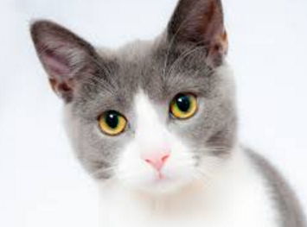
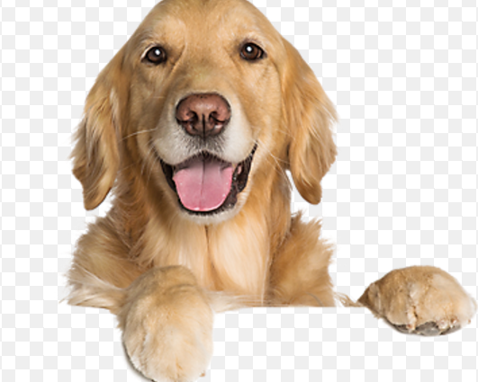
deployment
The Testing data containing 12500 Images is fed to the trained Model
Predcicted Class : 0 – CAT
1 - DOG

Slide 10


