Slide 1
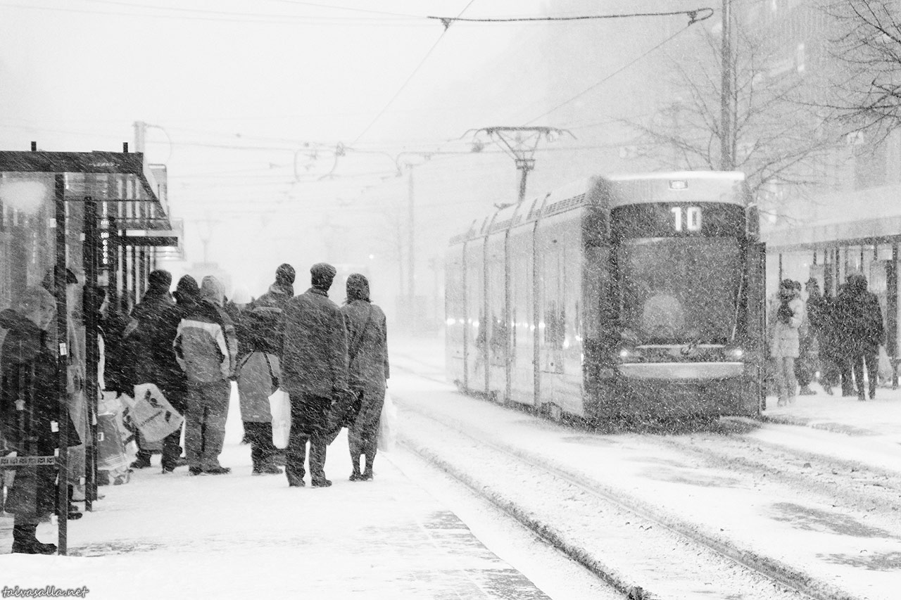

Unsupervised Classification of Vertical Profiles of Dual-Polarization Radar Variables
Jussi Tiira and D. Moisseev
University of Helsinki, Finland
Photo Niklas Sjöblom

Slide 2
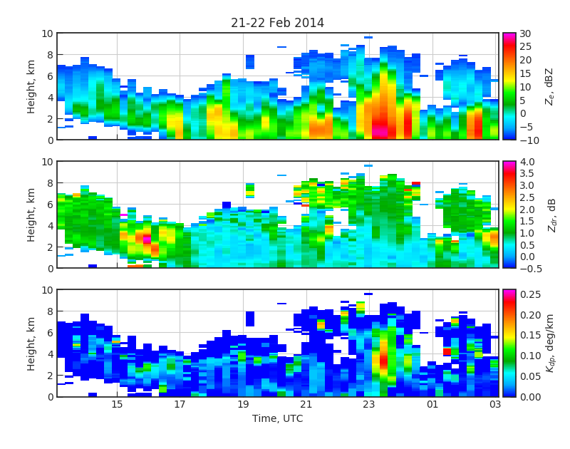
Motivation
Can we use vertical profiles of polarimetric radar variables as fingerprints of growth processes?
Could this lead to:
  Adaptive Z-S
  Intelligent VPR correction

Slide 3
Motivation
Can we use vertical profiles of polarimetric radar variables as fingerprints of growth processes?
Could this lead to:
  Adaptive Z-S
  Intelligent VPR correction
The first question to answer: can we classify vertical profiles to a finite number of classes?

Slide 4
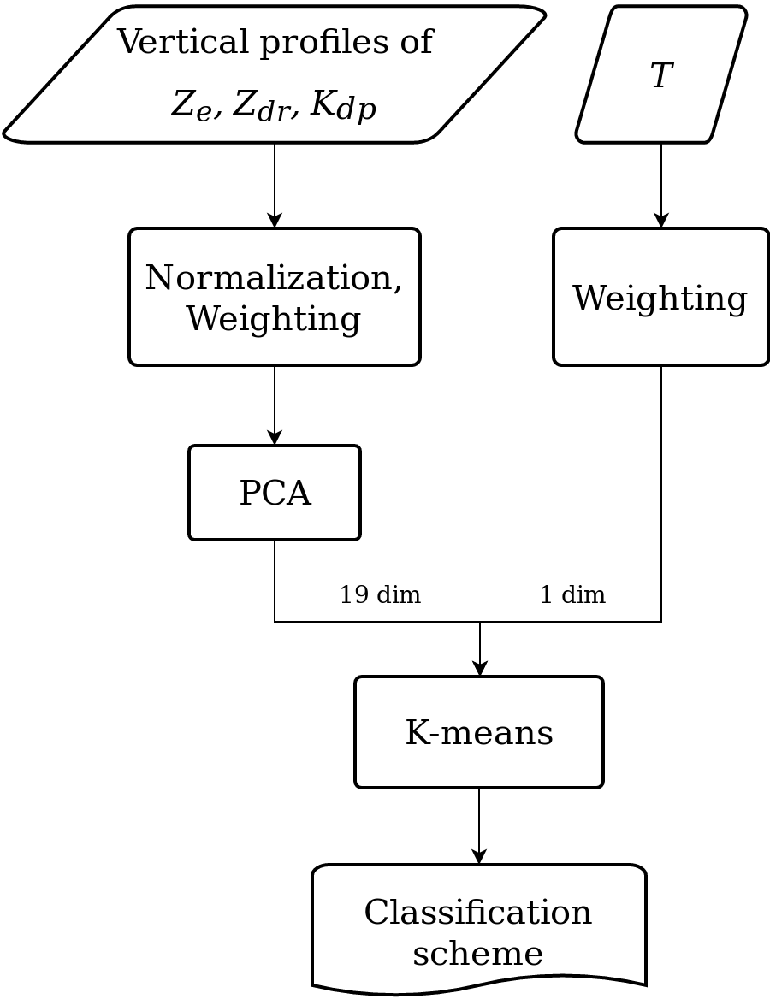
Classification method
Feature scaling and weighting of radar variables prior to PCA
Dimension reduction of vertical profiles using PCA
K-means clustering of the combination of PCA-reduced profiles and weighted T

Slide 5
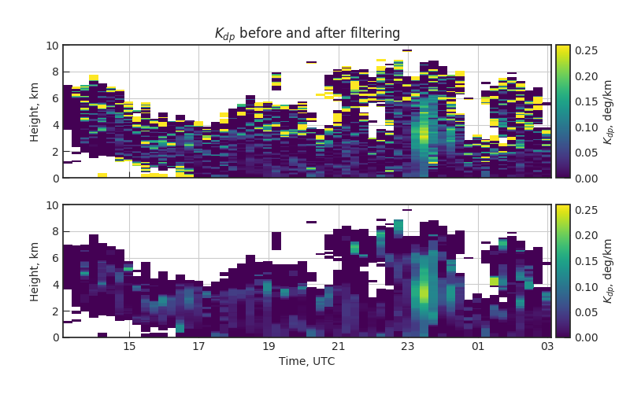
Preprocessing
Vertical profiles extracted from RHI scans
Z_{dr} and very noisy K_{dp} recovered using median filter
A combination of median and threshold based filters for GC

Slide 6
Data
75 snow cases from 3 winters 2013/14, 14/15, 15/16
Data collected over Hyytiälä, U. Helsinki measurement station in Finland
RHI observations from the FMI Ikaalinen radar, 64 km from the station
Surface temperature is measured at the station
19 profile classes explain over 90% of the profile variance

Slide 7
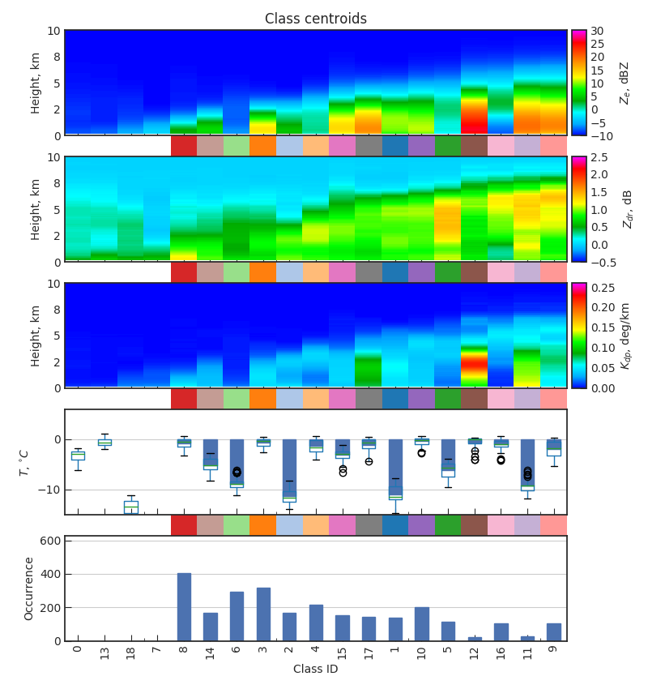
Resulting centroids sorted by echo top height

Slide 8
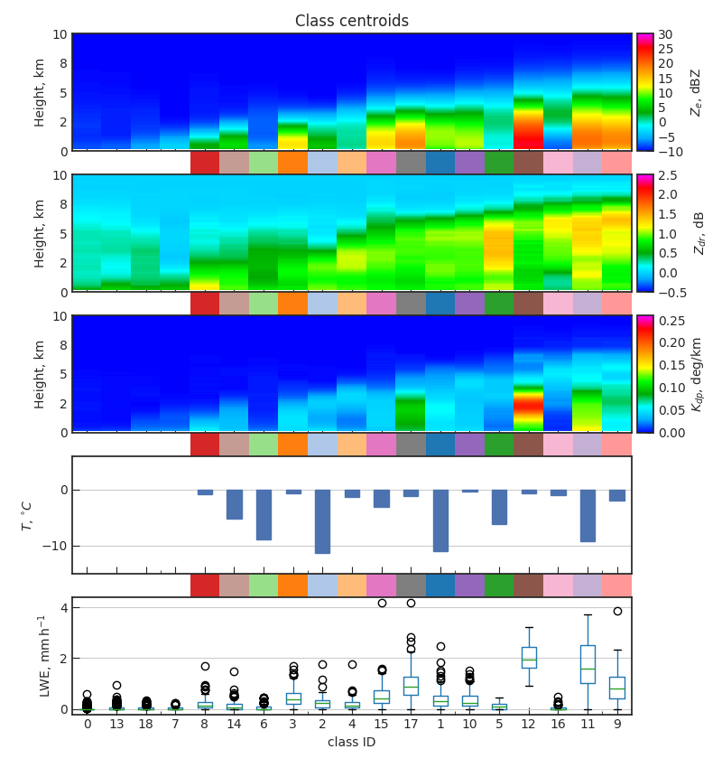
Classification vs. mean LWE precipitation rate
Sampled over next 15 minutes after each RHI

Slide 9

Classification vs. Rime mass fraction
Rime mass fraction is derived using Moisseev et al. (2017) method

Slide 10
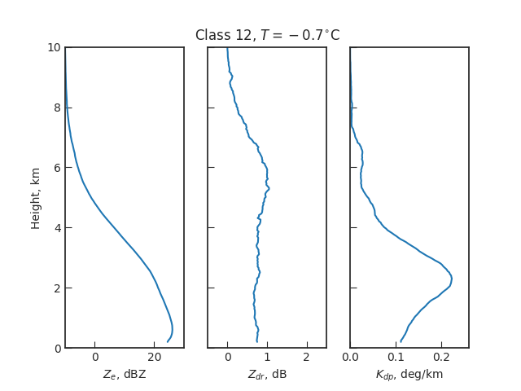
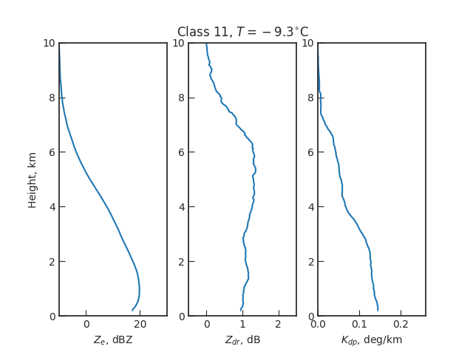
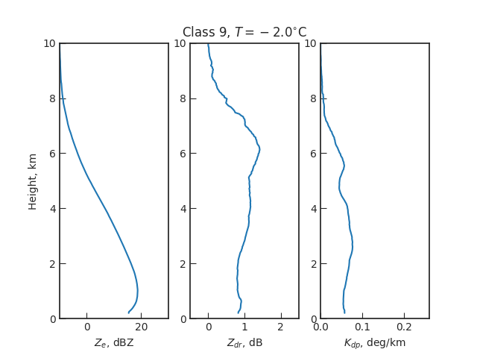
”Dendritic growth” profiles
Class centroids feature:
High cloud top
strong Z_{e}
Z_{dr} maxima at 6 km
K_{dp} signal
Occurrences are linked to:
High precipitation rate

Slide 11
Precipitating stratiform cloud
Represented by 4 classes
Main differences in temperature and

Slide 12
Snow generating cells
2 Feb 2014
12 Dec 2014
17 Dec 2014
10-11 Jan 2015
5-6 Feb 2015
17 Dec 2015
28 Jan 2016?
21 Feb 2016?
Current method unaware of time evolution of the profiles

Slide 13
Summary
The presented method that uses PCA and K-means can produce profile classes with distinct, physically meaningful features
Using the test data 19 classes were identified
High K_{dp} classes are associated with increased snowfall rate
Several classes could represent same growth processes and need to be combined
Further study linking growth processes and profile classes are needed

Slide 14
